Slide 1

Financial Aid: The Basics and the New Details in our Ever-Changing World
Emily Goldman
OASFAA Outreach Committee

Slide 2
Topics We Will Discuss Tonight
What is financial aid?
Cost of attendance (COA)
Student Aid Index (SAI)
Financial need
Categories, types, and sources of financial aid
Free Application for Federal Student Aid (FAFSA)
Verification
Special circumstances

Slide 3
What is Financial Aid?
Financial aid consists of funds provided to students and families to help pay for postsecondary educational expenses

Slide 4
What is Cost of Attendance (COA)?
Direct costs
  Tuition
  Fees
  Housing and Food
Indirect costs
Books, course materials, supplies and equipment
Transportation
Personal Expenses
Direct and indirect costs combine to determine the Cost of Attendance
Varies widely from college to college

Slide 5
What is the Student Aid Index (SAI)?
Index number used by colleges to determine eligibility for aid
Calculated using information provided on the FAFSA
Stays the same regardless of college
Not the amount of money owed to the college
Based on ability to pay for college not willingness
Ranges from -1500 to 999,999
The lower the SAI = more aid eligibility

Slide 6
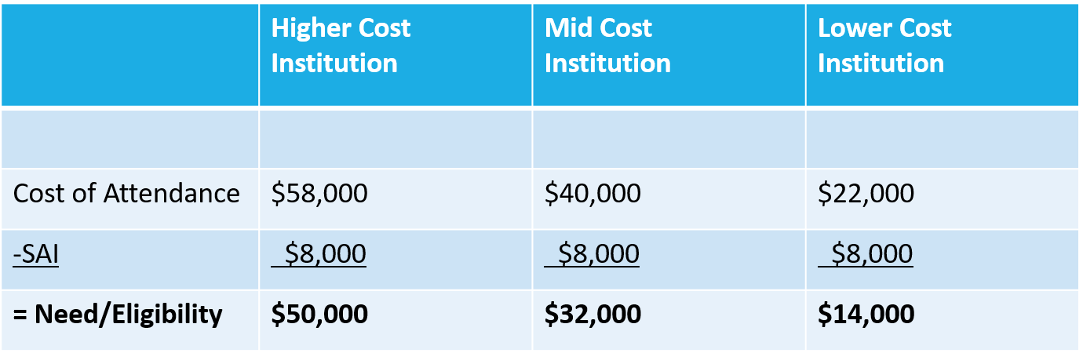
What is Financial Need?
Cost of Attendance – Student Aid Index = Financial Need

Slide 7
Categories of Financial Aid
Two Types:
Need-based aid
Non-need-based aid
Scholarships
Grants
Loans
Employment

Slide 8


Gift Aid:
Money that does not have to be paid back
Scholarships
Based on merit, skill, or unique characteristic
Grants
Based on financial need

Slide 9
Self-Help Aid: Loans
Money students and parents borrow to help pay college expenses
Repayment typically begins after education is finished (students)
Only borrow what is really needed
Look at loans as an investment in the future

Slide 10

Self-Help Aid: Work-Study Employment
Allows student to earn money to help pay educational costs
  A paycheck; or
  Nonmonetary compensation, such as room and board
Student decides whether or not to work or number of hours to work
While eligibility may be shown on aid offer, separate application is necessary

Slide 11
Sources of Financial Aid
Federal Government
States
Employers
Private Sources
College and Universities

Slide 12
Federal Student Aid Programs
Federal Pell Grant
Federal Supplemental Educational Opportunity Grant (FSEOG)
Teacher Education Assistance for College and Higher Education (TEACH) Grant
Federal Work-Study (FWS)
Federal Direct Student Loans (Direct Loans)
Federal PLUS Loans

Slide 13

Ohio Student Aid Programs 2024-2025
Ohio College Opportunity Grant (OCOG)
Ohio War Orphans Scholarship & Severely Disabled Veteran’s Children’s Scholarship Program
Ohio Army National Guard Scholarship
Ohio Safety Officers College Memorial Fund
Nurse Education Assistance Loan Program (NEALP)
Choose Ohio First Scholarship: STEM Disciplines
Governor’s Merit Scholarship
Ohio Work Ready Grant
College Adoption Grant
Grow Your Own Teacher Scholarship
Visit highered.ohio.gov to learn more!

Slide 14
Colleges and Universities
Awarded on the basis of both merit and need
Awards might be gift aid or self-help aid
Use information from the FAFSA and/or other applications
Deadlines and application requirements vary by institution
Check with each college or university

Slide 15
Outside Sources
Foundations
Local businesses
Charitable organizations
Civic organizations
Church
Parents’ employers
VA – Post 9/11 GI Bill
Deadlines are generally in the spring
Small scholarships add up!

Slide 16
Everything FAFSA

Slide 17

FAFSA = Free Application for Federal Student Aid
Application for:
  Federal grants, work-study, and federal student loans
  State of Ohio grants
  For some schools, institutional scholarships and grants
  Information Provided:
  Demographic (student and parent if dependent)
  Taxable and untaxed income for 2023

Slide 18
Where and When
Studentaid.gov or Paper FAFSA (last resort)
The FAFSA for 2025-26 may be filed on or before December 1, 2024
Create your FSA ID now!
Many colleges set FAFSA priority deadlines
Student does not have to be admitted to a school to submit the FAFSA
Submit a new form every year – usually opens October 1…

Slide 19
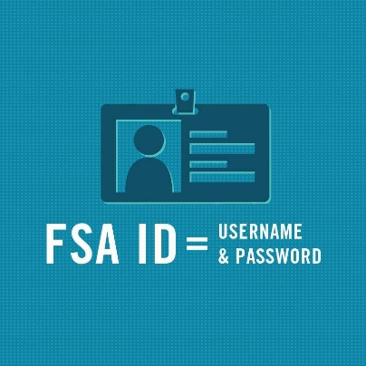


One FAFSA per student, per year
School #1
School #2
School #3
School
Up to 20

Slide 20
How to Create An FSA ID
Student and parent(s) will each need individual FSA IDs
Go to studentaid.gov – Top right has “Create an account” button
Enter Log-in Information
Enter Personal Information
Enter Mailing Address, Email, Phone and
language preference, Challenge Questions
https://studentaid.gov/fsa-id/create-account/launch

Slide 21
FSA ID TIPS
Phone numbers, SSNs, and emails can only be associated with one FSA ID
Do not use high school email accounts
Both parents should create an FSA ID
Each student filing a FAFSA needs an FSA ID
FSA ID should not be shared

Slide 22
Completing FAFSA

Slide 23
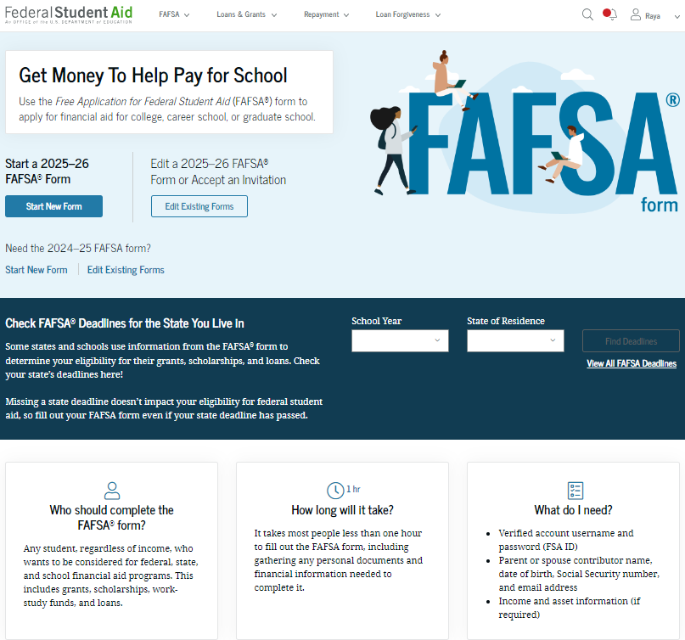
Landing Page

Slide 24
FAFSA Roles

Slide 25
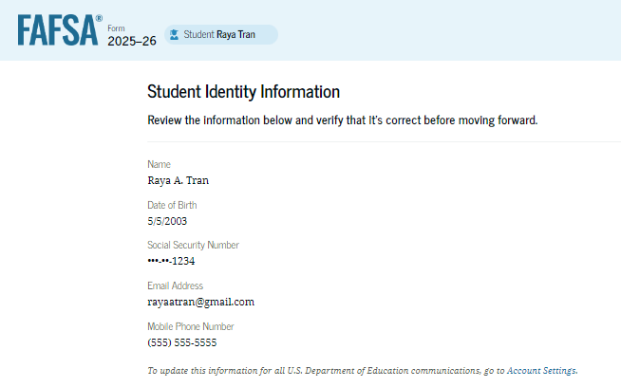
Student Identity Information
To update any of the personal information, the student must access their Account Settings on StudentAid.gov.
For fields related to the student’s mailing address, the student can edit them directly on this page.

Slide 26
IRS Consent Required – Tax Filers or Not

Slide 27
IRS Consent Required – Tax Filers or Not
EVERYONE who contributes the FAFSA will be required to provide consent to transfer data from the IRS.
This includes non-filers, people without social security numbers, and foreign tax filers.
The processing system will confirm if there is tax information on file and bring it directly into the FAFSA.
Will confirm those who are non-filers which may reduce verification burden.
NO CONSENT = NO FEDERAL AID

Slide 28
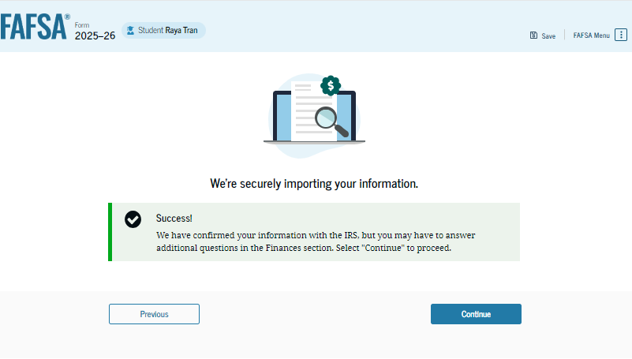
Importing Data

Slide 29
Student Dependency Status
Dependent
Under the age of 24 with no unusual circumstances. If a student is dependent, they will report their own and their parent(s)/ contributor(s) information.
Independent
Independent students will report their own (and their spouse if they are married) income.

Slide 30
Student Dependency Status
Graduate Student
Marital Status
Veteran
Orphan/ward of court/foster care
Emancipation/Legal Guardianship
Has children/dependents

Slide 31
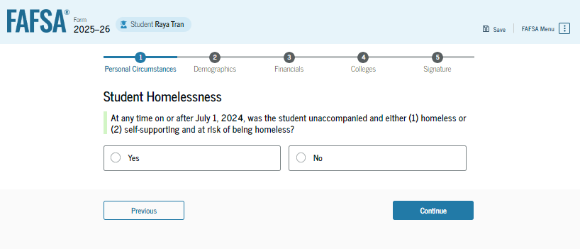
Student Other Circumstances

Slide 32
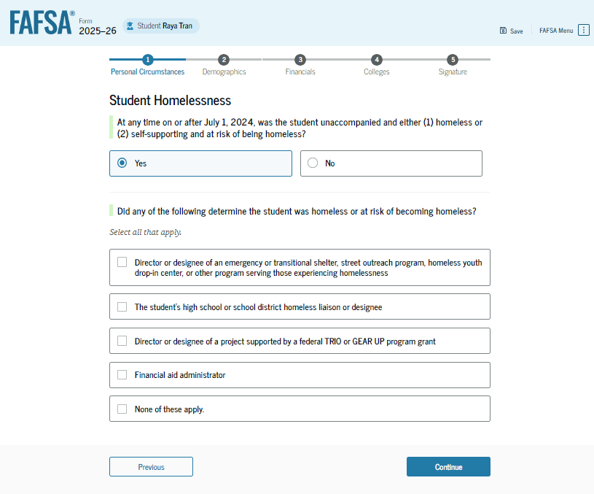
Student Other Circumstances

Slide 33
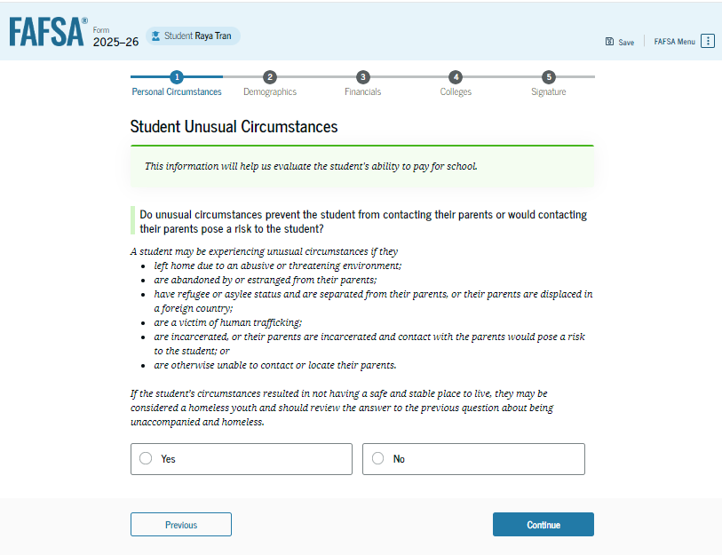
Student Unusual Circumstances
The student is asked if unusual circumstances prevent them from contacting their parent(s).

Slide 34
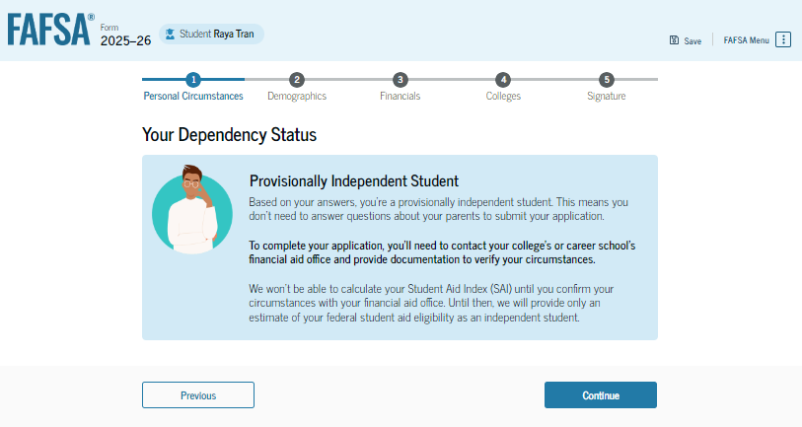
Provisionally Independent
If the student answers yes to the questions in the “Other Student Circumstances” section, they will be considered Provisionally Independent and will need to connect with their college’s financial aid office.

Slide 35
Student Dependency Status
This is the only option if the student’s parents are totally unwilling to provide information.
The college will determine the student’s eligibility for a Direct Unsubsidized Loan only.

Slide 36
Who is My Parent?
Online tool: studentaid.gov/fafsa-apply/parents

Slide 37
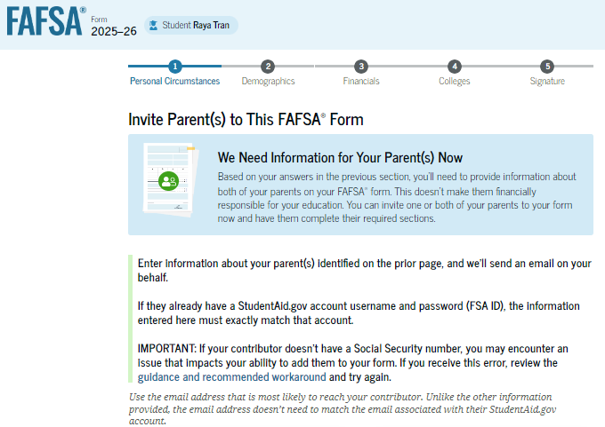
Student will invite Parent to FAFSA
Dependent Students will need to know their parent(s) name, social security number (if applicable) and DOB

Slide 38
Key Guidance: Inviting Parent
Parent invite must match legal name, date of birth, and SSN or mailing address (if parent has no SSN)
Email address for the parent invite must match the one used for FSA ID
Only one parents info is needed to progress through the form, the second parent can be invited by the first parent, if needed
If there is an issue with a match – the student will need to make the fix
Recommendation: Talk through the parent wizard questions before starting the FAFSA

Slide 39
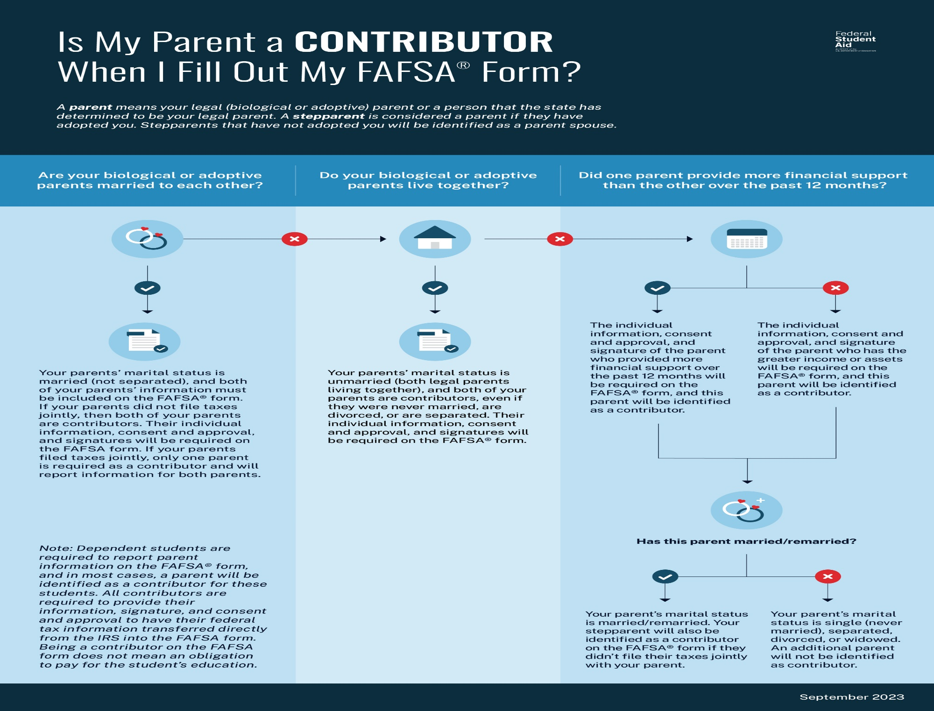

Slide 40
Student Demographics
Student will be asked about gender, race, and ethnicity
Responses to the demographic questions are for research purposes only
Answers will not
  Affect student eligibility for federal student aid
  Be used in any calculations
  Be shared with the schools to which the student applies

Slide 41
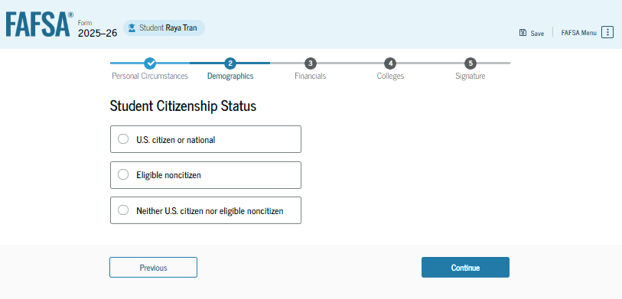
Student Citizenship Status

Slide 42
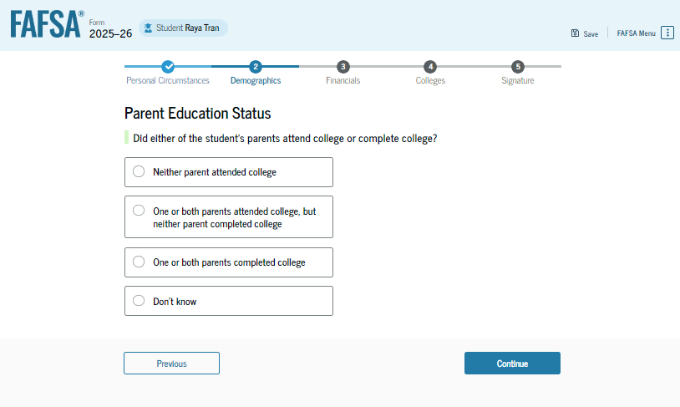
Parent Education Status

Slide 43
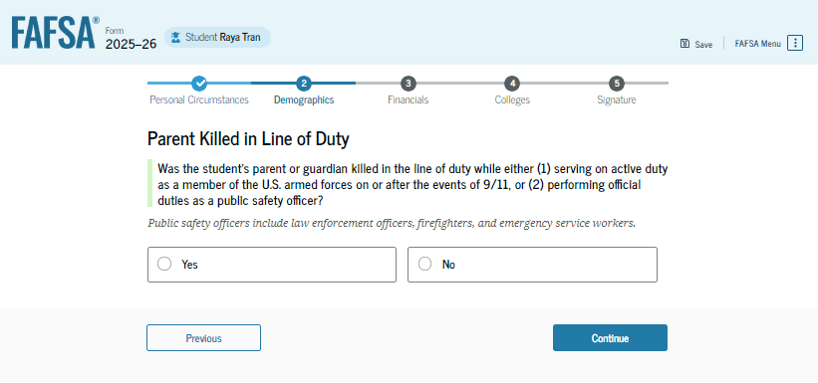
Student’s Parent Killed in Line of Duty

Slide 44
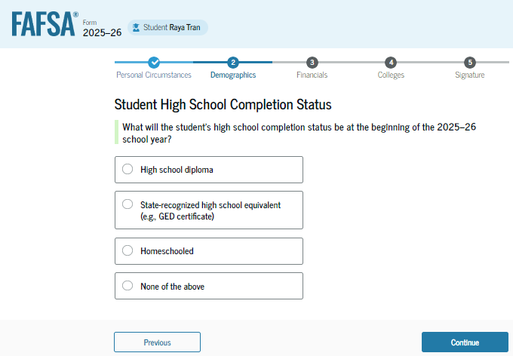
Student High School Completion Status

Slide 45
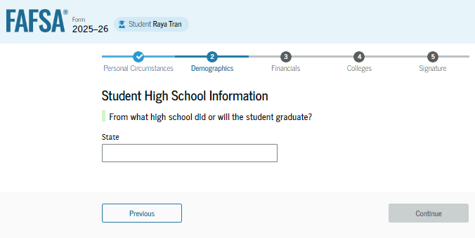
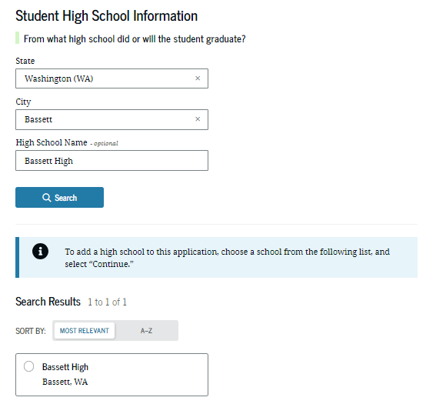
Student High School Information

Slide 46
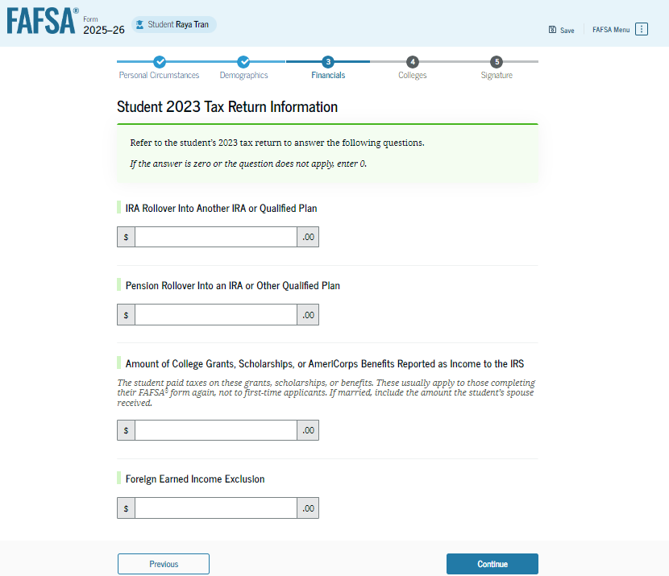
Student Financials – 2023 Taxes

Slide 47
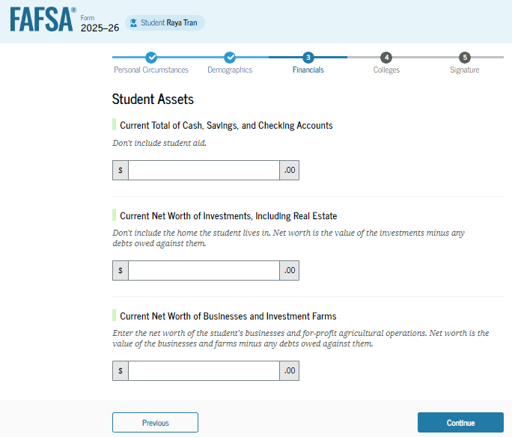
Student Assets
Families that meet all three following criteria will not have to report assets.
Have a total AGI of less than $60,000
Do not file a Schedule A, B, D, E, F, or H (or equivalent successor schedules) on their federal tax return
and either do not file a Schedule C or file that form with a net business gain or loss of $10,000 or less
Students will always answer these questions if they start the form because we do not have the family AGI. The answers are not used in the SAI calculation if the above criteria are met.

Slide 48
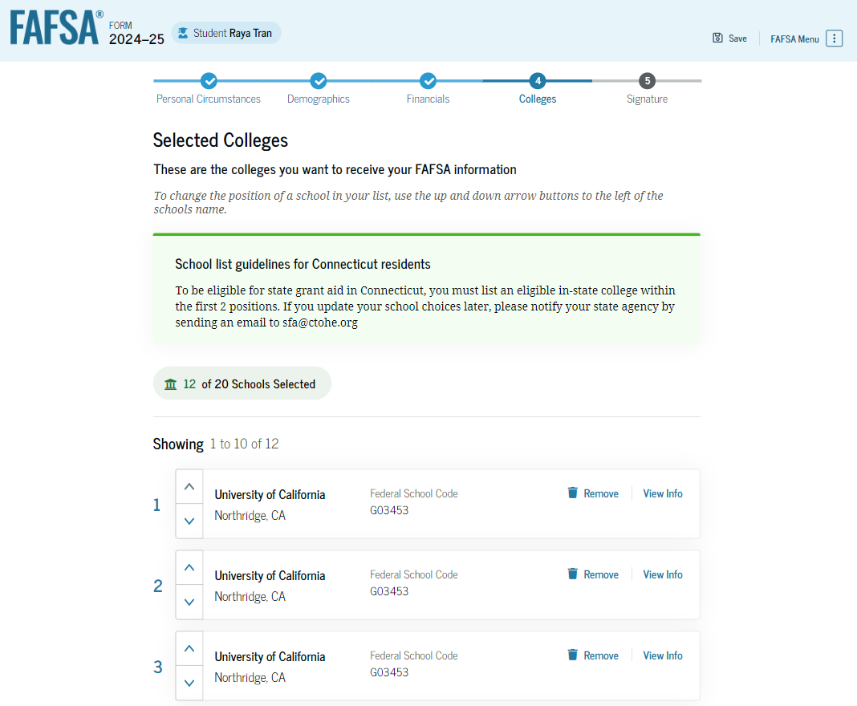
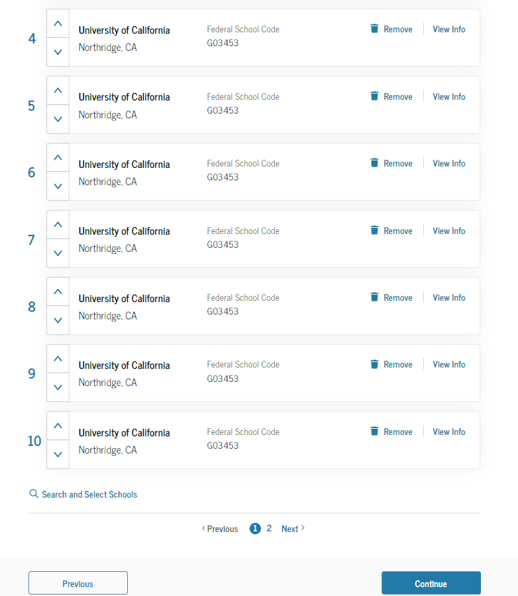
Search and Select Colleges
Select up to 20 schools to receive your FAFSA information

Slide 49
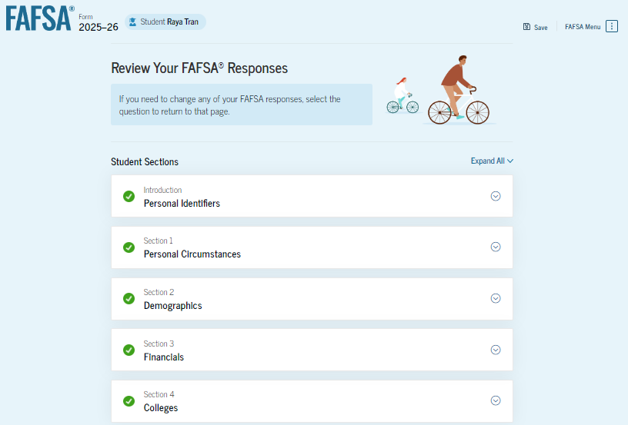
Student Review Page

Slide 50
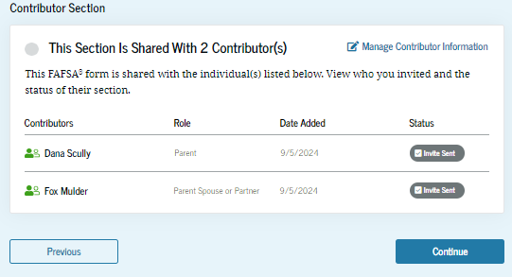
Student Review Page (cont’d)

Slide 51
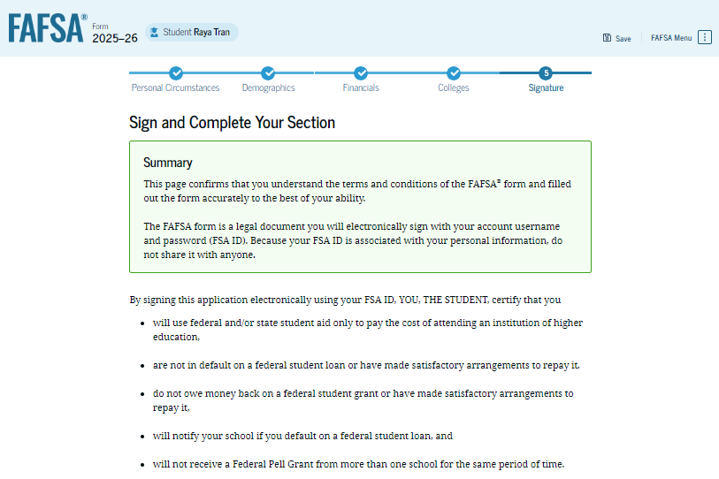
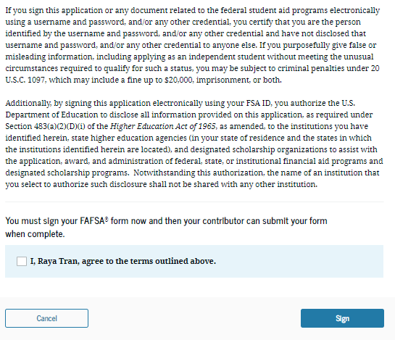
Student Signature

Slide 52
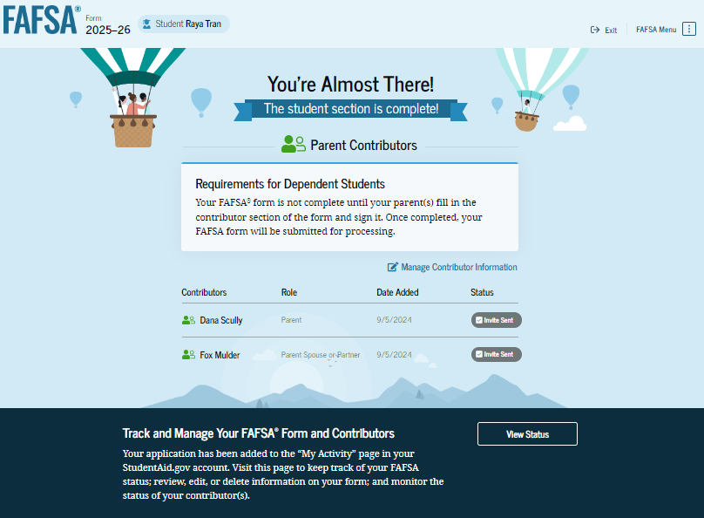
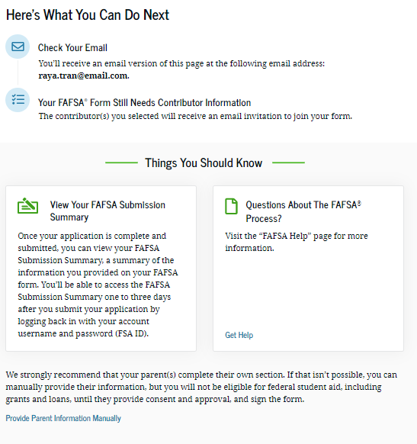
Student Section Complete

Slide 53
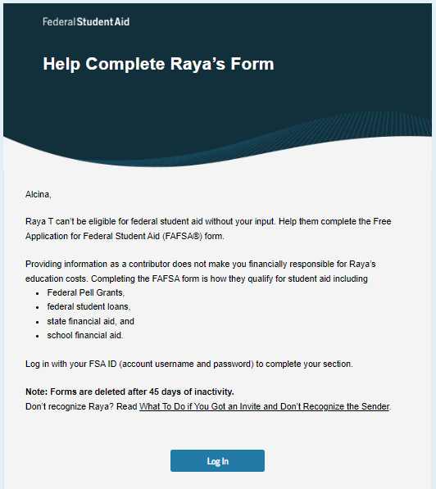
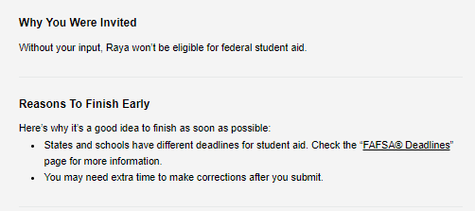
Parent Invitation Email

Slide 54
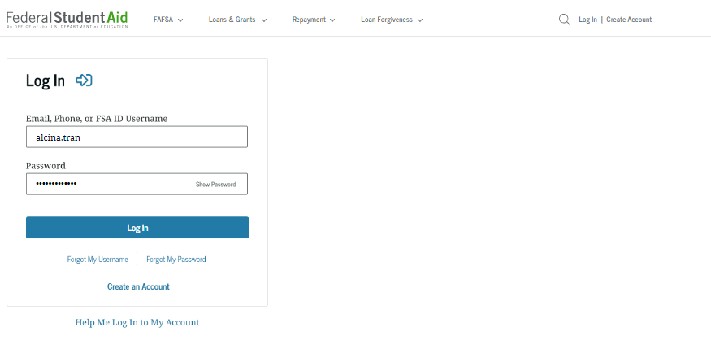
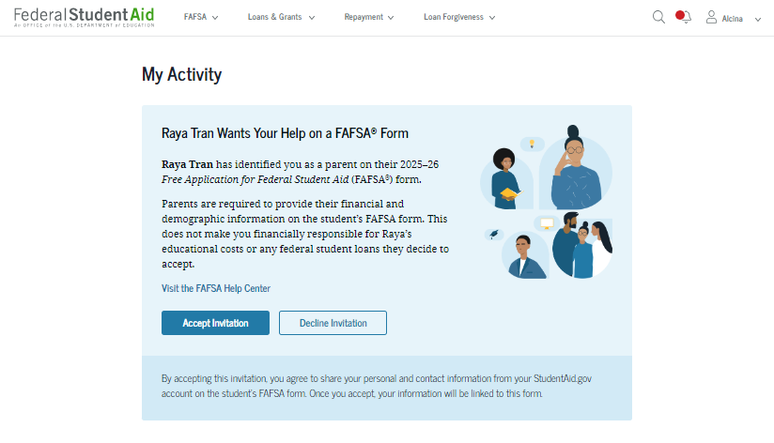
Parent Log In and My Activity

Slide 55
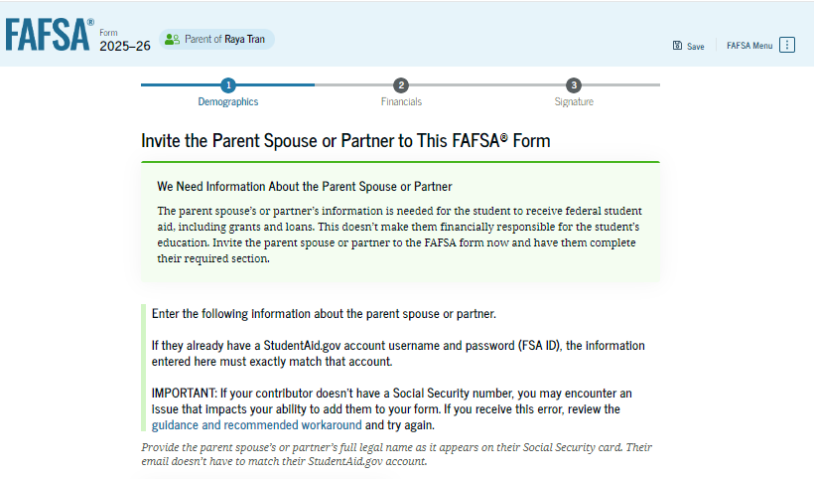
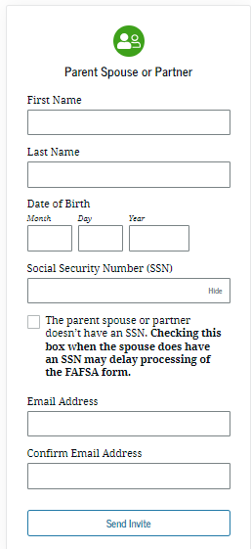
Parent Spouse/Partner Invite

Slide 56
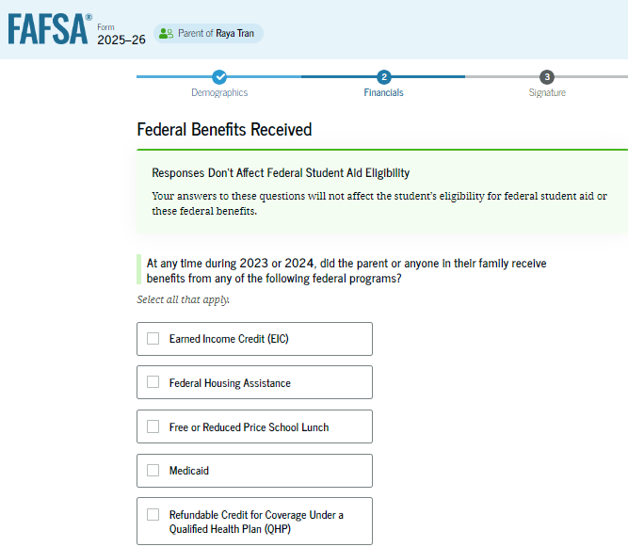
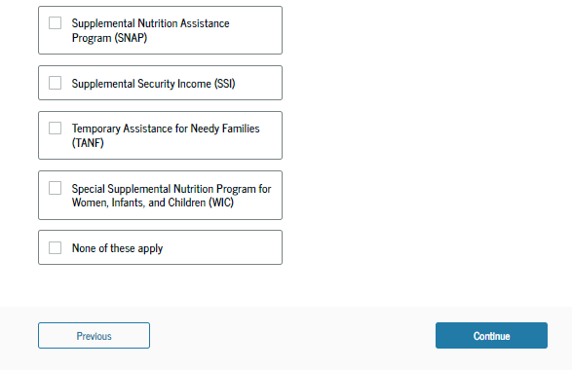
Federal Benefits Received

Slide 57
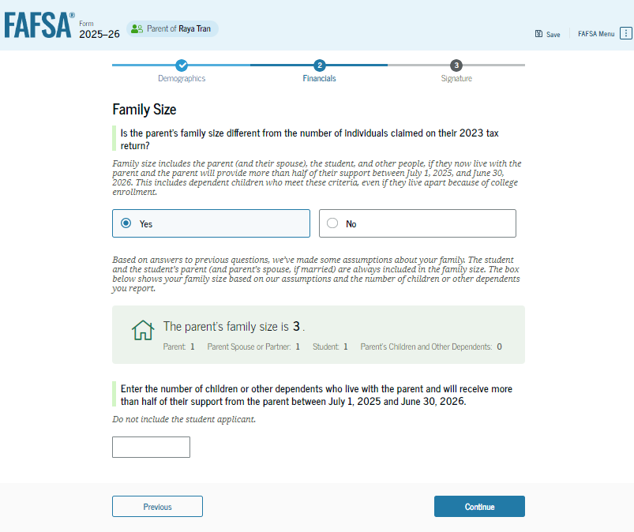
Parent Family Size

Slide 58
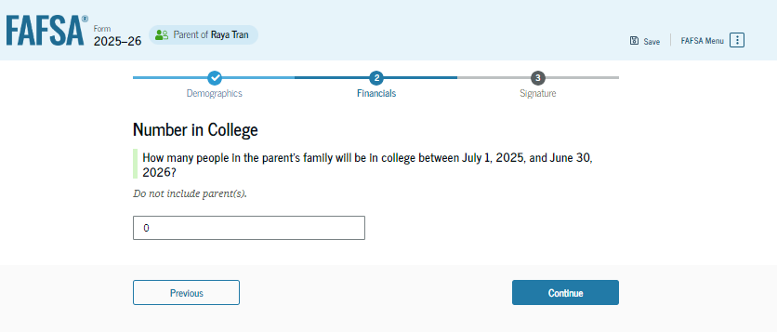
Parent – Number in College
This information will not be used in the SAI calculation

Slide 59
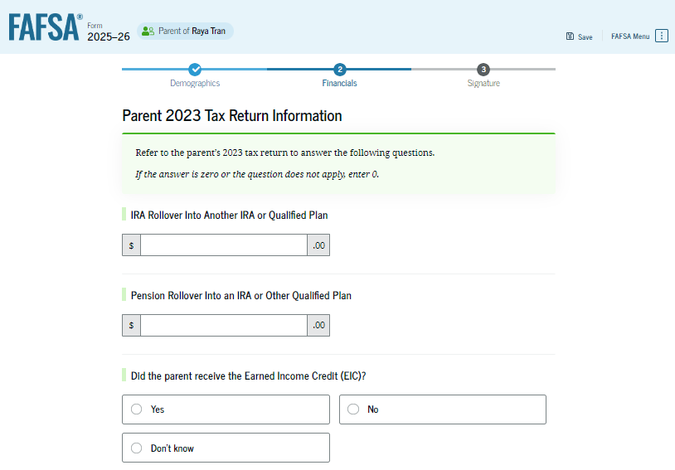
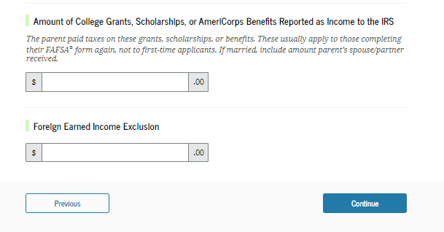
Tax Filers
The 2025-2026 FAFSA will use tax information from 2023.

Slide 60
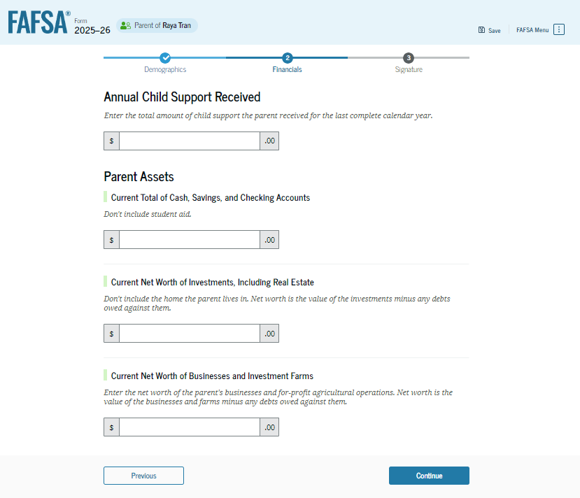
Parent Assets
ASSETS DON’T INCLUDE
Value of your primary residence
Value of life insurance
Traditional retirement plan

Slide 61
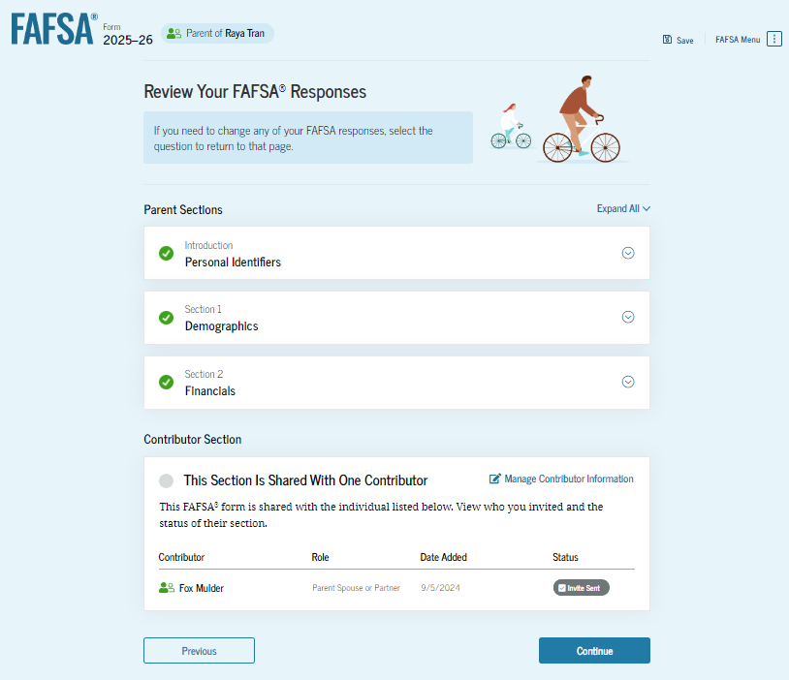
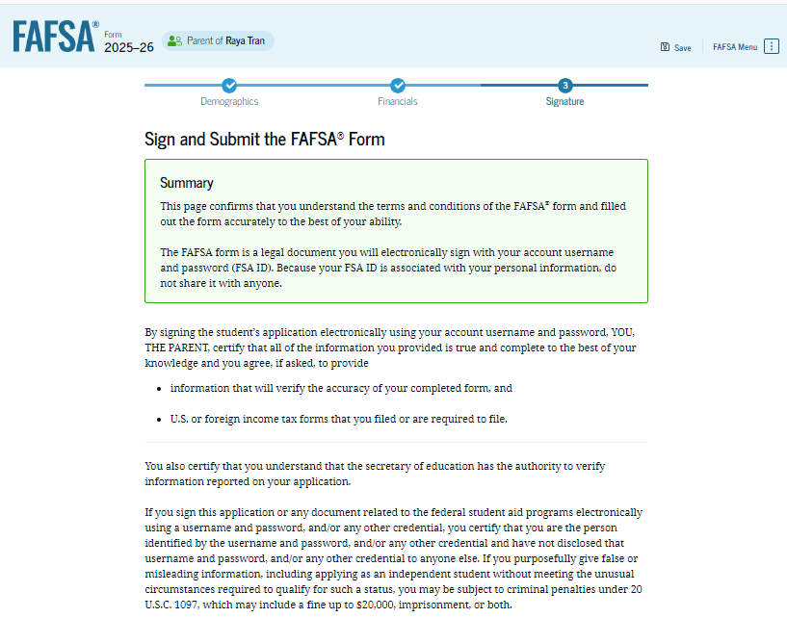
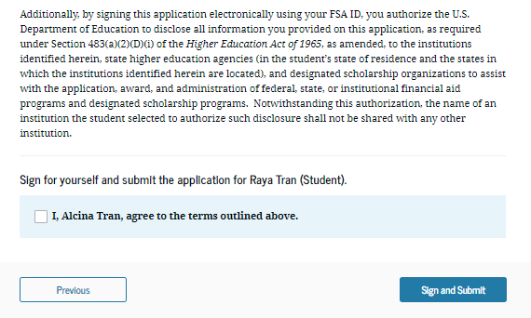
Almost Done

Slide 62
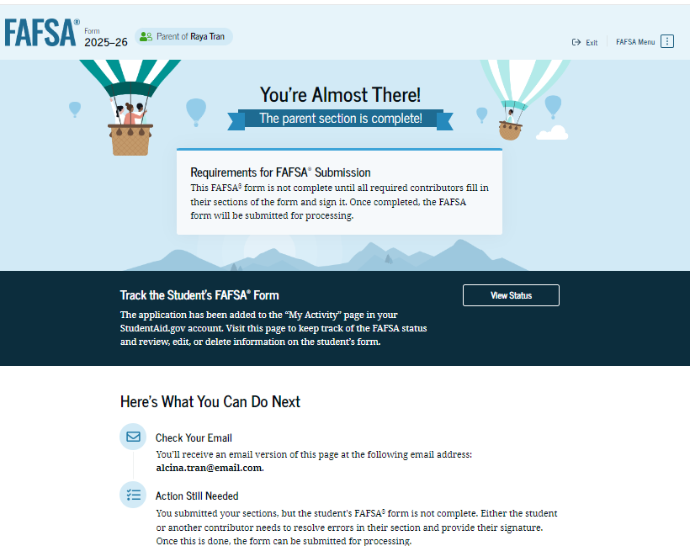
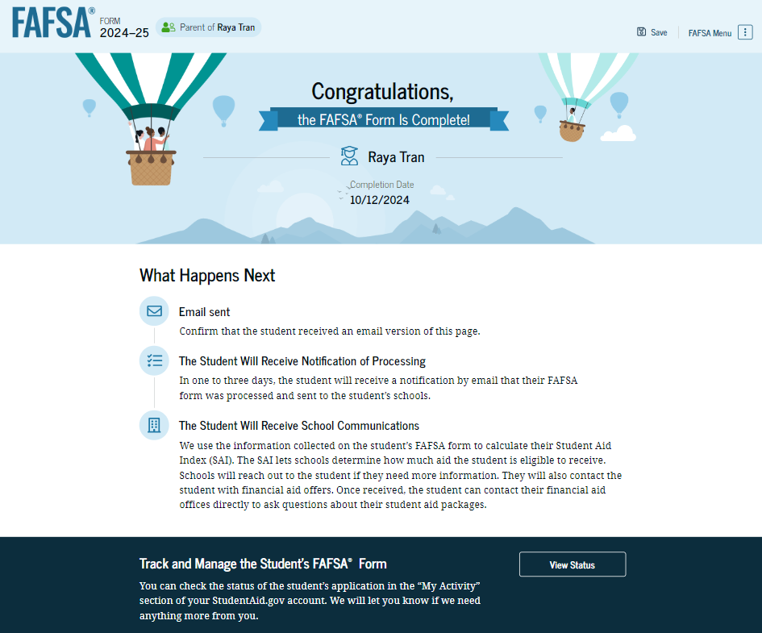
FAFSA Confirmation

Slide 63
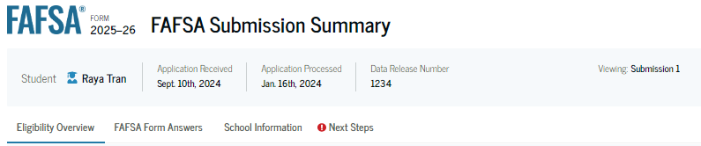
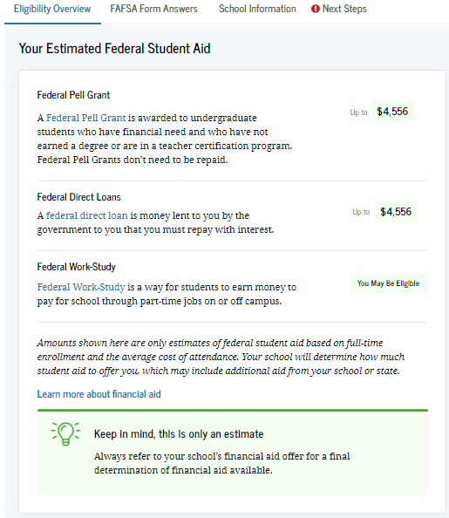
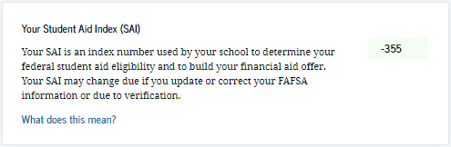
FAFSA Submission Summary
May be needed for scholarship applications

Slide 64
Verification
Prescribed by the US Department of Education
If required, all schools need to complete the review
Additional documentation would need to be submitted to each school your student is considering
IRS Consent may reduce verification documentation needed
Used to confirm accuracy of FAFSA data

Slide 65
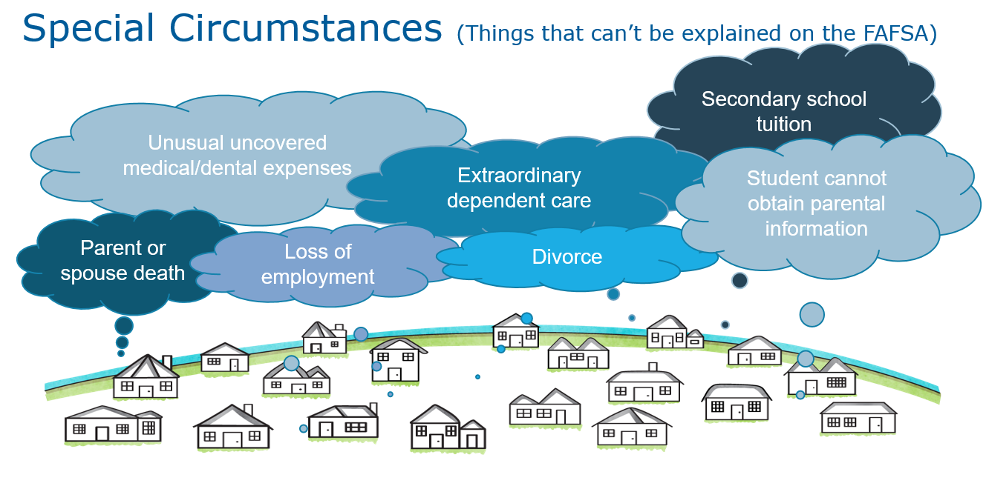

Slide 66
Special Circumstances
Each college handles this process differently; no universal procedures
College will review and request additional information if necessary
Send written explanation and documentation to financial aid office at each college

Slide 67

College Communication Methods:
Most institutions use a school portal; an online resource that students can access to register for classes, view financial aid and billing.
Most colleges/universities use a school assigned email account that students are required to activate and check regularly. Schools will begin to communicate with the student primarily through this email account.
More documents being handled electronically i.e., e-signature capabilities, secure document portals
Parents should be advised that once a student enrolls in college, their Personal Identifiable Information (PII) becomes protected under FERPA and students would need to give parent/guardian permission to access this information if they choose.

Slide 68
Getting Help
College Financial Aid Offices
https://studentaid.gov
  Resource page – infographics, videos, etc.
High school guidance counselors
Net Price Calculators
https://ohasfaa.memberclicks.net/stu-par-resources
Be cautious if a consultant will help you for a “small fee”!

Slide 69
Thank you!

