Slide 1

FINANCIAL AID UPDATES
For the 2025-2026 School Year
Presented by: [presenter names here]

Slide 2
ABOUT OASFAA AND THIS PRESENTATION
OASFAA is a non-profit organization comprised of financial aid professionals. The OASFAA Outreach Committee is an all-volunteer committee that serves as a primary resource of pertinent and current financial aid information. The committee disseminates this information through a variety of activities including training programs for various stakeholders external to OASFAA such as admissions staff, high school counselors, access advisors, TRIO, etc.
OASFAA has provided the information today as a free service to counselors.
You have permission to copy and distribute these materials to your students and families. Charges may not be assessed for the material or for the information presented. Permission must be granted for other use of this information or these materials. Contact the OASFAA Outreach Chairperson(s) listed on the OASFAA website or e-mail the OASFAA Outreach Committee at: outreach@oasfaa.org.

Slide 3
FAFSA PROCESSING NUMBERS

Slide 4
OVERVIEW OF FAFSA COMPLETIONS
As of 8/23/24 – Nationally, Class of 2024 is DOWN 9.5% compared to Class of 2023.
NO states have an increase this year.
As of 8/23/24 – In Ohio, Class of 2024 was DOWN 9.1% compared to Class of 2023.
As of 8/23/24 – Ohio has the 19th highest completion rate in the country with 50.9% of the Class of 2024 completing a FAFSA
We have A LOT work to do.
The state has awarded FAFSA25 grants in five regions to help the entire state increase FAFSA completion.

Slide 5
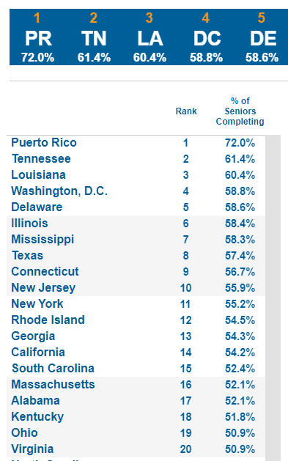
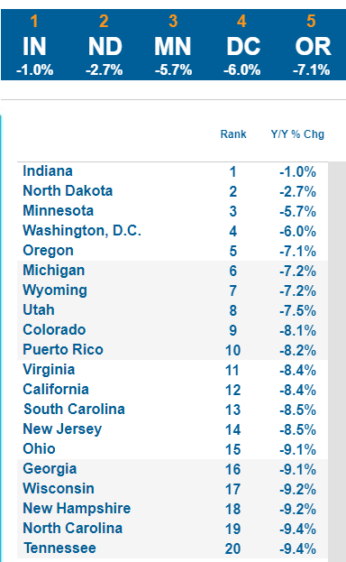
FAFSA BY THE NUMBERS

Slide 6

Top changes coming with 25-26 fafsa

Slide 7
Top FAFSA Changes
FAFSA will open for all on or by December 1, 2024.
FSA will clone the 24-25 system and make some enhancements but not change any questions.
Will be enhanced instructions and help text.
Testing will begin October 1 with selected groups of students starting with one hundred and ramping up to tens of thousands by November 1.
These will be real FAFSAs submitted and sent to states/colleges and will not need to be resubmitted.
GOAL-WHEN THE FAFSA OPENS IT WILL HAVE FULL FUNCTIONALITY AND ALL PROCESSES WILL BE IN PLACE.

Slide 8
Fafsa preparation
FSA IDs should be established well ahead of December-host setup events.
People without SSNs can set up the FSA ID and do not need to complete the identity verification prior to accessing the 25-26 FAFSA online. They should submit required identity documents.
Attestation Form will be online document-long timeframe to review submitted identity documents.
Encourage students to check on updated FAFSA priority deadlines at colleges.

Slide 9
Fafsa preparation
Check deadlines for colleges with early decision process.
FAFSA completion events should begin in early December.
FSA will provide timeline of when resources will be available.
Another year with a condensed timeframe for submitting FAFSAs but should be smoother than previous year.

Slide 10
Fafsa completion for 2025-2026 cycle
Many enhancements to the “unsub only” question to reduce student errors.
Need to help students understand the true definition of “unusual circumstances.”
Contributors without an SSN will have to continue to enter their financial information manually.
Contributor invites are tricky-may be better for parent to start and invite the student.
Hope for the Known Issues page to disappear for 25-26 but no guarantee.
Housing plans question will not be added back.

Slide 11
FAFSA PROCESSING FOR 25-26
Once FAFSA is submitted, student should get an email letting them know it has been processed.
Forms should be processed within 1-3 days and forwarded to state agencies and colleges.
FAFSA Submission Summaries will be available immediately upon processing.
Corrections should be available immediately upon processing.
Perhaps we are headed to a “return to normal.”
When the entire process works it is quicker than previous years.

Slide 12

Parent Contributors

Slide 13
Legal Parent definition
The FAFSA defines legal parent as:
Biological or adoptive (regardless of gender), or as determined by the state (for example, if the parent is listed on the birth certificate).
Grandparents, foster parents, legal guardians, widowed stepparents, aunts, uncles, and siblings are not considered parents on the FAFSA unless they have legally adopted the student.
Notes:
https://studentaid.gov/help/who-is-parent

Slide 14
Determining Parent Contributor
Parents’ Marital Status | Provide Information for
Married (not separated) | Both of student’s legal parents
Unmarried (divorced, separated, or never married) and not living together. | Provide information about the parent who provided more financial support during the last 12 months, even if the student did not live with them. If both parents provided an exact equal amount of financial support or if they don’t support the student financially, applicant should provide information for the parent with the greater income and assets. If the divorced parent is remarried, determine which parent’s information should be reported using the guidance above and include stepparent’s information.
Unmarried (divorced, separated, or never married) and living together | Both of student’s legal parents
Widowed | Student’s legal parent
Notes:
https://studentaid.gov/help/who-is-parent

Slide 15
Parent contributor FAFSA Role
Students who start their FAFSA will invite parent contributor(s) to the form:
  The student enters the parent’s name, date of birth, and email address.
  If the parent has a social security number (SSN), the student must also enter the correct SSN on the invitation screen.
Parent(s) must log into the FAFSA with their own FSA ID.
Parent contributors then complete the parent sections of the form, providing their personal and financial information.
Notes:
It is strongly recommended that the student, not the parent, start their own FAFSA form and complete their section first to save time and prevent errors. However, if the parent initiates the FAFSA, then the student doesn’t “invite” them as a contributor.

Slide 16
FEDERAL STUDENT AID ID (FSA ID)
Required for everyone:
An FSA ID is a username and password that gives a student/parent access to Federal Student Aid’s online systems and serves as their legal signature.
The student and parent(s) whose information will be on the FAFSA will need their own individual FSA IDs.
People without social security numbers will need to get an FSA ID. They will use the same website to set it up but will have different questions. The signature page is gone.
It is ESSENTIAL to request FSA IDs before beginning the FAFSA at studentaid.gov.
FSA ID will require an email address.
A mobile phone number can also be used to verify the ID. An email address and mobile number can only be associated with one FSAID. A one-time back up code will be provided when setting up an FSA ID.

Slide 17
FEDERAL STUDENT AID ID (FSA ID)
A multi-factor authentication process will happen every time a person logs in to the FAFSA.
A social security number, email address, and mobile phone number can only be associated with one FSA ID.
If you’re the parent or spouse of a student applying for aid and you create a studentaid.gov account without a social security number (SSN), you’ll need to complete the ID verification process at: https://studentaid.gov/fsa-id/create-account.
Creating your FSA ID is vital if you want to apply for federal and other student aid. If you are applying for financial aid, you’ll want to apply for an ID as soon as possible. Each person submitting income and asset information will need their own.

Slide 18
Dependency status

Slide 19
Dependency Status
Dependent = Student and Parent(s) must complete sections of FAFSA
Independent = Student (and spouse if married) apply without parent(s)
Categories to be classified independent remain the same as previous years:
  Age
  Graduate Student
  Married
  Veteran/Active Duty
  Children/ Dependents
  Orphan/Ward of Court/Foster Care
  Emancipation/Legal Guardianship
  Homelessness
  }
  Most high school students will be dependent

Slide 20
Dependency Status
Age 24
  As of January 1, of filing year; not upon turning 24
Graduate Student
  At beginning of academic year
Married
  At time of filing FAFSA; changes to marital status must be determined by school
Active Duty/Veteran
  Beyond training
  Reserves and National Guard status are not included
Dependent(s)
  Children or other people (excluding your spouse) who will live with and who receive more than half of their support from the student during the academic year (July 1-June 30)

Slide 21
Dependency Status
Orphan/Guardianship
  At 13 or older, no living biological or adoptive parent(s)
  At 13 or older, ward of the court or in foster care
Emancipated Minor/Legal Guardianship
  Emancipated minor as determined by court in state of legal residence
  In legal guardianship as determined by a court in state of legal residence (not the same as legal custody)
Homelessness
  As of July 1 of filing year, student unaccompanied and (1) homeless or (2) self supporting and at risk of being homeless as determined by:
    Emergency or transitional shelter, street outreach program, homeless youth drop-in center, or other program serving those experiencing homelessness
    High school or school district homeless liaison or designee
    Director or designee of a project supported by a federal TRIO or GEAR UP program grant
    Financial aid administrator

Slide 22
Dependency Determination
Order of Questions
  Birthdate, year in college, marital status all collected on FAFSA
  Remaining items (with the exception of Homelessness) listed as “Student Personal Circumstances” questions that student may check if they apply or they may select none of these apply
  If they answered yes to any of these questions, they would complete FAFSA as independent student
  If none apply, next screen, “Student Other Circumstances”, asks about (1) homelessness or (2) self-supporting and at risk of being homeless
  If yes, student will complete the FAFSA as provisionally independent
  If no, student will be asked if they are able to provide parent information or if they have an unusual circumstance preventing contact with parents or puts them at risk to do so
    Examples: Left abusive/threating environment, abandoned but not adopted, refugee or asylee separated from parent in foreign country, human trafficking victim, you or parents incarcerated, or otherwise unable to contact or locate parents and not adopted
  If no unusual circumstances, completes FAFSA as dependent with parents

Slide 23
Dependency Documentation
College has right to request supporting docs for any dependency category response.
College required to reach out in cases of provisional independent status (homelessness and unusual circumstances) for information and supporting documentation.
Provisional independent status will calculate an SAI but will not be eligible for aid until resolved by college.
Once independent, student anticipated to remain so.
  Future FAFSAs will keep these answers and limit need to redocument in future years.
  Colleges therefore may seek defining documentation when reviewing independent (and provisionally independent) to solidify determination.

Slide 24
Dependent – Parent Refusal
Student may report on FAFSA parents are unwilling to provide information though no unusual circumstance exists.
These students can request to be considered for limited federal aid.
  Only Federal Direct Unsubsidized Loan can be awarded
  Up to $5,500 freshmen/$6,500 sophomores/$7,500 junior or senior
No SAI calculated.
Documentation of this status may be requested by school.
College may work with such students to alert parents that dependency status does not obligate them as way to get complete FAFSA for better aid package.

Slide 25
UNUSUAL VS. SPECIAL CIRCUMSTANCEs
Unusual Circumstances
  Used in FAFSA Completion
  Conditions that justify adjusting student’s dependency status based on unusual situation (e.g., parental abandonment or human trafficking)
  Commonly referred to as Dependency Appeal or Override
Special Circumstances
  Used in COA or SAI data adjustments
  Special or extenuating situations (such as job loss) that impact student or parent(s) financial condition and support adjusting data elements in COA or SAI calculation
Both are professional judgments exercised on a case-by-case basis
Determined by financial aid administrator so may differ slightly college to college
Documentation for both Unusual and Special Circumstances will be requested by school

Slide 26

Federal aid programs

Slide 27
FEDERAL AID PROGRAMS
Pell Grant and TEACH
Campus-Based Programs
Direct Loans

Slide 28
FEDERAL GRANTS
Pell Grant
TEACH Grant
The maximum Federal Pell Grant award is $7,395 for the 2024–25 award year.
Amount received depends on SAI, cost of attendance, and enrollment status.
Students have a maximum number of terms they can receive Pell Grant.
  600% of an annual award amount, or the equivalent of 12 full-time semesters.
Students can attend on a year-round basis and receive up to 150% of their annual award.
  2024-2025 will no longer have half-time enrollment requirement
For any 2024–2025 TEACH Grant first disbursed on or after Oct. 1, 2024, and before Oct. 1, 2025, the maximum award of $4,000 is reduced by 5.7% ($228).
Grant of up to $3,772 per year to students who intend to teach in a public or private elementary or secondary school that serves students from low-income families.
  Grant is prorated based on enrollment status.
Service requirement upon graduation must be met, or grant becomes an Unsubsidized Direct Loan that must be re-paid!

Slide 29
Campus-based Programs
Federal Supplemental Educational Opportunity Grant (FSEOG)
Offered to undergraduates with exceptional financial need.
  A student with a negative SAI could be considered "needier" than a student with a zero SAI for purposes of awarding a higher FSEOG amount.
Award ranges from $100 to $4,000, depending on when student applies, financial need, and the funding and policies of school attending.
“Priority Deadlines” can impact eligibility between schools
Notes:
Speaker Note:
Reference the “FAFSA Priority Deadline OASFAA 2025-26” --survey document Outreach Committee has reached out to colleges and Universities to collect – for first time in long time there were MANY changes. Especially to the following
“FAFSA Priority Date (Fall Starts; Regular Decision)* “
“Estimated Aid Offer Start Date”
LeeAnn I also added the note to this slide about changes to priority deadlines – I wasn’t sure whether to say “may have” or “many have” .. I went with “many” – feel free to change to “may” if think appropriate.

Slide 30

Campus-based Programs
Federal Work Study (FWS)
Undergraduate and graduate students are eligible.
Employment can be on or off campus.
FWS wages are excluded from SAI calculation.
Ohio Minimum Wage in 2024 is $10.45/hour.
There is a difference between work-study and “work” or “employment” on an aid offer.
Interest in Work-Study question removed from FAFSA. Alternative collection of interest may be used by schools.
For most schools, FWS earnings are given in paycheck form and not applied directly to the student’s bill.
“Priority Deadlines” can impact eligibility between schools
Notes:
Speaker Note:
Reference the “FAFSA Priority Deadline OASFAA 2025-26” --survey document Outreach Committee has reached out to colleges and Universities to collect – for first time in long time there were MANY changes. Especially to the following
“FAFSA Priority Date (Fall Starts; Regular Decision)* “
“Estimated Aid Offer Start Date”
LeeAnn I also added the note to this slide about changes to priority deadlines – I wasn’t sure whether to say “may have” or “many have” .. I went with “many” – feel free to change to “may” if think appropriate.

Slide 31
Direct loans: Undergraduate
Subsidized Undergraduate | Unsubsidized Undergraduate
Need-Based | Not Need-Based
Interest is fixed at 6.53% for new undergraduate loans disbursed during 2024-2025*; interest is subsidized while the student is in school and during deferment. Loan fees are 1.057% - no change | Interest is fixed at 6.53% for all new loans disbursed during 2024-2025*; interest accrues from time of disbursement of the funds. Loan fees are 1.057% - no change
*Interest rates recalculated annually and are effective July 1st based on the 10-year treasury note index plus 2.05%, capped at 8.25%.
Notes:
Subsidized Loan-interest is deferred ONLY during periods of half-time or more enrollment. (During grace period and valid deferment periods)
Fees for Federal Student Loans
Most federal student loans have loan fees. These fees are a percentage of the total loan amount.
A loan fee comes out of the amount of money that is disbursed (paid out) to you while you’re in school. This means the money you receive will be less than the amount you actually borrow.
You’re responsible for repaying the entire amount you borrowed and not just the amount you received.

Slide 32
Direct loans: Undergraduate
Annual loan limits – no changes
Class Year | Maximum Subsidized Amount | Additional Unsubsidized Amount | Total Available to Borrow
Freshman | $3,500 | $2,000 | $5,500
Sophomore | $4,500 | $2,000 | $6,500
Junior | $5,500 | $2,000 | $7,500
Senior | $5,500 | $2,000 | $7,500
Undergraduate Independent Students and Dependent Students whose parents have been denied the PLUS Loan are eligible for additional Direct Unsubsidized Loans ($4,000 as freshmen and sophomores and $5,000 as juniors and seniors).
Notes:
Subsidized Loan-interest is deferred ONLY during periods of half-time or more enrollment. (During grace period and valid deferment periods)
Fees for Federal Student Loans
Most federal student loans have loan fees. These fees are a percentage of the total loan amount.
A loan fee comes out of the amount of money that is disbursed (paid out) to you while you’re in school. This means the money you receive will be less than the amount you actually borrow.
You’re responsible for repaying the entire amount you borrowed and not just the amount you received.

Slide 33
FEDERAL PARENT PLUS LOAN
  Loan to parent(s)/guardian(s) of dependent students
  Loan limits up to cost of attendance less any financial aid received
  Interest rate is 9.08% fixed* for 2024-2025
  Loan fees are 4.228% (no change)
  Repayment begins within 60 days of full disbursement; payments may be deferred while student is in school
  FAFSA completion is required
  *Interest rates recalculated annually and are effective July 1st based on the 10-year Treasury note index plus 4.6%, capped at 10.5%
Notes:
Fees for Federal Student Loans
Most federal student loans have loan fees. These fees are a percentage of the total loan amount.
A loan fee comes out of the amount of money that is disbursed (paid out) to you while you’re in school. This means the money you receive will be less than the amount you actually borrow.
You’re responsible for repaying the entire amount you borrowed and not just the amount you received.

Slide 34

Ohio Financial Aid programs 2024-2025

Slide 35
OHIO COLLEGE OPPORTUNITY GRANT (ocog)
ELIGIBILITY
Ohio’s only need-based grant program
Must file FAFSA
Students must be:
  Ohio residents
  Enrolled in an eligible degree-granting program at an eligible institution
  EFC must not exceed 3,750
  Household income must not exceed $96,000

Slide 36
OHIO COLLEGE OPPORTUNITY GRANT (ocog)
Grant amounts are determined by institution type
    Community College or Regional campus - $0.00
    Public, 4-year, Main campus – up to $4,000.00
    Private, Non-Profit – up to $5,000.00
    Proprietary – $2,000.00
More information
highered.ohio.gov

Slide 37
Governor’s Merit Scholarship
Up to $5,000 each year
Renewable
  Receive up to four (4) years of funding
Students must be:
  Ohio residents
  Top 5% of class as determined by high school, charter school or other secondary institution
  Complete secondary education on-time
  Enroll at a qualifying post-secondary institution

Slide 38
OTHER State Aid Programs
Ohio Safety Officers College Memorial Fund
Ohio War Orphans & Severely Disabled Veterans’ Children Scholarship
Ohio National Guard (ONG)
Nurse Education Assistance Loan Program (NEALP)

Slide 39
OTHER State AID PROGRAMS
Ohio Safety Officers College Memorial Fund provides undergraduate tuition assistance to a child, spouse, or qualified former spouse of peace officers, fire fighters and certain other safety officers who are killed in the line-of-duty, anywhere in the United States.
Ohio National Guard (ONG) provides scholarships to current members of the Ohio Army & Air National Guard, as well as former members with qualifying deployment time.
Ohio War Orphans awards tuition assistance to the children of deceased or severely disabled Ohio veterans who served in the armed forces during a period of declared war or conflict.
Nursing Education Assistance Loan Program (NEALP) provides forgivable loans to Ohio students enrolled in an approved Ohio nurse education program. Forgiveness is contingent upon meeting post-graduation work requirements.

Slide 40
OTHER State AID PROGRAMS program amounts
Ohio Safety Officers College Memorial Fund covers 100% of tuition and fees at public colleges and $9,449 at private colleges.
Ohio National Guard (ONG) covers 100% of instructional and general fee charges at public institutions and an equivalent amount at private colleges after considering federal aid and Department of Defense funding.
Ohio War Orphans covers 79% of tuition and general fees at public colleges and $6,618 at private colleges.
  Any qualifying student whose parent was killed in action receives 100% coverage.
Nursing Education Assistance Loan Program (NEALP)
  Loan forgiveness program
  Amounts to be determined
Notes:
As if 8/23/24 no NEALP values have been determined – please update once available

Slide 41
OTHER STATE AID PROGRAMS important information
Require additional action beyond filing the FAFSA
  Safety Officers – Student must submit eligibility documents to the college/university
  War Orphans, NEALP & ONG – Must complete supplemental application
Some programs have a service/work component
  ONG – Must serve in Ohio National Guard
  NEALP – Must complete 4 years of post-graduation employment in Ohio
Full eligibility information: highered.ohio.gov

Slide 42
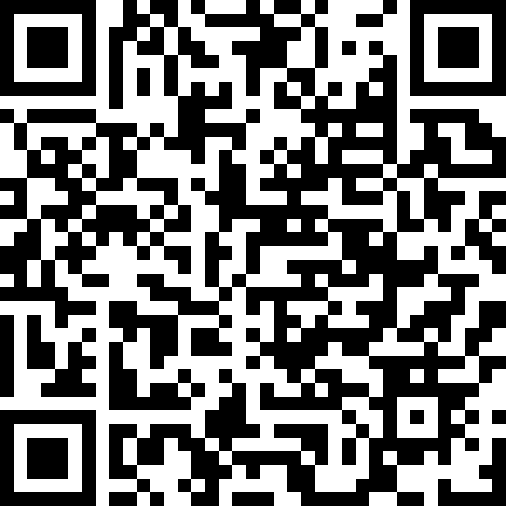
FULL PROGRAM LISTING
Review Ohio’s Financial Aid Programs at
highered.ohio.gov
SCAN ME!

Slide 43
resources

Slide 44
OASFAA COUNSELOR RESOURCES
OASFAA Counselor Resources link: oasfaa.org/counselors
  Request a financial aid night presenter
  Put yourself in the OASFAA Counselor database to receive all important training/resource notices
  Register for Financial Aid 101 Webinar
  Find additional resource documents

Slide 45
Financial Aid Counselor workshops
Basic training on the federal financial aid process and programs.
All counselors should attend as there were significant changes to the form this past cycle.
We are offering 13 in-person workshops all over Ohio!
Registration is open now!
Available on the OASFAA Counselor page.
Event Link:
You will receive confirmation email after registering.

Slide 46
OASFAA RESOURCES – Counselor workshops
oasfaa.org/counselors
Friday, October 11: Ohio University - Zanesville
Tuesday, October 15: The Ohio State University
Wednesday, October 16: Ashland University
Monday, October 21: Baldwin Wallace
Tuesday, October 22: University of Dayton
Tuesday, October 22: University of Northwestern Ohio
Friday, October 25: Wilmington College
Sinclair Community College - TBD
Tuesday, October 29: Ohio University - Athens
Friday, November 1: Ohio University - Chillicothe
Friday, November 8: Kent State University
Friday, November 15: Shawnee State University
Friday, November 22: Stark State University
Friday, November 22: Bowling Green State University
Virtual Workshop - COMING SOON

Slide 47
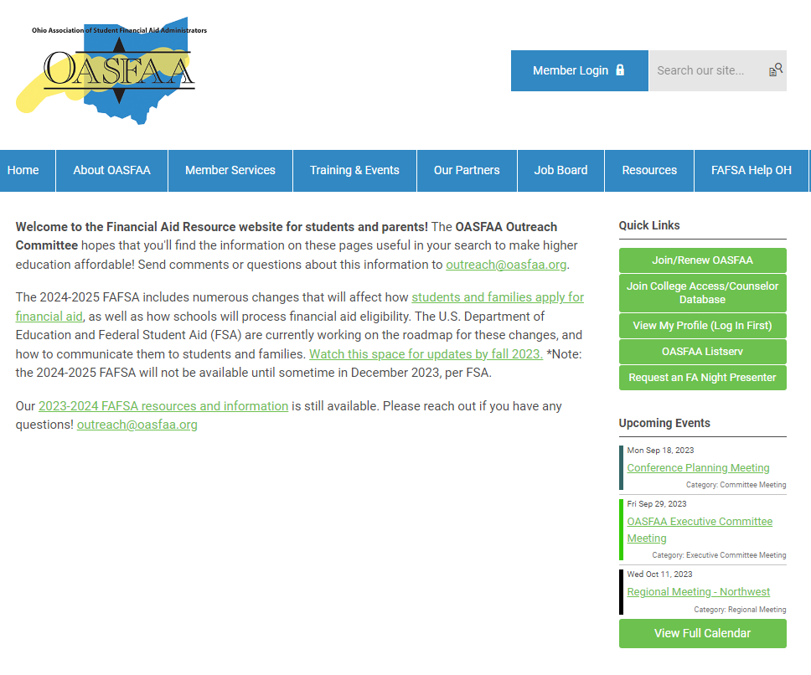
OASFAA RESOURCES – FAFSA Help Oh
  Resources for students and parents
    Instructional videos
    Handouts
    You can link to your school site

Slide 48
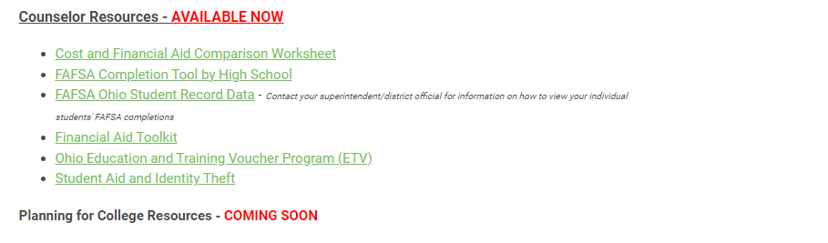
More Counselor Resources

Slide 49


