Slide 1
FAFSA TRAINING & RESOURCES OCTOBER 2021
Presenters: Faith Phillips & MorraLee Keller

Slide 2
ABOUT OASFAA AND THIS PRESENTATION
OASFAA is a non-profit organization comprised of financial aid professionals. The OASFAA Outreach Committee is an all-volunteer committee that serves as a primary resource of pertinent and current financial aid information. The committee disseminates this information through a variety of activities including training programs for various stakeholders external to OASFAA such as admissions staff, high school counselors, access advisors, TRIO, etc.
OASFAA has provided the information today as a free service to counselors.
You have permission to copy and distribute these materials to your students and families. Charges may not be assessed for the material or for the information presented. Permission must be granted for other use of this information or these materials. Contact the OASFAA Outreach Chairperson(s) listed on the OASFAA website or e-mail the OASFAA Outreach Committee at: outreach@oasfaa.org.

Slide 3
Ohio FAFSA 22 Initiative
Supported by the Ohio Department of Higher Education (ODHE)
New statewide effort to increase FAFSA completion for the Class of 2022
Grants to community organizations, school districts, agencies, etc. to implement strategies through the 2021-2022 academic year ($1.7M to 25 groups)
Professional development such as today’s webinar made available by ODHE
Web resources available at www.oasfaa.org Counselor page
Enhancements to FAFSA student-level tracking system
Notes:
Note: Cell phone carriers are beginning to recycle old cell phone numbers and assign them to new phones; Students or Parents with recycled cell phone numbers may need to reach out to an FSA Specialist if their recycled number is already associated with an FSA ID. They will not be able to proceed in obtaining an FSA ID unless they take this step.

Slide 4
Ohio FAFSA Numbers
As of September 24, Ohio ranked 14th in the country for FAFSA completion for the Class of 2021.
That is 4.7% behind the Class of 2020.
Only 62.3% of the Ohio Class of 2021 has completed a FAFSA.
Much assistance is needed if we are going to get the number of FAFSAs completed near 2020 levels.
Nationally we are 4.2% behind the Class of 2020 and only 58.8% of students have completed the FAFSA
Notes:
Note: Cell phone carriers are beginning to recycle old cell phone numbers and assign them to new phones; Students or Parents with recycled cell phone numbers may need to reach out to an FSA Specialist if their recycled number is already associated with an FSA ID. They will not be able to proceed in obtaining an FSA ID unless they take this step.

Slide 5
TRACKING FAFSA COMPLETION
To look at aggregate number and comparison options:
www.formyourfuture.org/fafsa-tracker
Compare this year versus last year at the state, city, district or building level:
To access student-level data for Ohio: https://www.ohio-k12.help/fafsa/
Need data sharing agreement signed by superintendent.
2022-2023 FAFSA data will become available in October.
Many enhancements done this year to the Ohio site.
Notes:
Make sure the audience understands that the FAFSA tracker is aggregate numbers and for comparing the current year to the previous year. I am trying to get more info from ODHE on the process for getting student level data this year.

Slide 6
FEDERAL STUDENT AID ID (FSAID)
https://fsaid.ed.gov
An FSA ID is a username and password that gives the student and parent(s) access to Federal Student Aid’s online systems and can serve as the legal signature.
The student and one parent whose information is on the FAFSA will need their own individual FSA IDs. Independent students do not need a parent signature on the form.
The FSA ID(s) should be requested before beginning the FAFSA.
FSA ID requires an email address or mobile phone number. An email address and mobile number can only be associated with one FSA ID. Parents and students cannot use the same email or mobile phone number.
Note: Students or Parents with recycled cell phone numbers may need to reach out to an FSA Specialist.
Students should not use a high school email address because it will be deleted after graduation.
Notes:
Note: Cell phone carriers are beginning to recycle old cell phone numbers and assign them to new phones; Students or Parents with recycled cell phone numbers may need to reach out to an FSA Specialist if their recycled number is already associated with an FSA ID. They will not be able to proceed in obtaining an FSA ID unless they take this step.

Slide 7
FAFSA WEBSITE
As we know it: www.fafsa.gov
New redirect: https://studentaid.gov/h/apply-for-aid/fafsa
Available in English and Spanish
Paper PDF version available for those who need it
Mobile App available-myStudentAid
Opens October 1st each year
Request income information from the 2020 federal tax form
Notes:
Note: Cell phone carriers are beginning to recycle old cell phone numbers and assign them to new phones; Students or Parents with recycled cell phone numbers may need to reach out to an FSA Specialist if their recycled number is already associated with an FSA ID. They will not be able to proceed in obtaining an FSA ID unless they take this step.

Slide 8
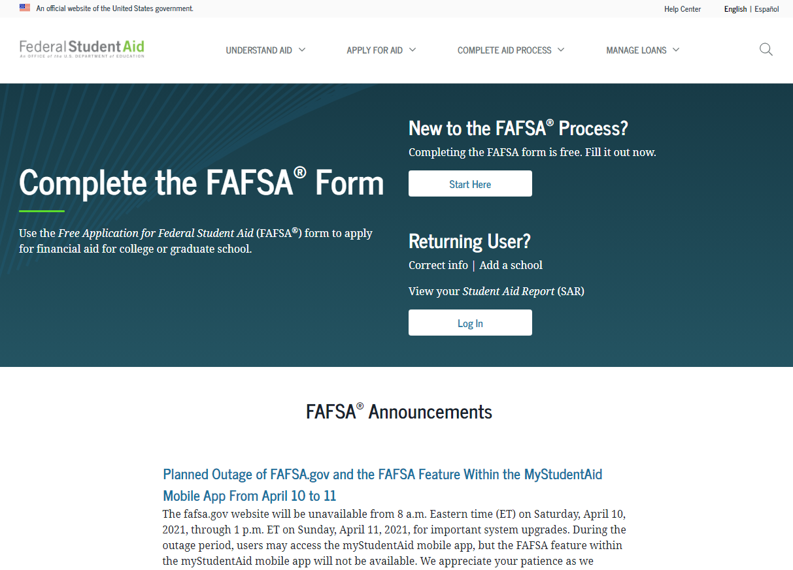
FAFSA® Form Welcome Page
Notes:
FAFSA Form Welcome page view
The applicant may have a direct link to the FAFSA form or may arrive from the FAFSA form home page. The “FAFSA Form Welcome” page directs new users to the “Start Here” button and returning users to the “Log In” button. For the purpose of this presentation, the applicant is beginning a new application.

Slide 9
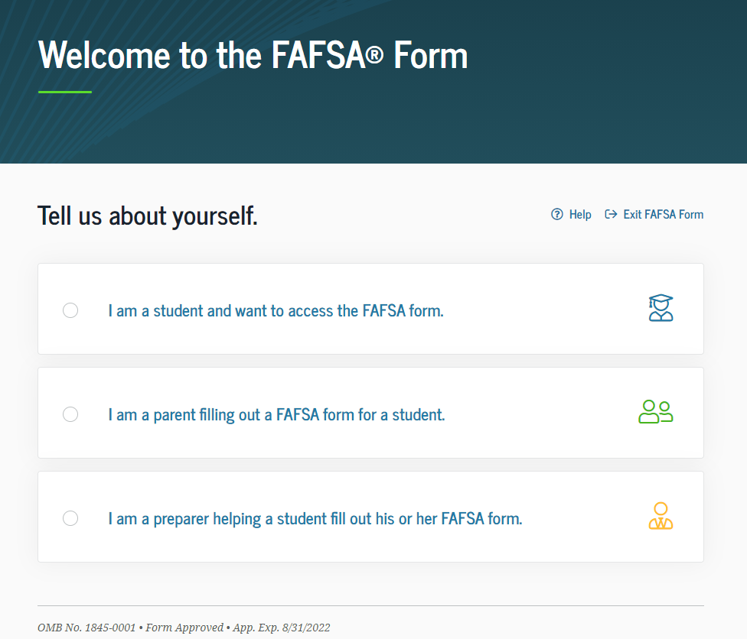
Role Selection
Notes:
Role Selection (1 of 3) view
The user will select the applicable role to fill out the FAFSA form: student, parent of a student, or preparer helping a student.
For this presentation, the user selects a student role. In the dependent student section, the parent will also log in to sign and submit the FAFSA form.

Slide 10
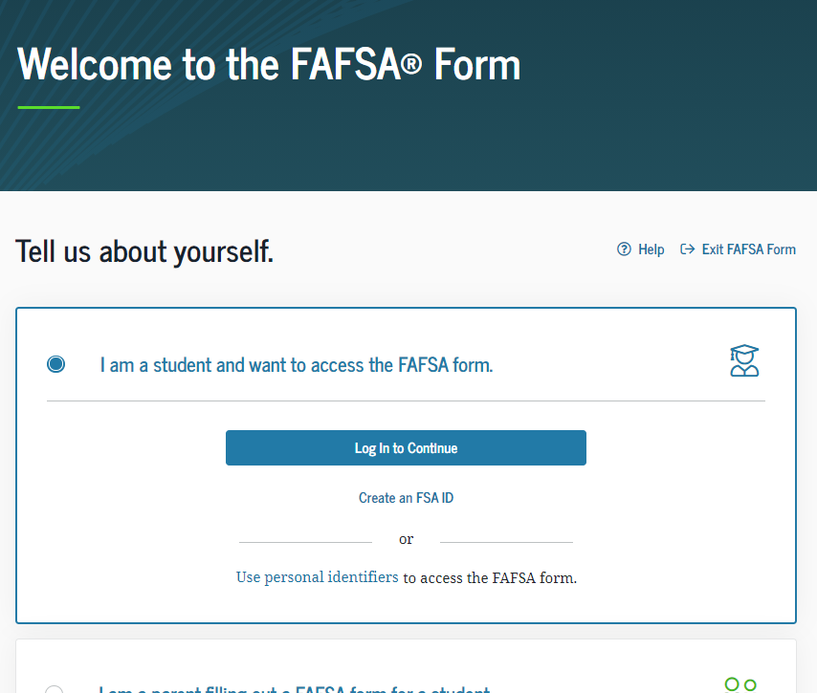
Role Selection Dependent
Notes:
Role Selection (2 of 3) view
The form will ask the user to log in or create an FSA ID or start the form with personal identifiers (next slide).

Slide 11
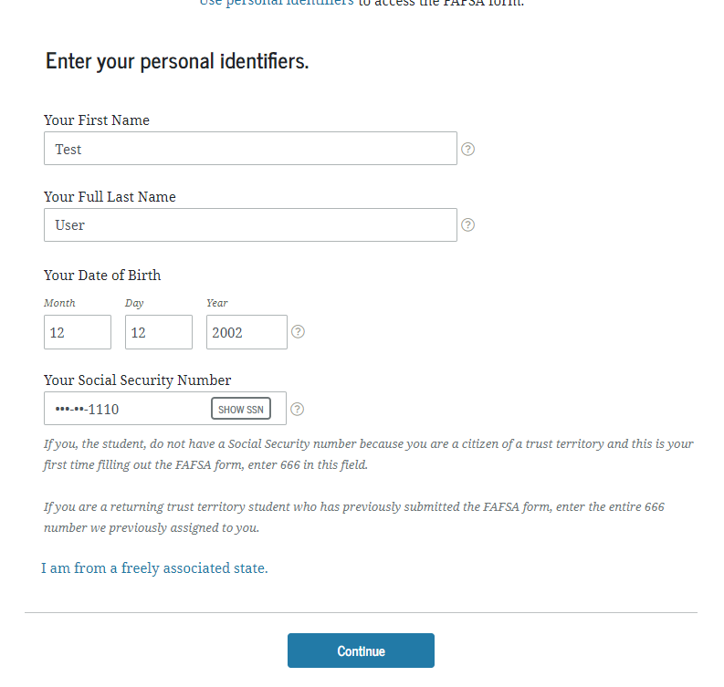
Role Selection
Notes:
Role Selection (3 of 3) view
The user may also choose to begin the FAFSA form with personal identifiers: first name, last name, date of birth, and Social Security number.
Once the user has entered in his or her personal identifiers, he or she will select “Continue.”

Slide 12
Log In Page
Notes:
Log In Page view
If the user has an FSA ID account, he or she will be prompted to log in with his or her credentials. If not, the user can select "Create an Account."

Slide 13
Dependent Student with Parental Data
Notes:
Dependent Student with Parental Data

Slide 14
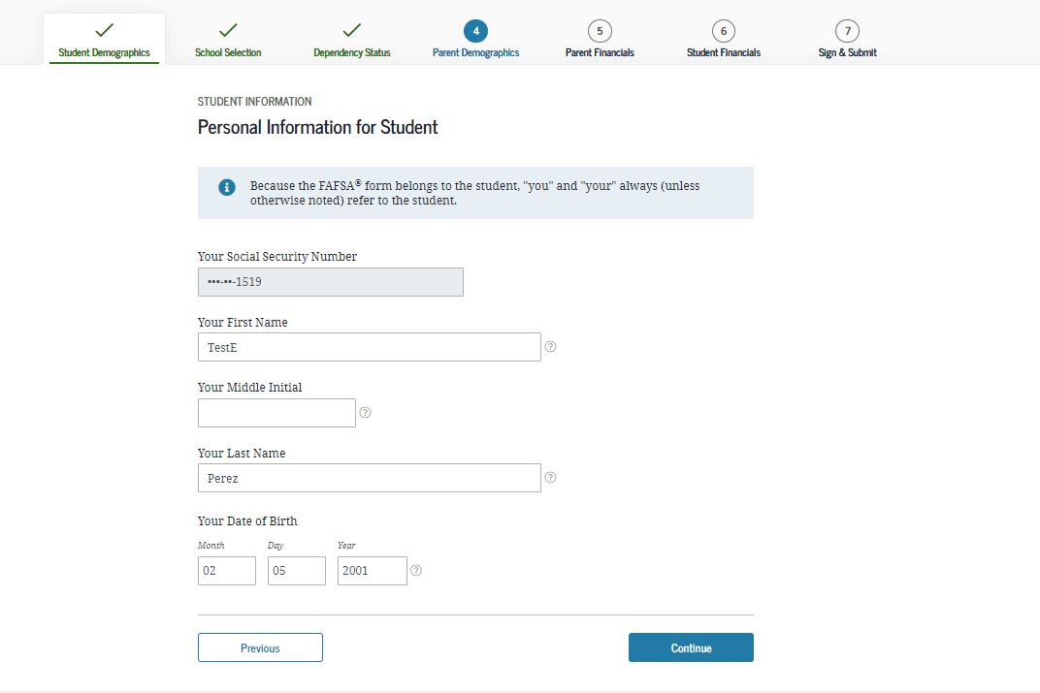
Personal Information for Student
Notes:
Personal Information for Student view
This is one of multiple pages on fafsa.gov that explains that “you” and “your” are referencing the student. Other pages where this messaging appears includes the "Search for High School," "Student Marital Status," "Parent Marital Status," and "Student Tax Filing Status." ​
Note: This is the first view for the Student Demographics section.

Slide 15
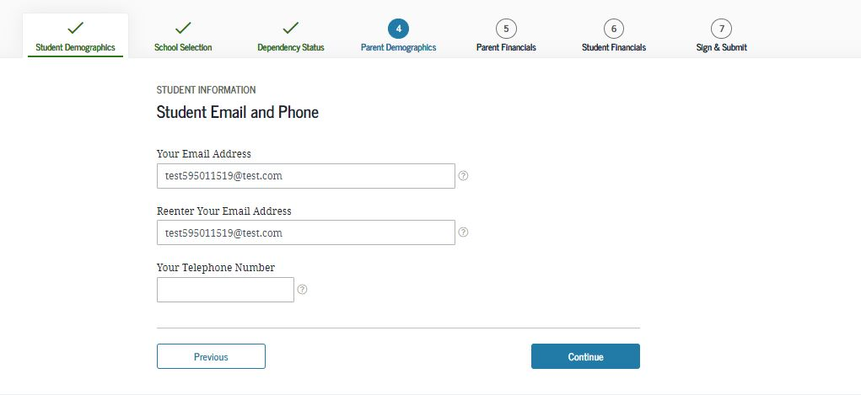
Student Email and Phone
Notes:
Student Email and Phone view
It is beneficial for the student to include an email address on the FAFSA form in order to receive important communications about the student’s financial aid.

Slide 16
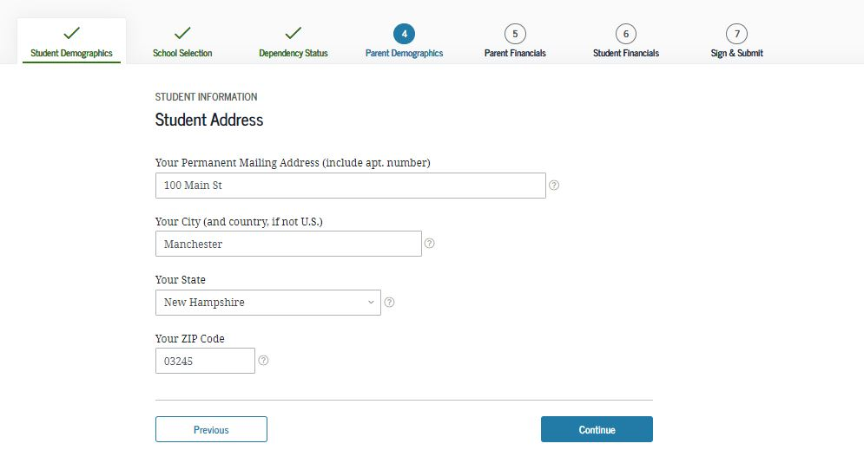
Student Address
Notes:
Student Address view

Slide 17
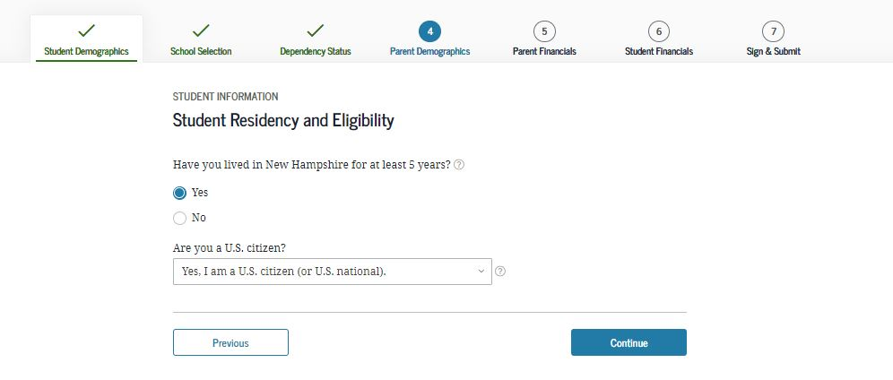
Student Residency and Eligibility
Notes:
Student Residency and Eligibility view

Slide 18
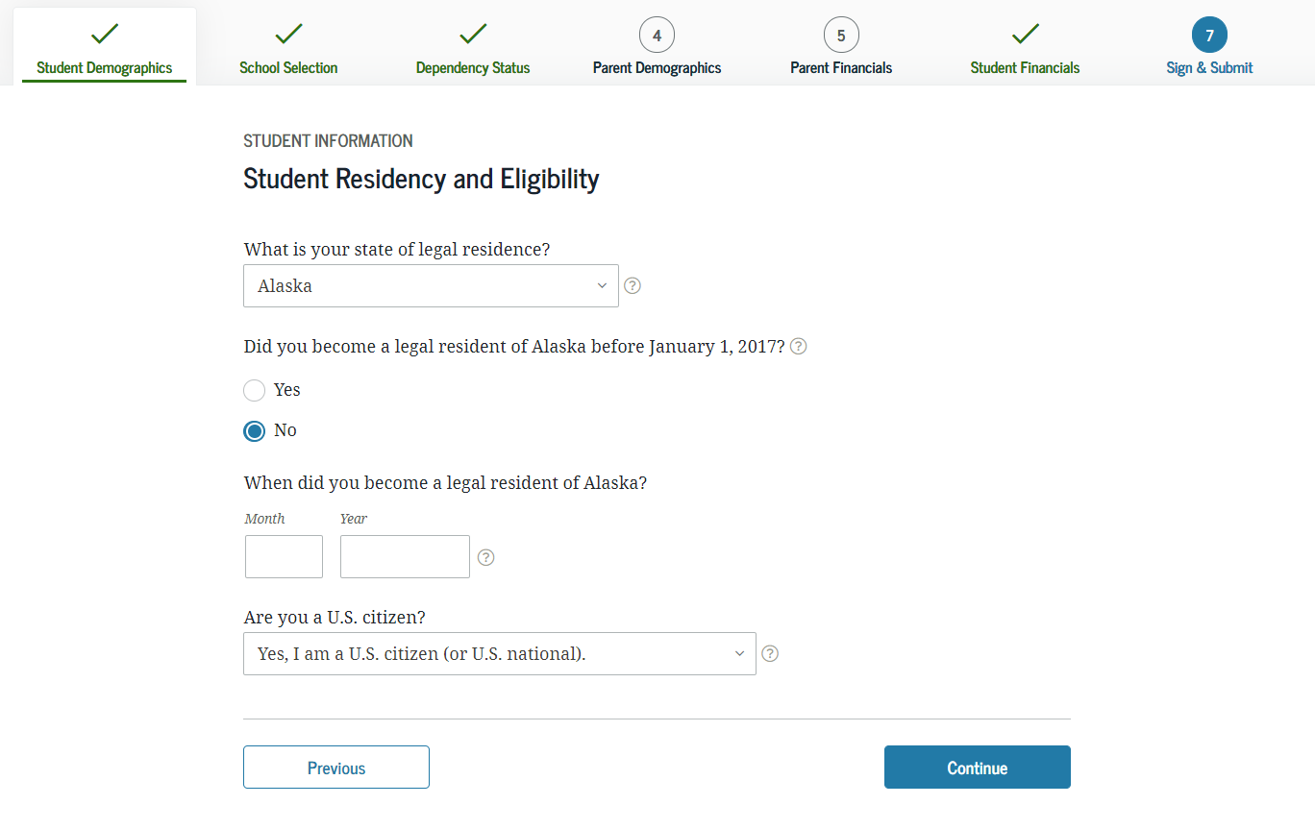
State of Legal Residence
Notes:
State of Legal Residence view

Slide 19
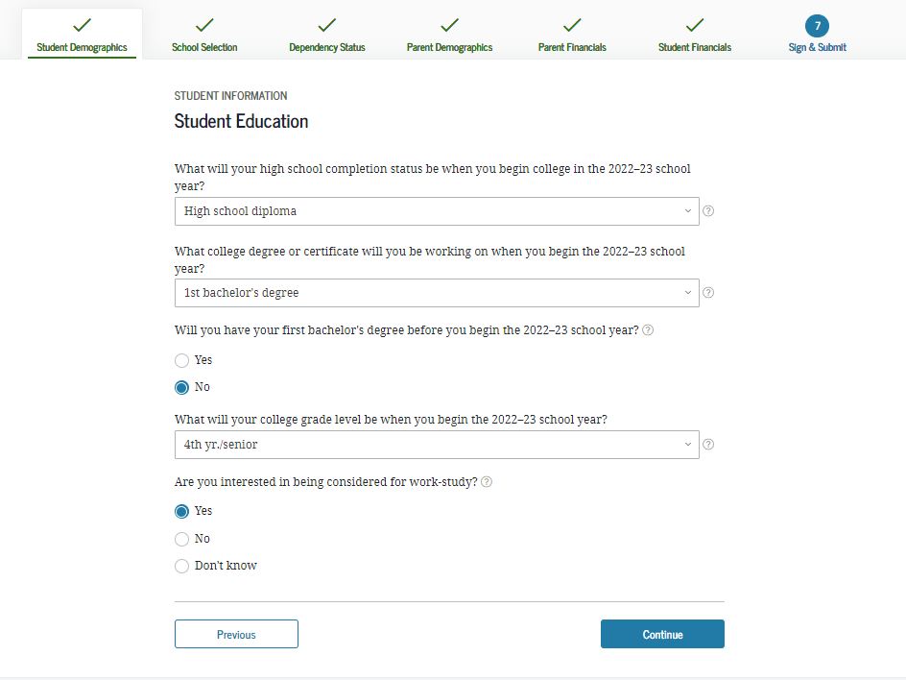
Student Education
Notes:
Student Education view

Slide 20
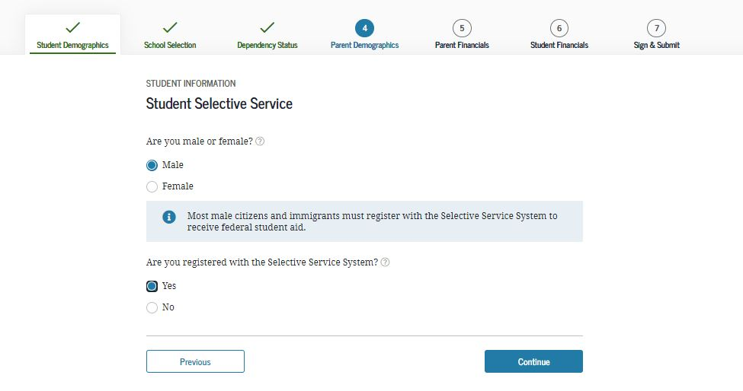
Student Selective Service
Notes:
Student Selective Service view
The response to this question is used to determine if the user needs to register with the Selective Service System. The answer to the Selective Service question will not impact the applicant’s eligibility to receive federal student aid.

Slide 21
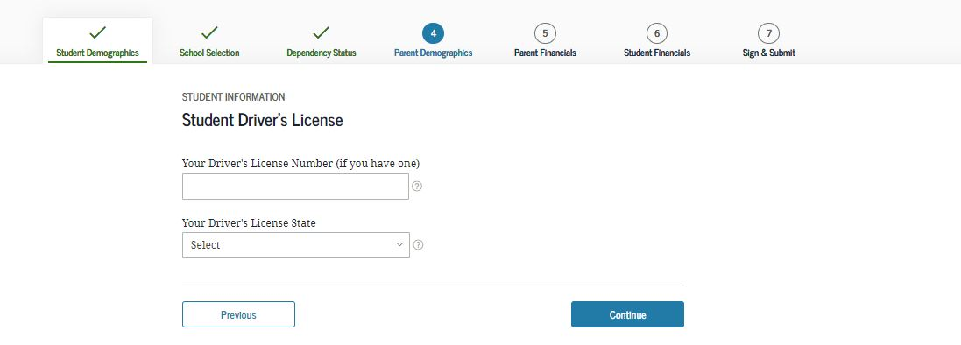
Student Driver’s License
Notes:
Student Driver’s License view

Slide 22
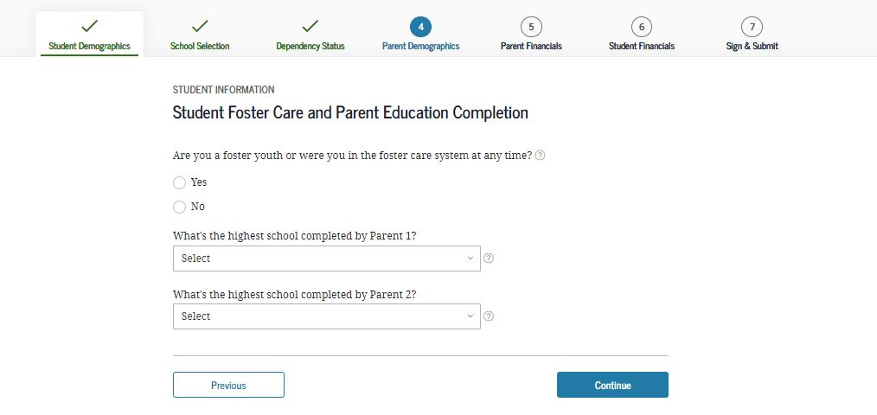
Student Foster Care and Parent Education Completion
Notes:
Student Foster Care and Parent Education Completion view

Slide 23
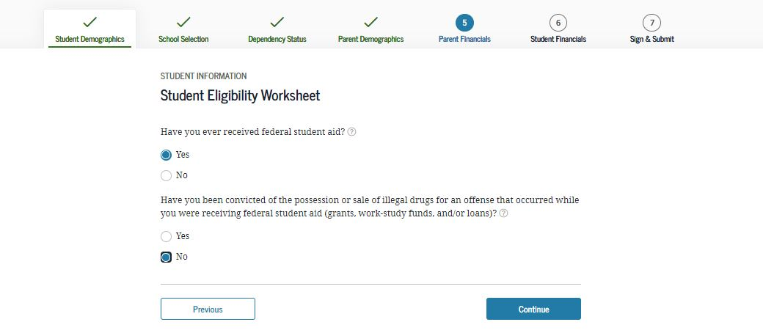
Student Eligibility Worksheet
Notes:
Student Eligibility Worksheet view
The answers to the student eligibility worksheet will not impact the applicant’s eligibility to receive federal student aid.

Slide 24
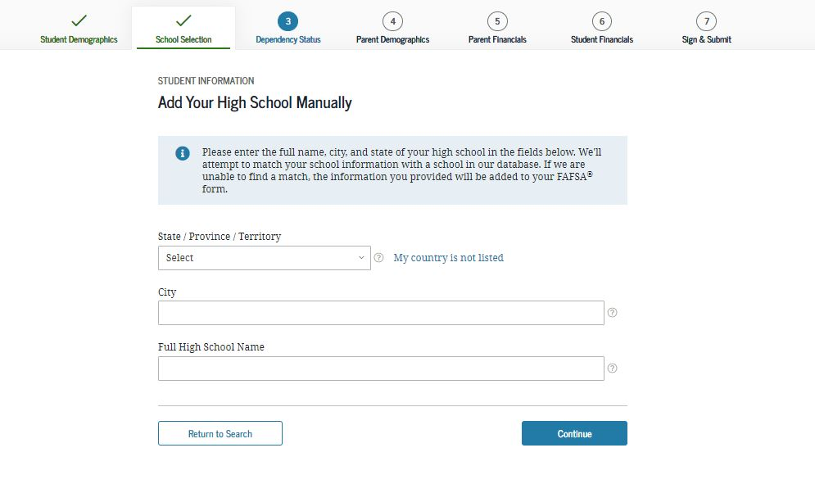
Add Your High School Manually
Notes:
Add Your High School Manually view
New: This functionality has been updated to allow the applicant to enter the full name, city, and state of the high school in the fields on this screen.

Slide 25
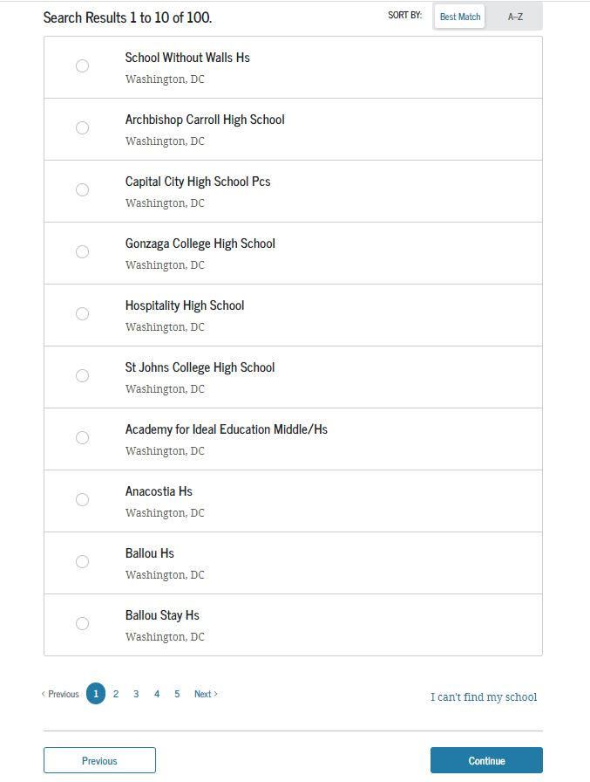
High School Search Results
Notes:
High School Search Results view

Slide 26
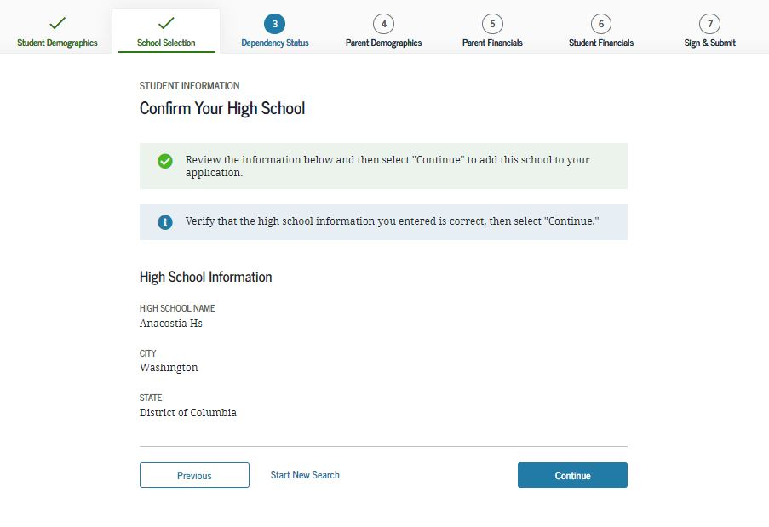
Confirm Your High School
Notes:
Confirm Your High School view

Slide 27
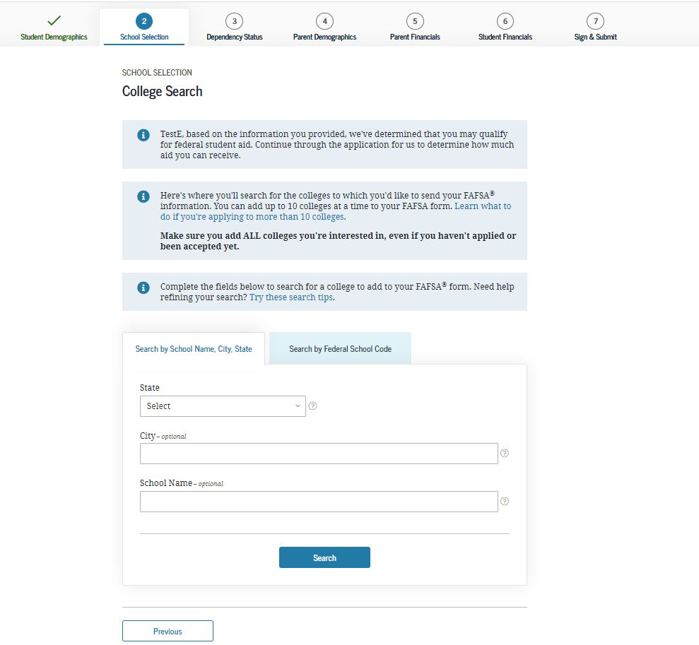
College Search
Notes:
College Search view

Slide 28
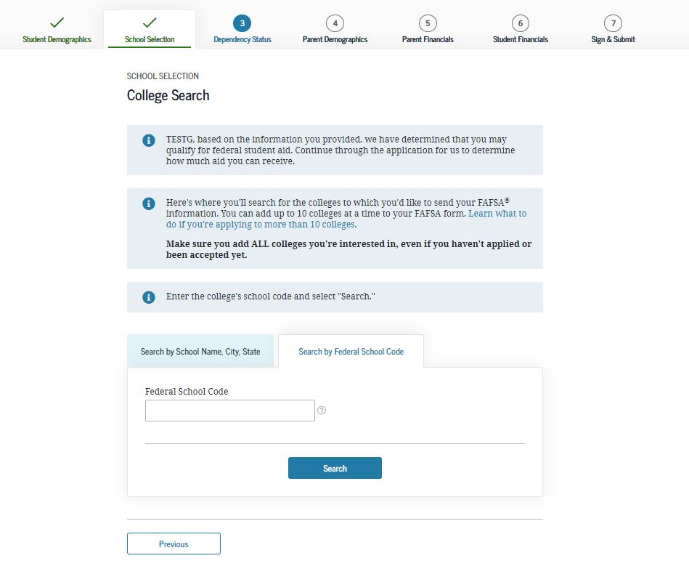
Search by Federal School Code
Notes:
Search by Federal School Code view

Slide 29
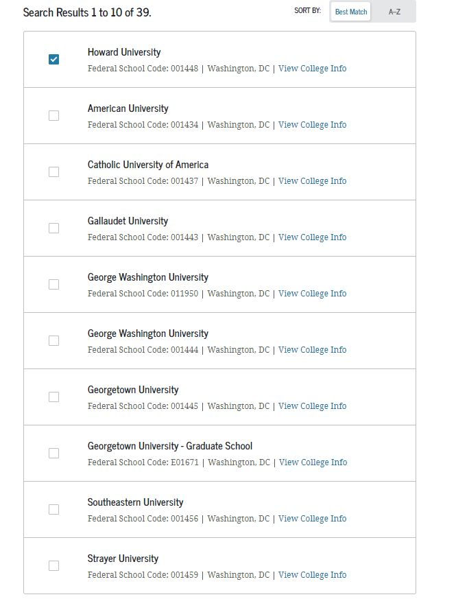
College Search Results
Notes:
College Search Results view

Slide 30
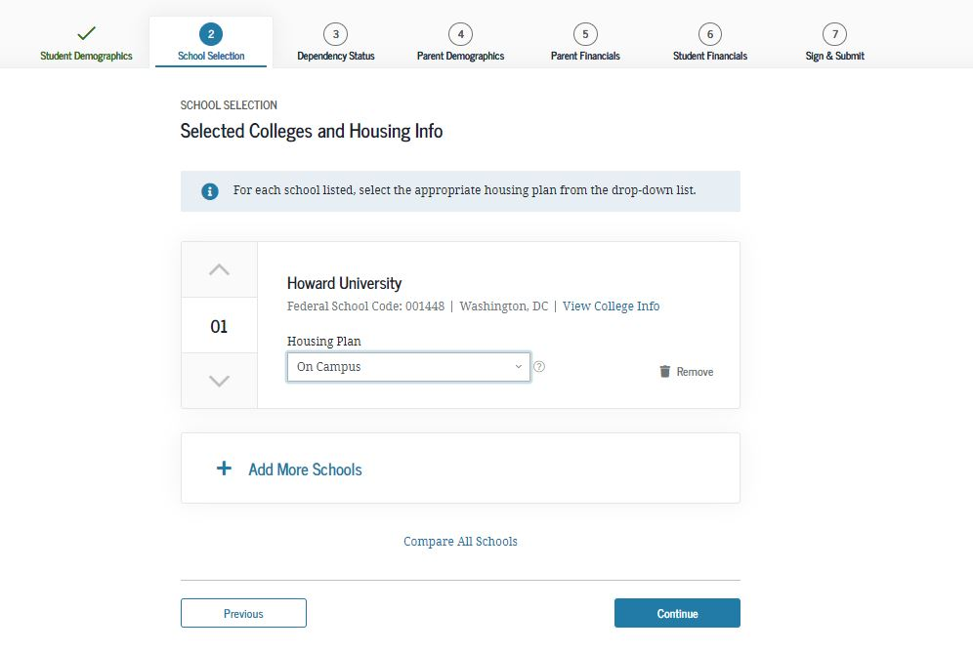
Selected Colleges and Housing Info
Notes:
Selected Colleges and Housing Info view
The applicant can reorder schools on this page which will not affect federal student aid but can affect state/school aid.

Slide 31
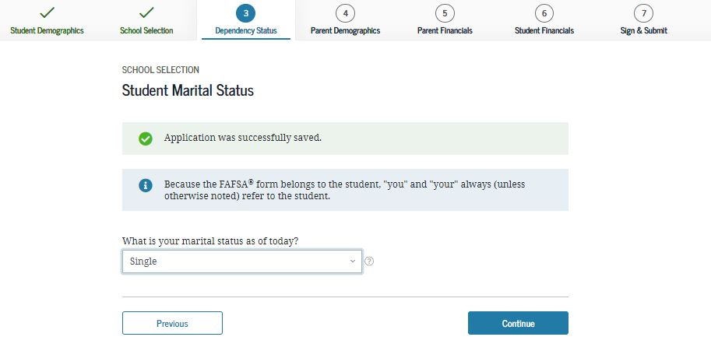
Student Marital Status
Notes:
Student Marital Status view
This is the first page of the Dependency Status section.

Slide 32
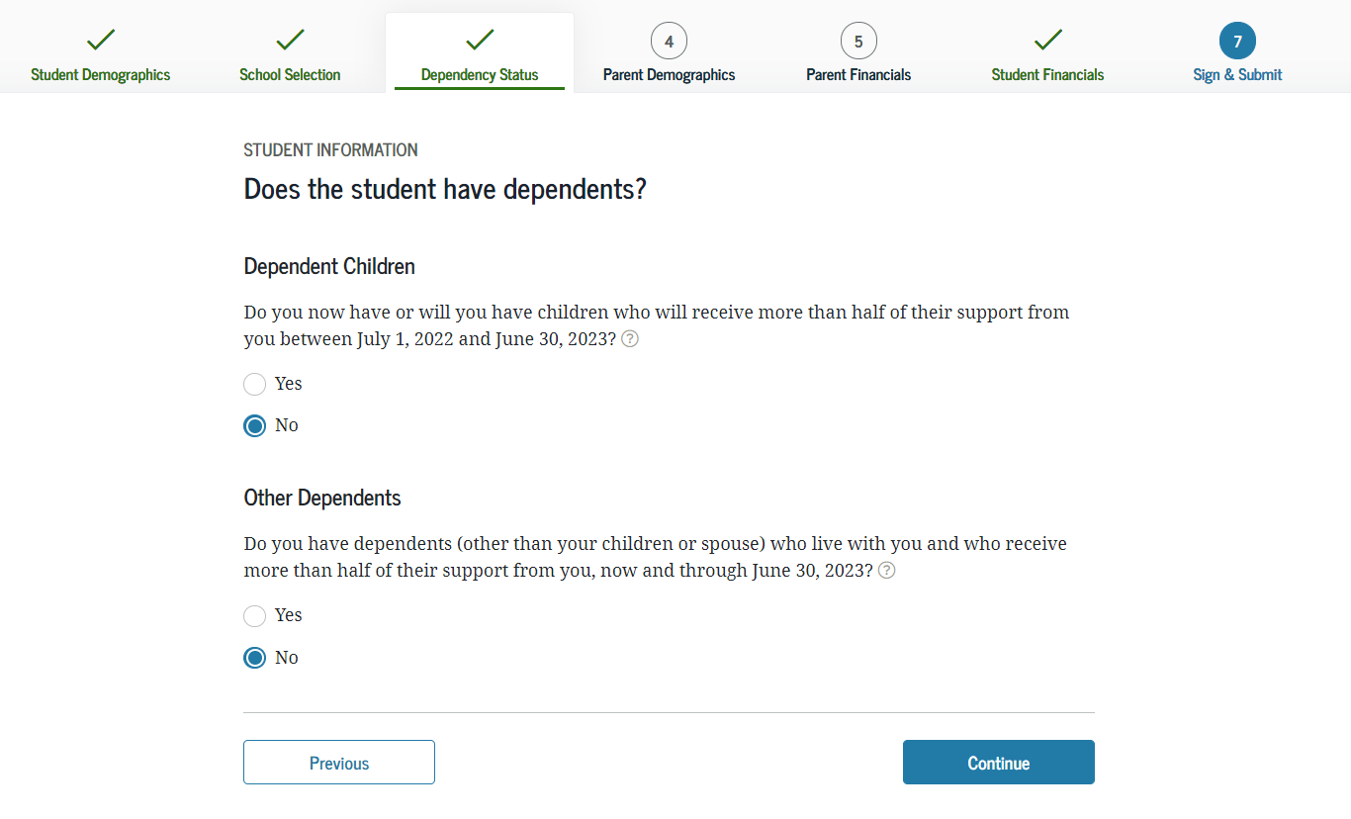
Does the Student Have Dependents?
Notes:
Does the Student Have Dependents? view

Slide 33
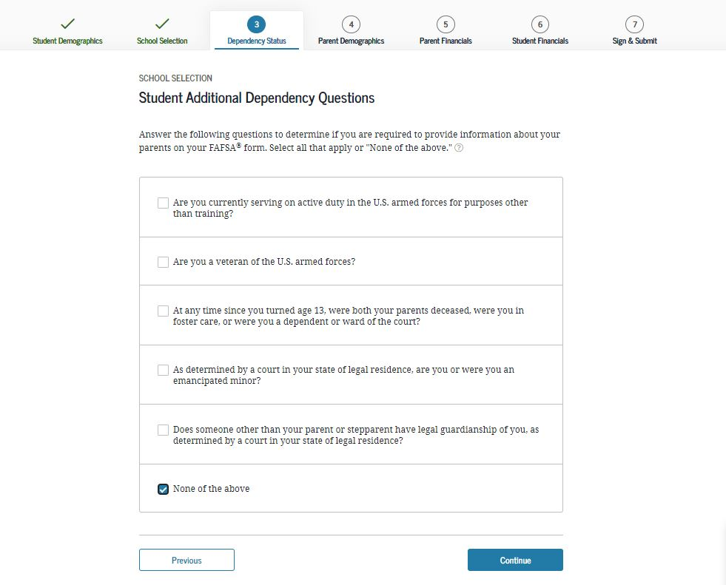
Student Additional Dependency Questions
Notes:
Student Additional Dependency Questions view

Slide 34
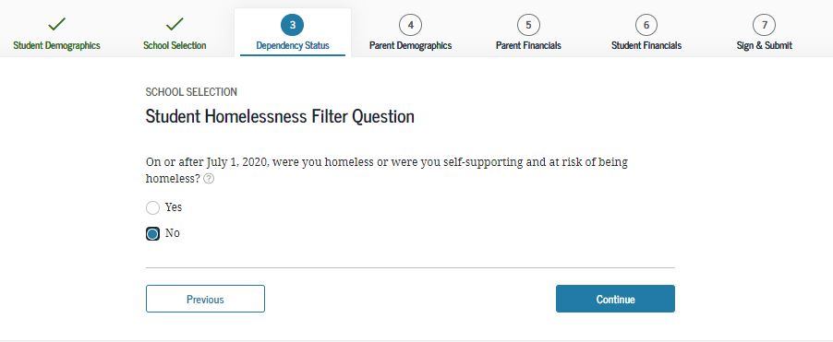
Student Homelessness Filter Questions
Notes:
Student Homelessness Filter Question view

Slide 35
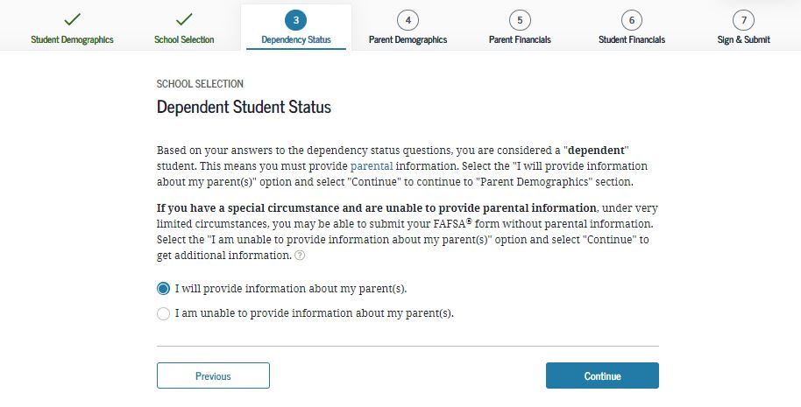
Dependent Student Status
Notes:
Dependent Student Status view
This page only displays if it has been determined that the applicant is considered to be a dependent student.

Slide 36
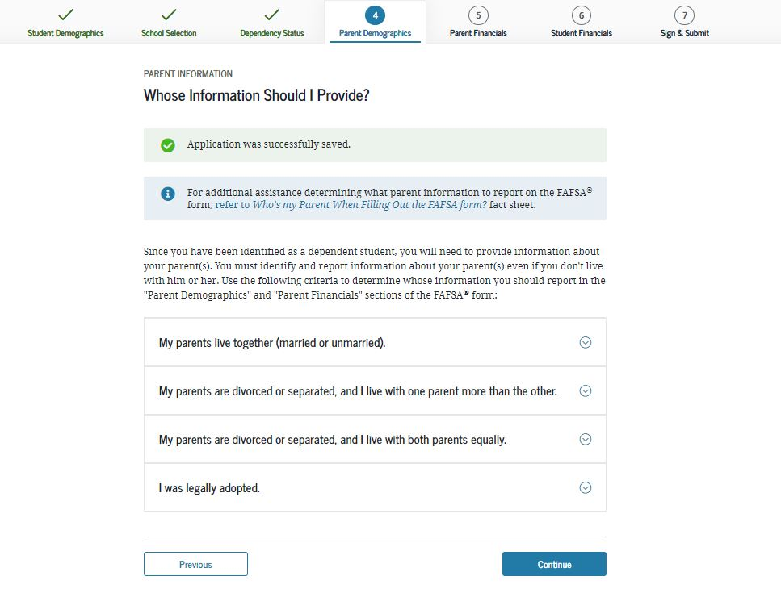
Whose Information Should I Provide?
Notes:
Whose Information Should I Provide? View
This is first view of the Parent Demographics section.

Slide 37
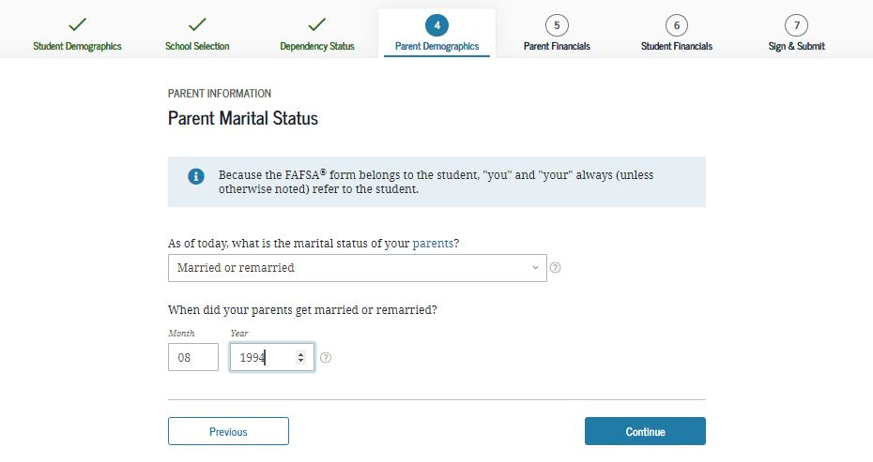
Parent Marital Status
Notes:
Parent Marital Status view

Slide 38
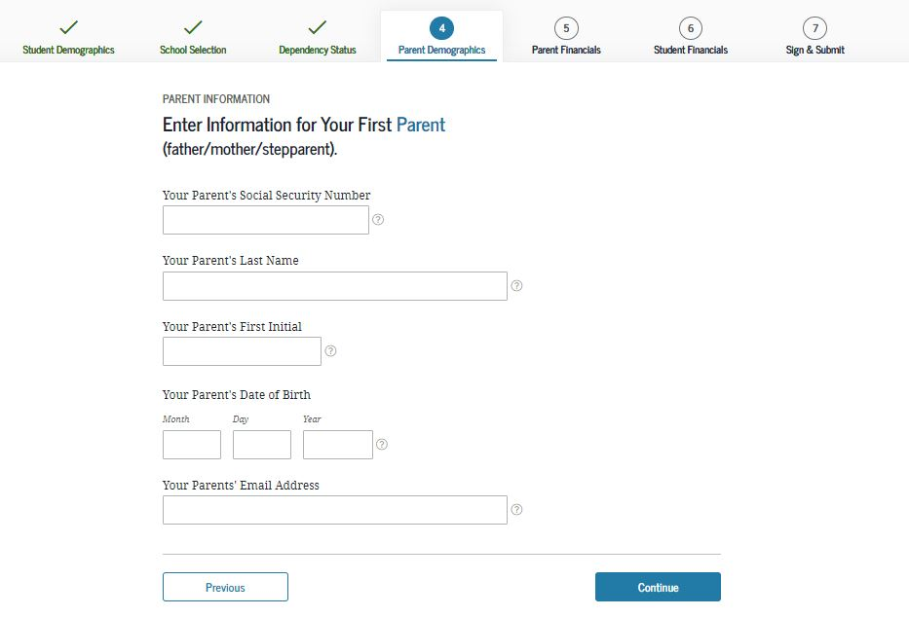
Personal Information for First Parent
Notes:
Personal Information for First Parent view

Slide 39
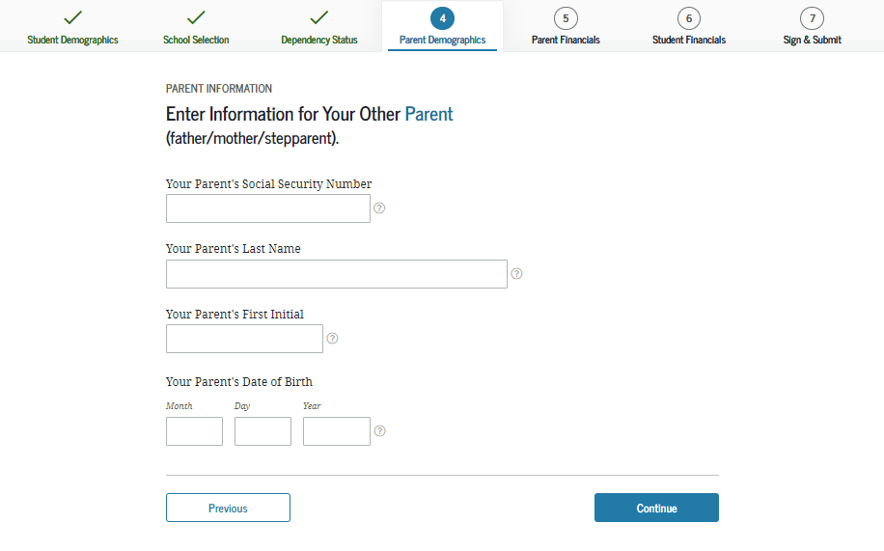
Personal Information for Other Parent
Notes:
Personal Information for Other Parent view

Slide 40
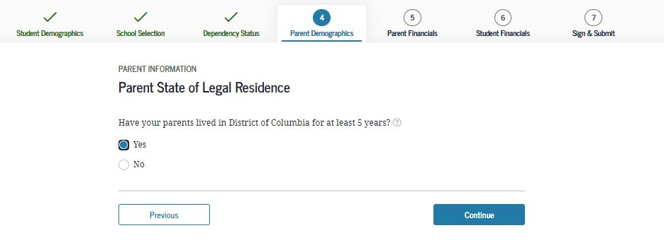
Parent State of Legal Residence
Notes:
Parent State of Legal Residence view

Slide 41
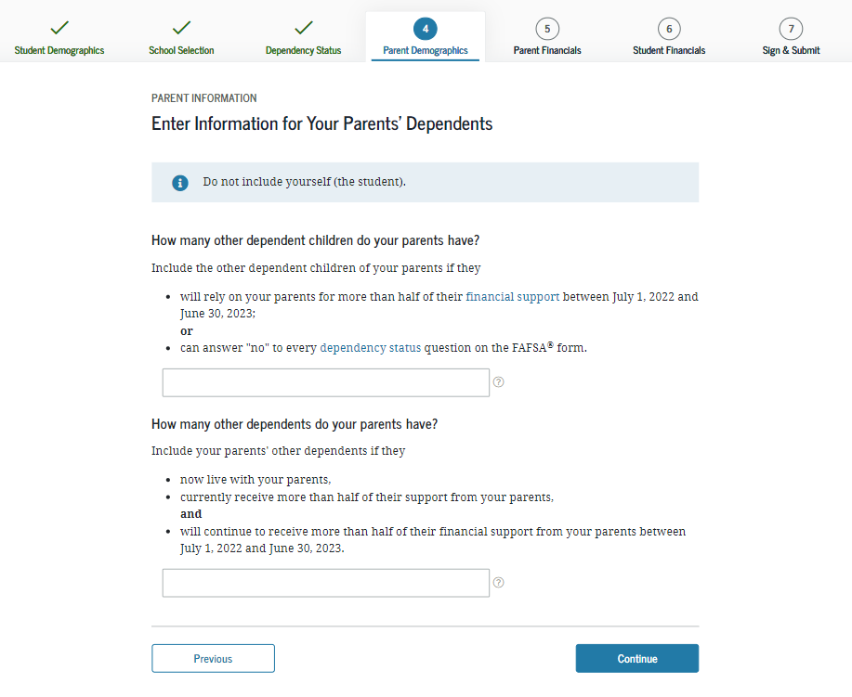
Enter Information for Your Parent’s Dependents (2 of 2)
Notes:
Enter Information for Your Parent’s Dependents view.

Slide 42
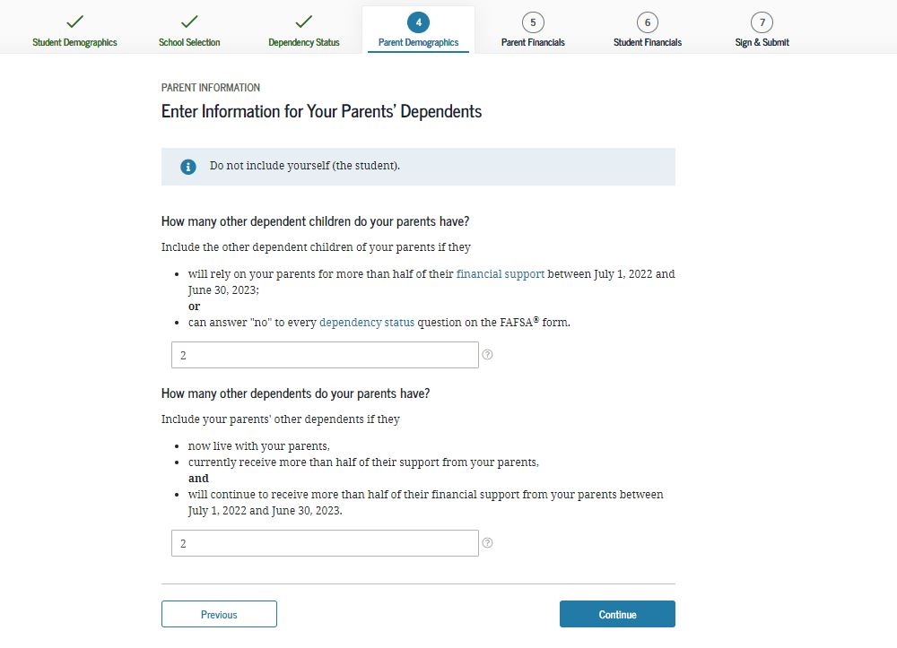
Enter Information for Your Parent’s Dependents
Notes:
Enter Information for Your Parent’s Dependents view
Note: In this view, the parent has additional dependents.

Slide 43
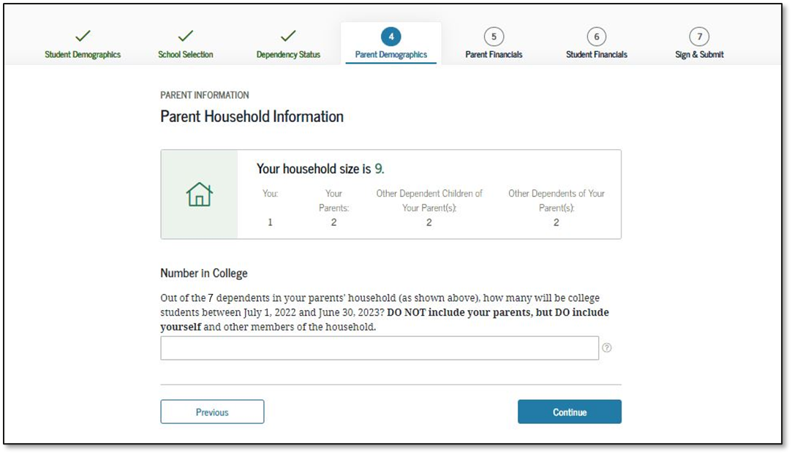
Parent Household Information
Notes:
Parent Household Information view
New: Household size is calculated based on previous answers. The applicant will enter the number of household members in college, including himself or herself.

Slide 44
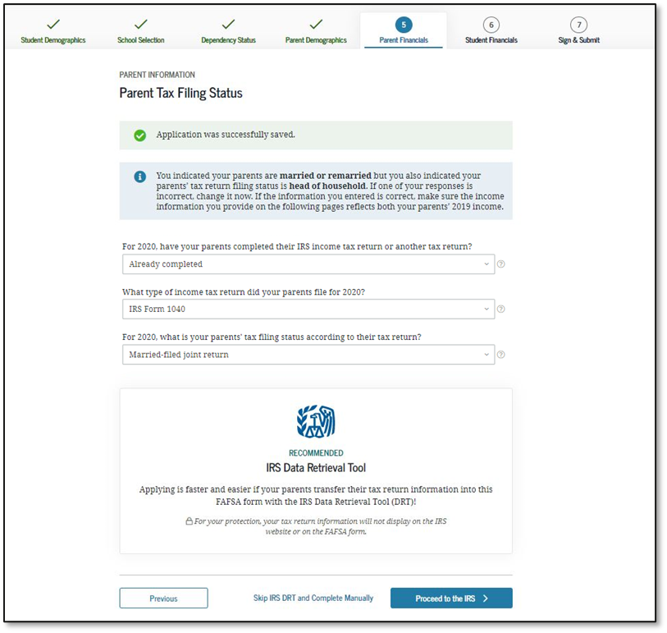
Parent Tax Filing Status
Notes:
Parent Tax Filing Status view
This view is displayed when the parent chooses not to use the IRS Data Retrieval Tool (DRT) on the previous view. An additional opportunity is presented to the parent to determine if he or she would like to link to the IRS for his or her financial information or to continue to enter it manually.
This is the first view in the Parent Financials section.

Slide 45
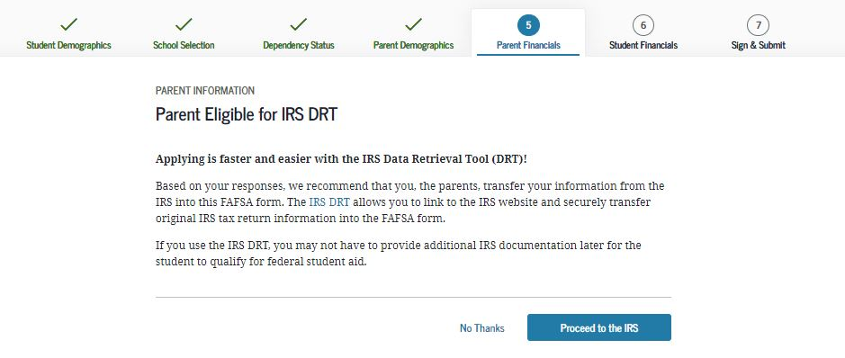
Parent Eligible for IRS DRT
Notes:
Parent Eligible for IRS DRT view

Slide 46
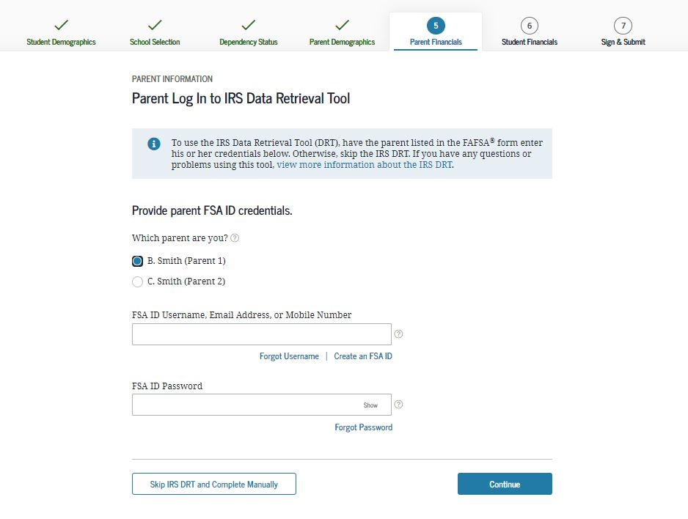
Parent Log In to IRS Data Retrieval Tool
Notes:
Parent Log in to IRS Data Retrieval Tool view
This screen only shows if the parent decides to use the IRS Data Retrieval Tool. In this example, the parent has indicated that he or she is married or living together.

Slide 47
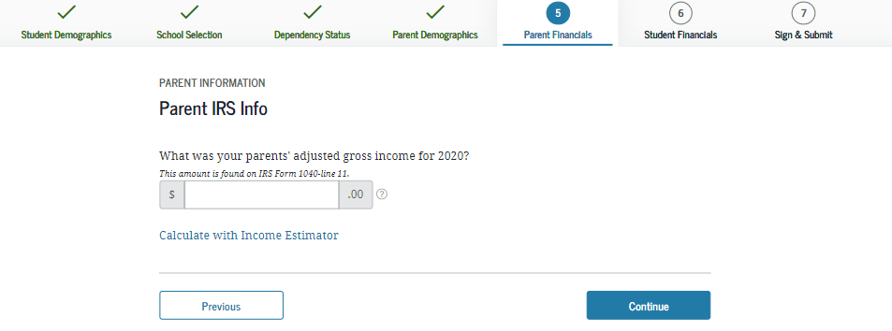
Parent IRS Info
Notes:
Parent IRS Info view
If the parent is either ineligible or decides not to use the IRS DRT, he or she will be required to enter his or her financial information manually.

Slide 48
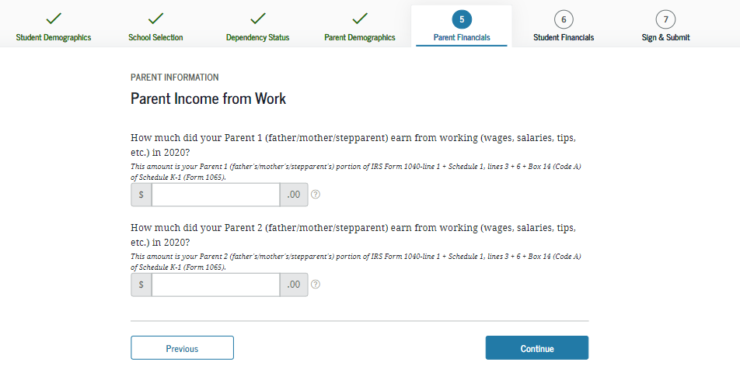
Parent Income from Work
Notes:
Parent Income from Work view

Slide 49
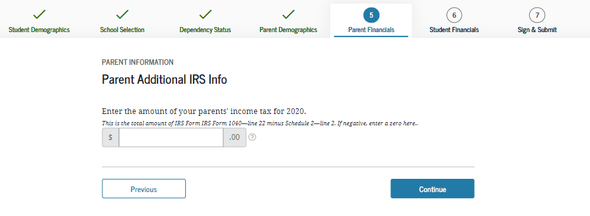
Parent Additional IRS Info
Notes:
Parent Additional IRS Info view

Slide 50
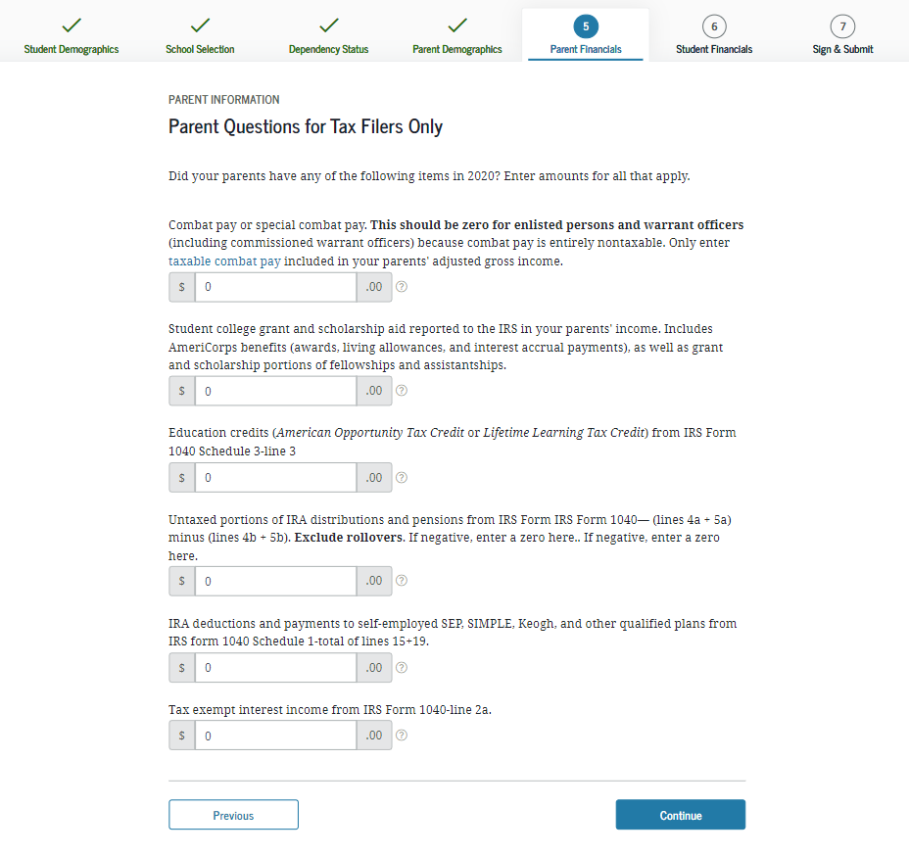
Parent Questions for Tax Filers Only
Notes:
Parent Questions for Tax Filers Only view

Slide 51
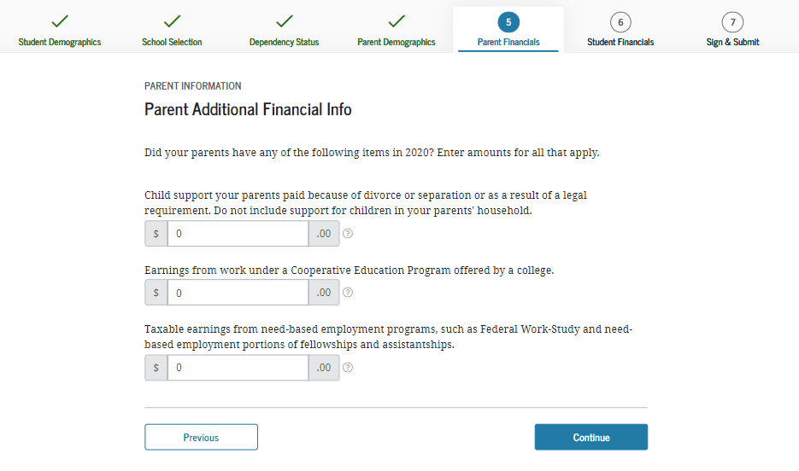
Parent Additional Financial Info
Notes:
Parent Additional Financial Info view

Slide 52
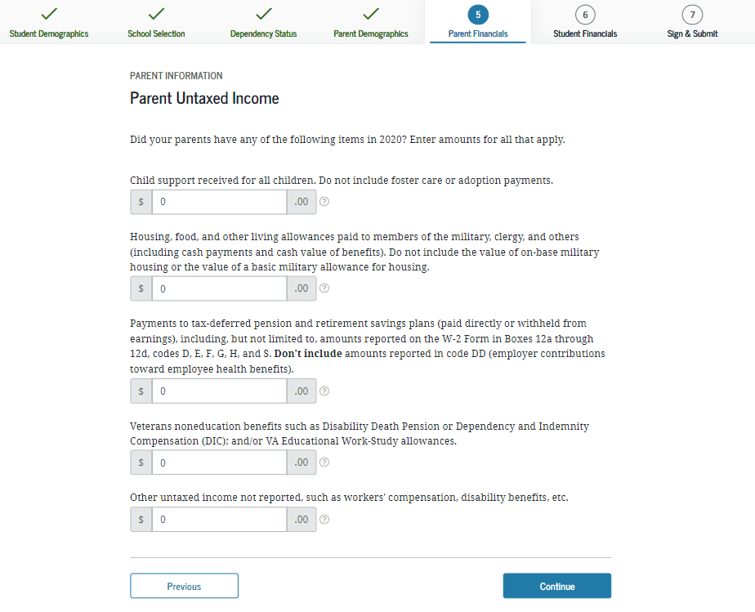
Parent Untaxed Income
Notes:
Parent Untaxed Income view

Slide 53
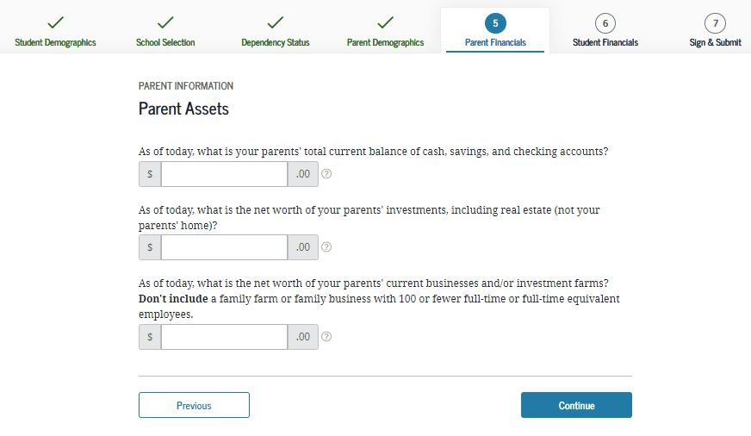
Parent Assets
Notes:
Parent Assets view

Slide 54
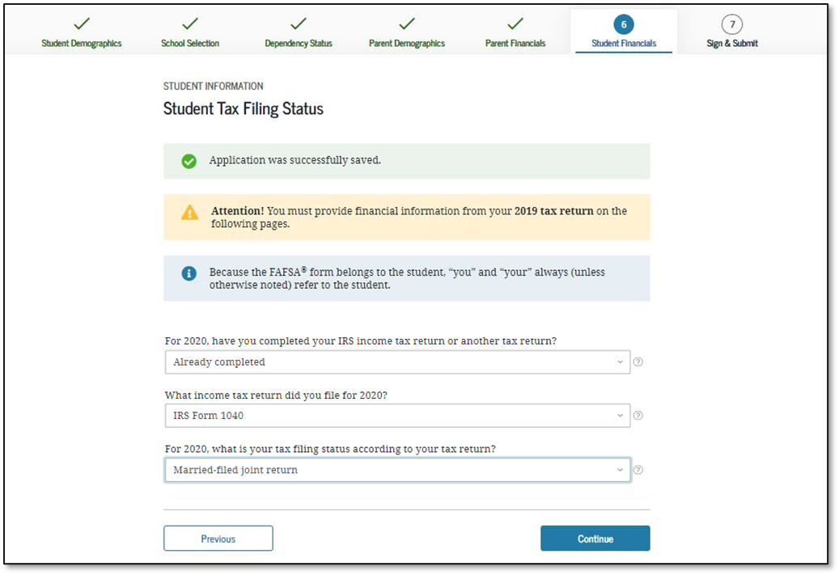
Student Tax Filing Status
Notes:
Student Tax Filing Status view
This is first view in the Student Financials section.

Slide 55
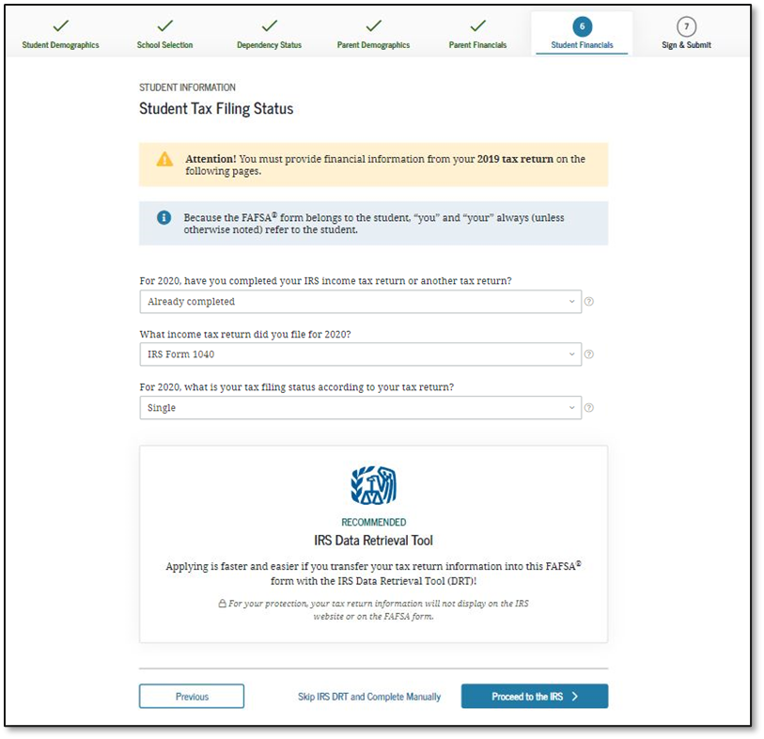
Student Tax Filing Status Dependent
Notes:
Student Tax Filing Status view
This view is displayed when the user chooses not to use the IRS Data Retrieval Tool on the previous view. An additional opportunity is presented to the user to determine if he or she would like to link to the IRS for his or her financial information or to continue to enter it manually.

Slide 56
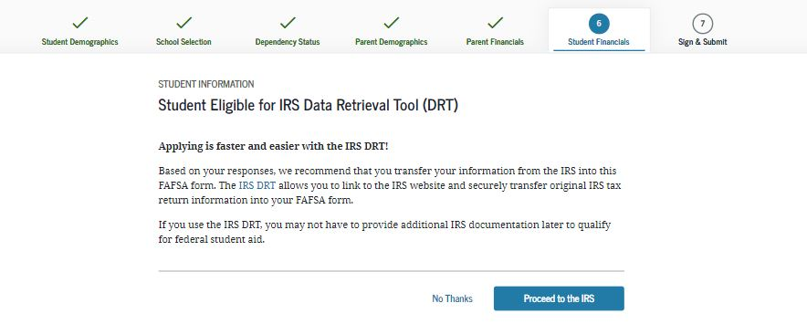
Student Eligible for IRS Data Retrieval Tool (DRT)
Notes:
Student Eligible for IRS Data Retrieval Tool (DRT) view

Slide 57
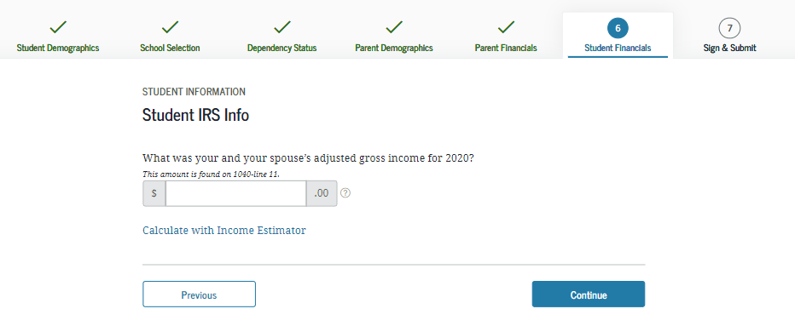
Student IRS Info
Notes:
Student IRS Info view
Note: If the user is either ineligible or decides not to use the IRS DRT, he or she will be required to enter his or her financial information manually.

Slide 58
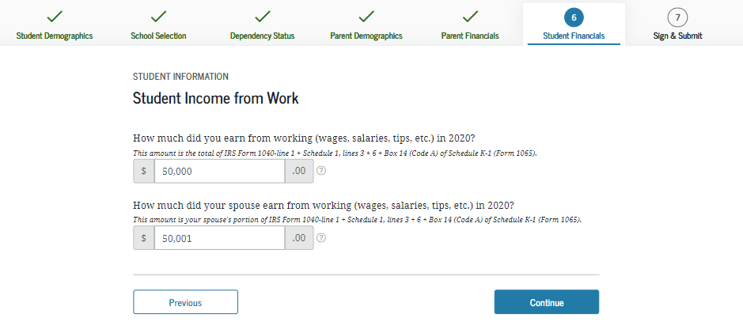
Student Income from Work
Notes:
Student Income from Work view

Slide 59
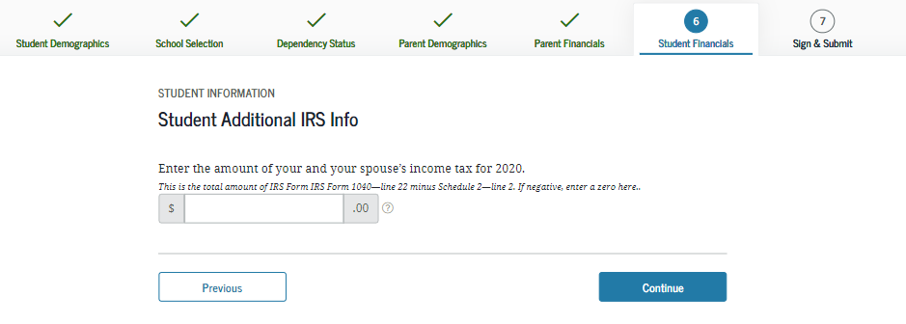
Student Additional IRS Info
Notes:
Student Additional IRS Info view

Slide 60
Student Questions for Tax Filers Only
Notes:
Student Questions for Tax Filers Only view

Slide 61
Student Additional Financial Info
Notes:
Student Additional Financial Info view

Slide 62
Student Untaxed Income
Notes:
Student Untaxed Income view

Slide 63
Student Assets
Notes:
Student Assets view

Slide 64
Preparer Info
Notes:
Preparer Info view
New: The Preparer view will now only show if someone has logged in under the Preparer role.

Slide 65
FAFSA Summary
Notes:
FAFSA Summary view

Slide 66
FAFSA Summary 1
Notes:
FAFSA Summary view – Student Demographics and School Selection
Note: Users can use the hyperlinks in the summary to edit any question in the form.

Slide 67
FAFSA Summary 2
Notes:
FAFSA Summary view (continued) – School Selection and Dependency Status

Slide 68
FAFSA Summary 3
Notes:
FAFSA Summary view (continued) – Parent Demographics and Parent Financials

Slide 69
FAFSA Summary 4
Notes:
FAFSA Summary view (continued) – Parent Financials Continued

Slide 70
FAFSA Summary 5
Notes:
FAFSA Summary view (continued) –Student Financials and Sign and Submit

Slide 71
Agreement of Terms
Notes:
Agreement of Terms student view
This is where the student acknowledges the Certification Statement.

Slide 72
Signature Status
Notes:
Signature Status view
The student’s signature was accepted, and now the parent will need to sign.

Slide 73
Parent Signature Selection
Notes:
Parent Signature Selection view
The choice between parents is only present if information was provided for two parents. Otherwise, this view does not display.

Slide 74
Agreement of Terms Dependent
Notes:
Agreement of Terms parent view
This is where the parent acknowledges the Certification Statement.

Slide 75
Signature Options
Notes:
Signature Options view

Slide 76
Parent Signature Selection
Notes:
Parent Signature Selection view
The choice between parents is only present if information was provided for two parents. Otherwise, this view does not display.

Slide 77
Confirmation Page
Notes:
Confirmation Page view

Slide 78
FEDERAL VERIFICATION

Slide 79
VERIFICATION
Students may be selected for a process called verification and must submit documents to confirm FAFSA information.
Roughly 18% of FAFSAs are selected for verification by the U.S. Department of Education. Students eligible for a Pell Grant will be selected at a much higher rate.
Students should respond quickly to any requests for information from the college.
If a student is not selected by the federal processor, a school may choose to institutionally select the FAFSA for verification if they have reason to question something.
The Department of Education suspended verification on July 13, 2021 for the remainder of the 2021-2022 academic year. However, verification is returning for the 2022-2023 FAFSA.

Slide 80
VERIFICATION
If selected, commonly requested documents include:
Verification Worksheet (these can look different across varying colleges and universities)
Federal Tax Return Transcript or Federal Tax Return for parents/student if they filed 2020 taxes
An alternative to submitting tax documentation is completing the IRS Data Retrieval Process within the FAFSA
W-2(s) for parents/students if they worked in 2020 but did not file taxes
Verification of Non-Filing Letter for parents and independent students who did not file 2020 taxes – (4506T request form) this is NOT needed for dependent students
Notes:
Verification can be a lot of work, especially for a student applying to multiple schools because they will need to complete verification at all schools in most cases to receive their award offers.
USING DRT could decrease the change of being selected for verification.
Like with most agencies, the IRS is also working remotely, so there may be a delay in requesting paper documents. If the family can complete these requests online, they will be encouraged to do so.

Slide 81
SPECIAL CIRCUMSTANCES

Slide 82
SPECIAL CIRCUMSTANCES
Eligibility for financial aid in 2022-2023 will be based on the 2020 tax year which may not be indicative of a family’s current ability to pay for educational expenses.
To remedy this, a financial aid administrator may evaluate special circumstances on a case-by-case basis, with adequate documentation, to better reflect a family’s financial picture.
Due to the COVID-19 pandemic, schools are preparing for an increase in appeals based on losses of income in 2020 and 2021..

Slide 83
SPECIAL CIRCUMSTANCES
Special Circumstances are conditions that exist which cannot be documented or explained on the FAFSA. Examples:
Loss or reduction of employment, wages, or unemployment compensation
Loss of untaxed income or benefits such as child support
Separation, divorce or death after the FAFSA was submitted

Slide 84
EXAMPLES OF SPECIAL CIRCUMSTANCES
Loss of Child Support
Unusual uncovered medical/dental expenses
Extraordinary dependent care
Parent or spouse death
Loss of income/ employment
Divorce

Slide 85
Resources

Slide 86
FAFSA HELP OHIO
Source for financial aid resources and tools provided by OASFAA
Training registrations are located here
Send questions to outreach@oasfaa.org

Slide 87
FAFSA HELP OHIO
FAFSA events
Add any FAFSA events you may be hosting
Resources for students and parents
Instructional Videos
Handouts
You can link this to your school site.

Slide 88
HIGH SCHOOL FINANCIAL AID NIGHTS
The OASFAA Outreach Committee can help facilitate your school’s financial aid presentation, even virtually. If you would like a presentation, please complete a request for a presenter on the OASFAA website.
A pre-recorded session is also available.

Slide 89
COLLEGE ACCESS AND SCHOOL COUNSELORS CONTACT DATABASE
Make sure you put your name and email address into our College Access and School Counselors Contact Database at www.oasfaa.org

Slide 90
QUESTIONS

