Slide 1
2024-2025 Financial Aid Process
Faith Phillips
Director, Student Financial Services
Ohio State Newark & Central Ohio Technical College

Slide 2
The Financial Aid Process begins with the FAFSA Form StudentAid.gov
The Free Application for Federal Student Aid
Watch for websites not affiliated with or endorsed by the U.S. Department of Education (ED) that charge a FEE.
Do not to pay for assistance that is provided for free.

Slide 3
2024-2025 Financial Aid Timelines
For students beginning enrollment Fall 2024 (possibly Summer 2024)
Typically available online October 1.
2024-2025 DATE yet to be Announced.
Submit early/meet college FAFSA Priority Date
**Early application allows time to compare aid offers and could maximize aid eligibility
Student does not need to be admitted to submit the FAFSA
**College may not review FAFSA/offer aid until admitted
Re-apply/submit the FAFSA every year
**2025-2026 FAFSA should go live on October 1, 2024

Slide 4
The FAFSA Form
Application for:
Federal grants, work-study, and student loans
State of Ohio grants
For some schools, institutional scholarships and grants
Information provided:
Demographic
Taxable and untaxed income for 2022
Assets (date the FAFSA is signed)
Students should submit the FAFSA regardless of income.
Income is not the only factor in determining eligibility.

Slide 5
Student Aid Index
Index figure used by schools to determine eligibility for aid
Calculated results from information provided on the FAFSA
Calculated using a formula established by law
Same figure reported to all schools
Factors that determine the SAI:
Student and parent income (taxed and untaxed) for 2022
Assets
Family Size

Slide 6
Federal Student Aid (FSA) ID
Account username and password
Legal electronic signature
Required to access the FAFSA form
Required of all students and parents
Request at least 3 days before starting FAFSA
You will need:
Social Security Number
Parent that does not have an SSN will have separate verification process
Using information from credit bureaus
This process is NOT available yet
Mobile number and email address
Do not use school email address
Each parent and student must have separate mobile number and email

Slide 7
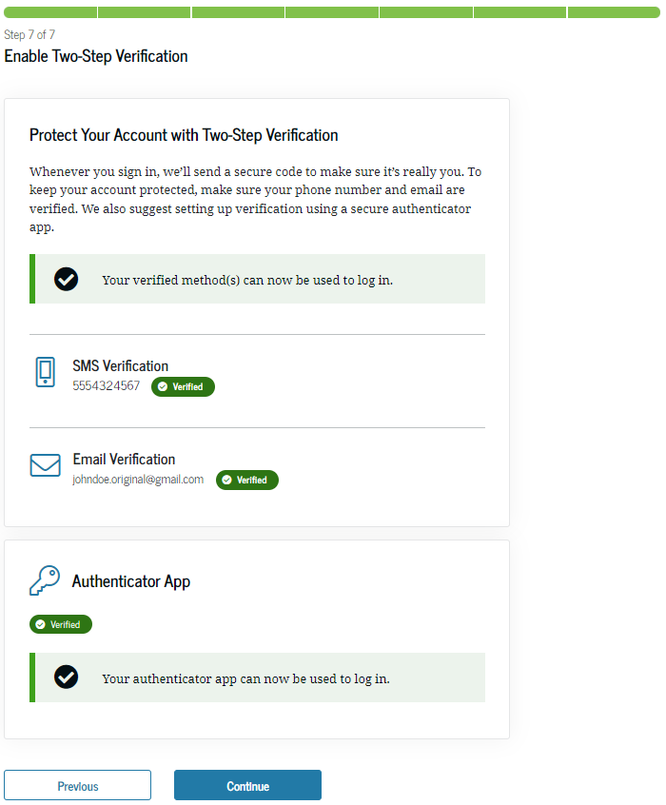
Multi-Factor Authentication (MFA)
Creating FSA ID requires use of MFA
Use MFA one-time code by:
Email
Text
Authenticator app (download from mobile store)
When FSAID is created you are presented with a one-use back-up code
WRITE THIS DOWN (You will not be presented with it again)
Used to access account if you cannot use any other MFA
Once used, MFA is disabled. Re-enable in your account settings
If you cannot log in with MFA or backup code call 1-800-433-3243

Slide 8
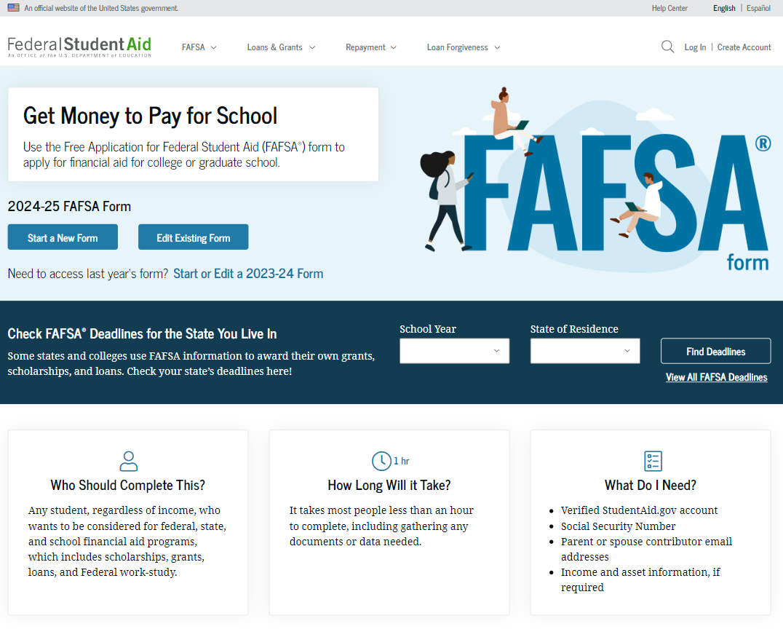
Student FAFSA®
Form Landing Page

Slide 9
Contributors
Anyone who provides information on the FAFSA
Student (and spouse if married)
Parent/Parents (for dependent students)

Slide 10
Overview of Contributors to the FAFSA
Designed to allow each contributor to complete the portion pertinent to them.
Each contributor must provide consent and approval for retrieval and disclosure of their Federal Tax Information (FTI).
All contributors must complete and sign their respective sections.
An incomplete application will not have an SAI calculated and the applicant will not be eligible for federal, state and some institutional aid.

Slide 11
Dependency Status
Dependent = Parent(s) apply with the student.
Independent = Student (and spouse) apply without parent(s).
Categories that make a student independent:
Age = 24 as of January 1
Graduate Student
Married
Veteran/Active Duty
Children/Dependents
Orphan/Ward of Court/Foster Care = Age 13 or older
Emancipation/Legal Guardianship
Homeless or at risk of homeless and self-supporting
Most high school students will be dependent.

Slide 12
Parent of Record on the FAFSA
Biological or Adoptive Parent(s)
If not married BUT living together report BOTH parents
If biological parents are divorced or never married:
Provide information for the parent that provides most financial support in 12 months prior to completing the FAFSA.
If support provided is equal, report for the parent with the greater income and assets.
EVEN if the student does not live with that parent.
If parent is re-married, report information about their spouse (student’s step-parent)

Slide 13
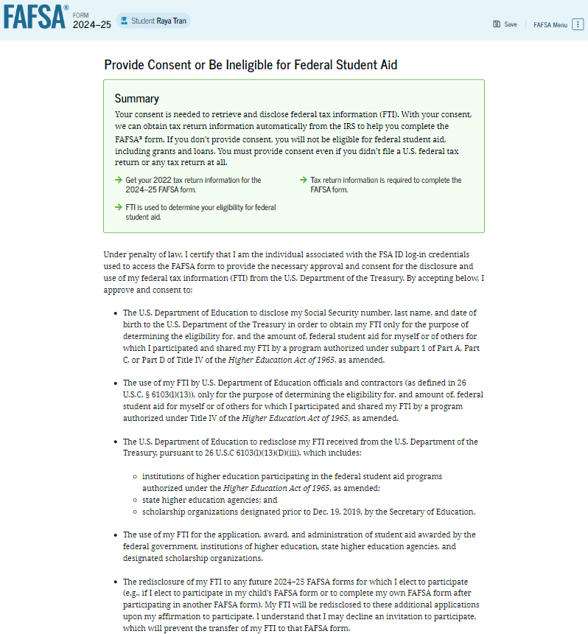
Student Provides Consent
By providing consent, the student’s federal tax information is transferred directly into the FAFSA® form from the IRS.

Slide 14
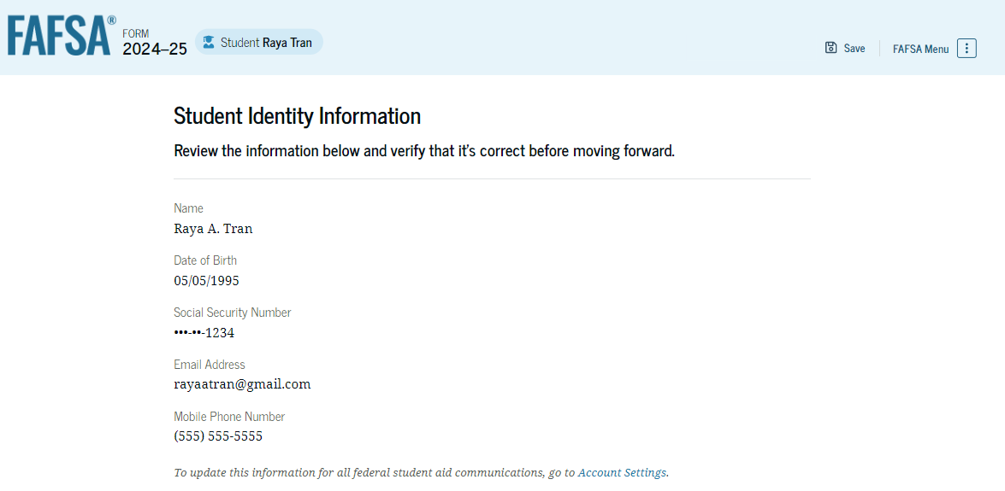
Student Identity Information

Slide 15
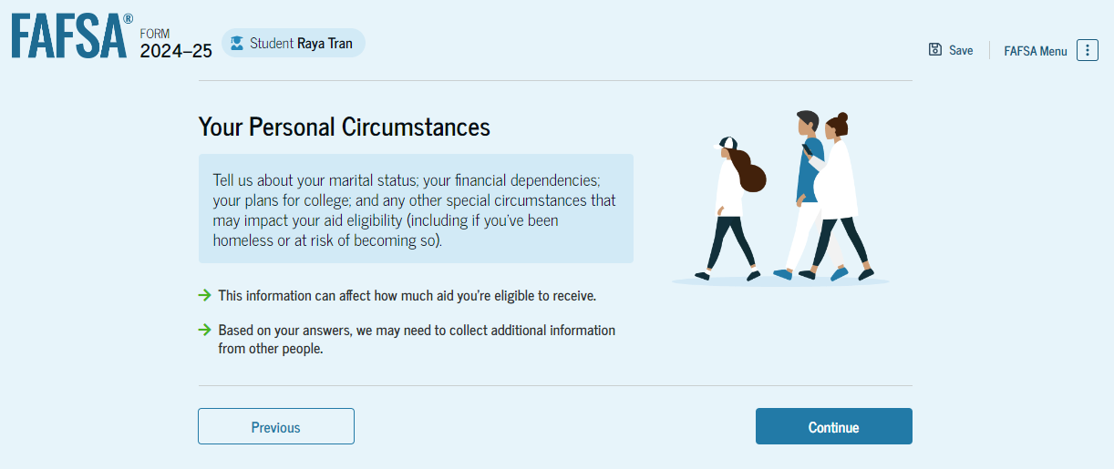
Introduction: Student Personal Circumstances

Slide 16
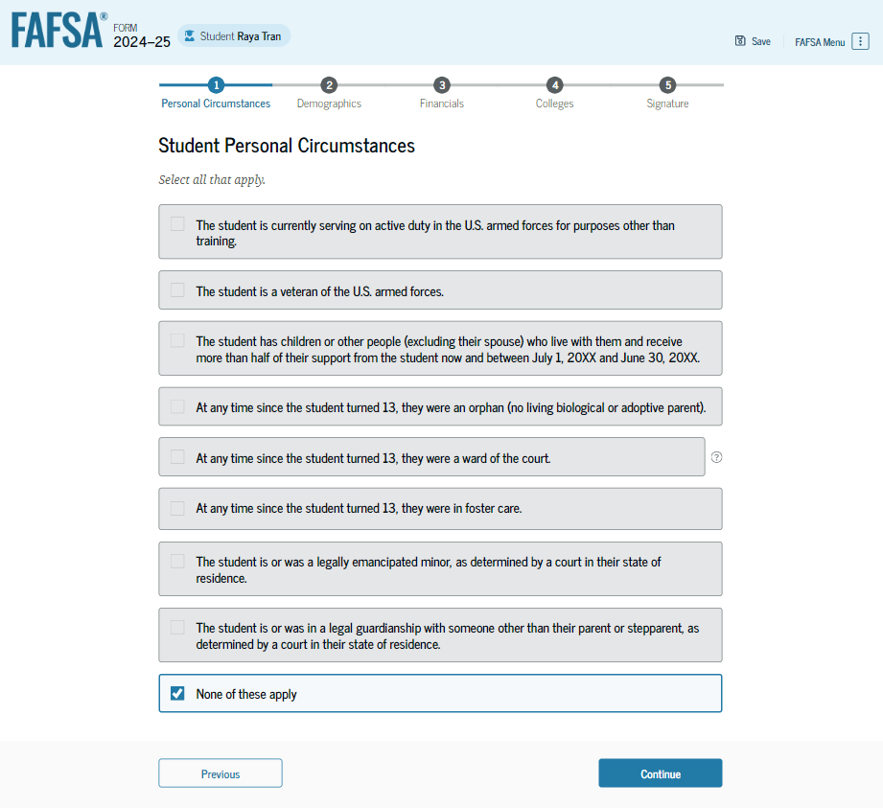
Student Personal Circumstances
The student is asked if any of the listed personal circumstances apply to them to determine the Dependency Status.

Slide 17
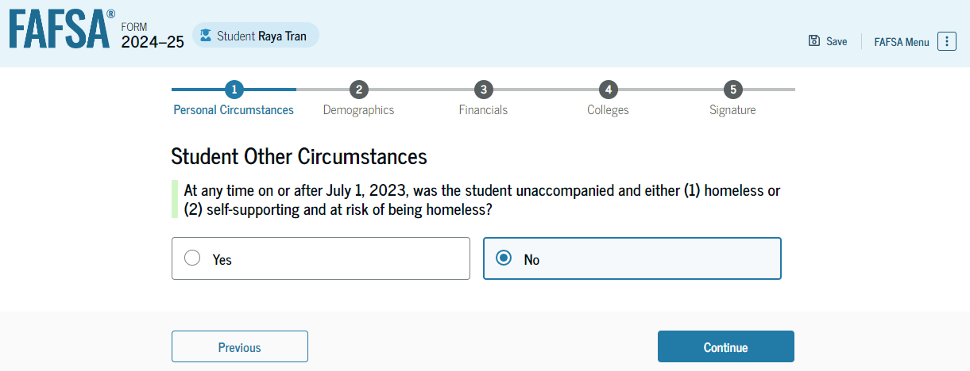
Student Other Circumstances
The student is asked if they were homeless or at risk of being homeless.

Slide 18
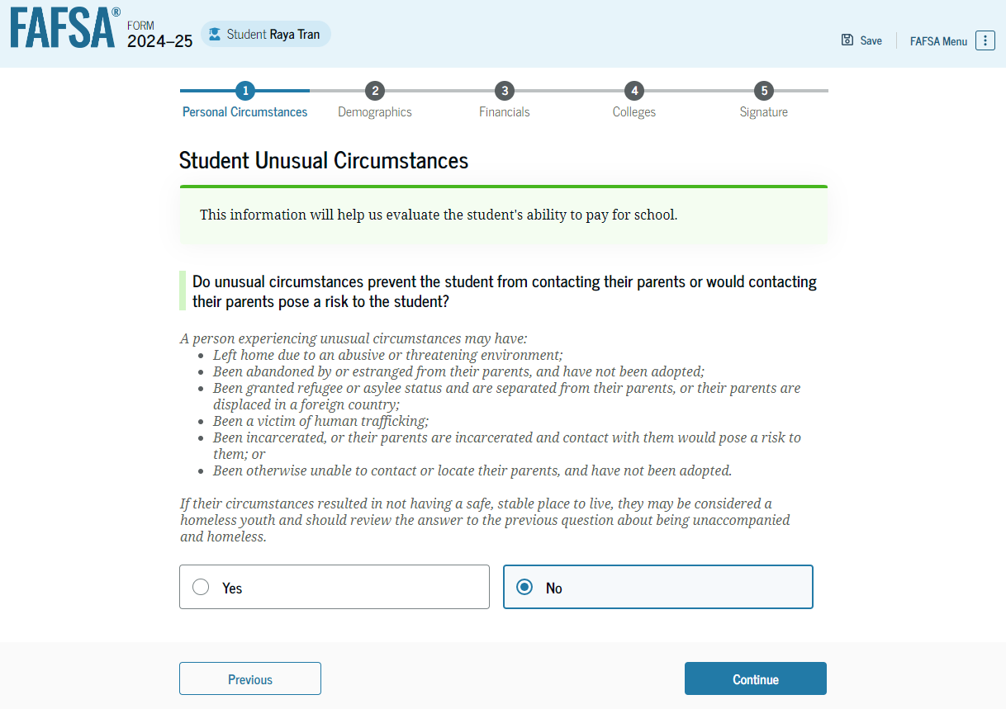
Student Unusual Circumstances
If a student says “YES” to unusual circumstances, they will submit the FAFSA without parent information.
The college(s) will work with them to finalize status.

Slide 19
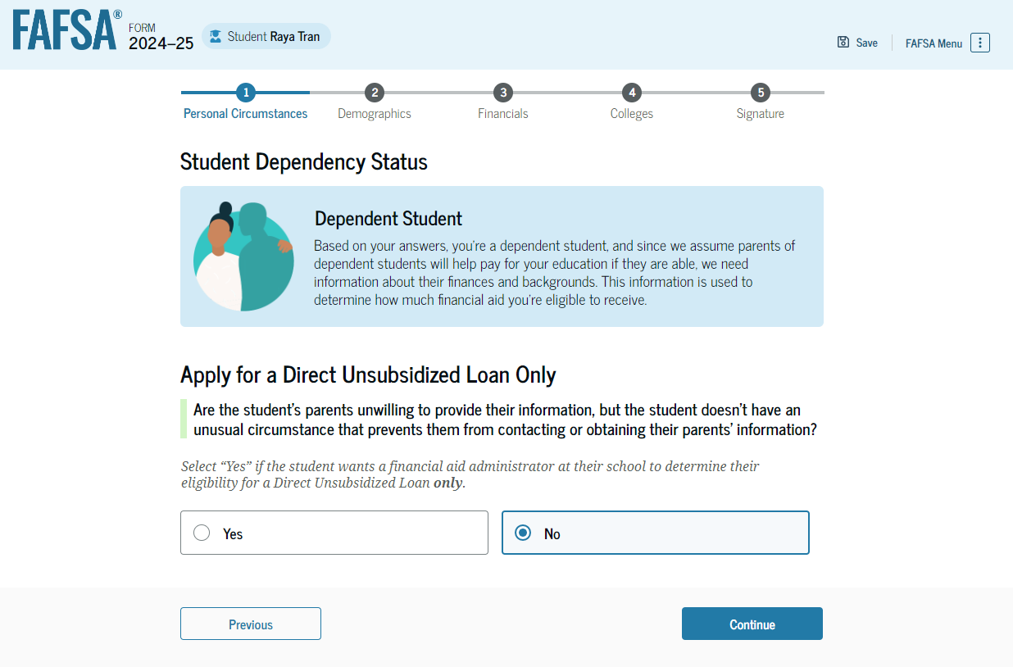
Student Dependency Status: Dependent Student
This is an option if the student’s parents are unwilling to provide information.

Slide 20
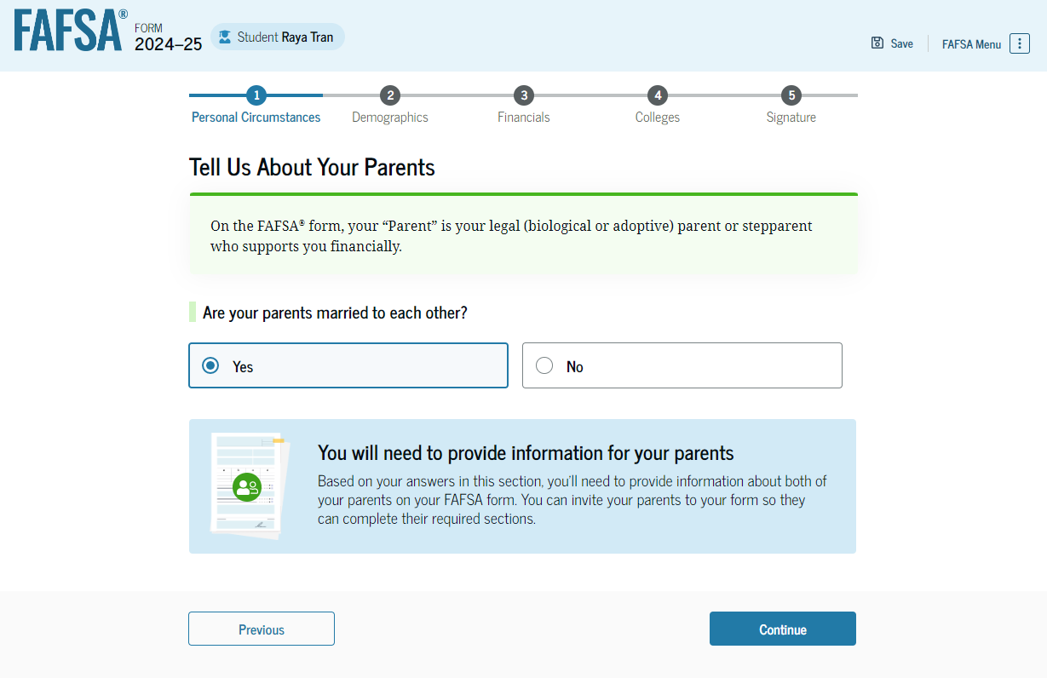
Student: Tell Us About Your Parents

Slide 21
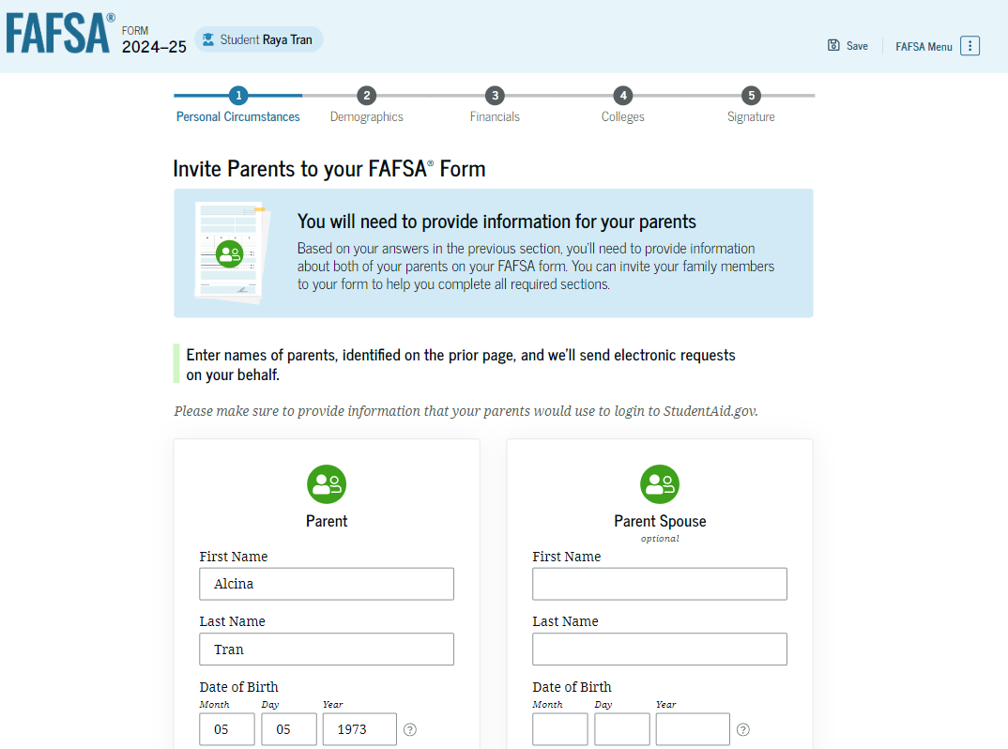
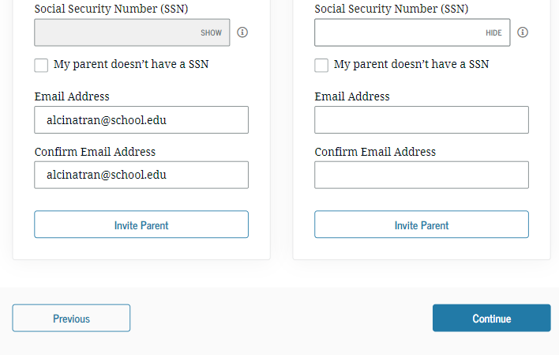
Dependent Student Invites Parents to FAFSA® Form
The student is asked to enter personal information about their parents to send them an invite to their FAFSA®.
Student must know parent(s) DOB and SSN to invite.

Slide 22
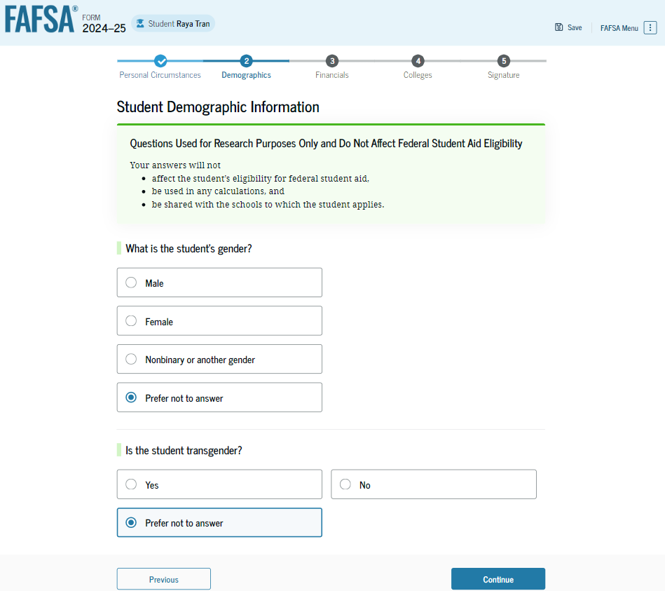
Student Demographic Information
Student is ask:
Race
Gender
Ethnicity
FOR Research Purposes only.
Response does not impact aid.
Schools to not see responses.

Slide 23
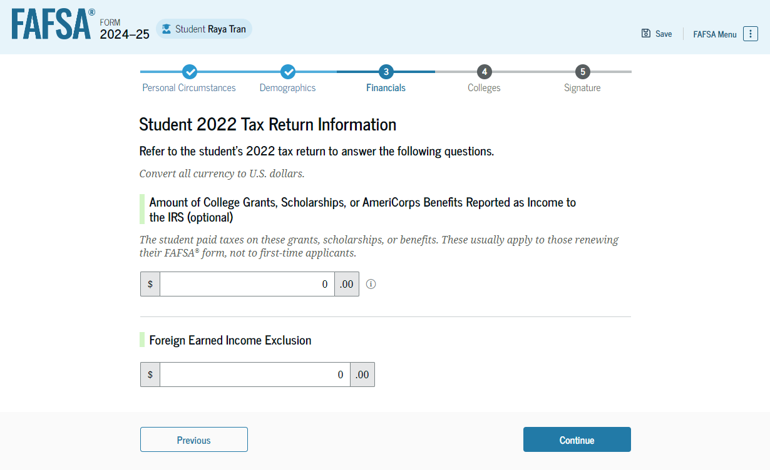
Student Tax Return Information
The student is asked questions about their 2022 tax return. The student enters a response in each entry field.
If the student filed a 2022 federal tax return, all other tax information is transferred from the IRS.

Slide 24
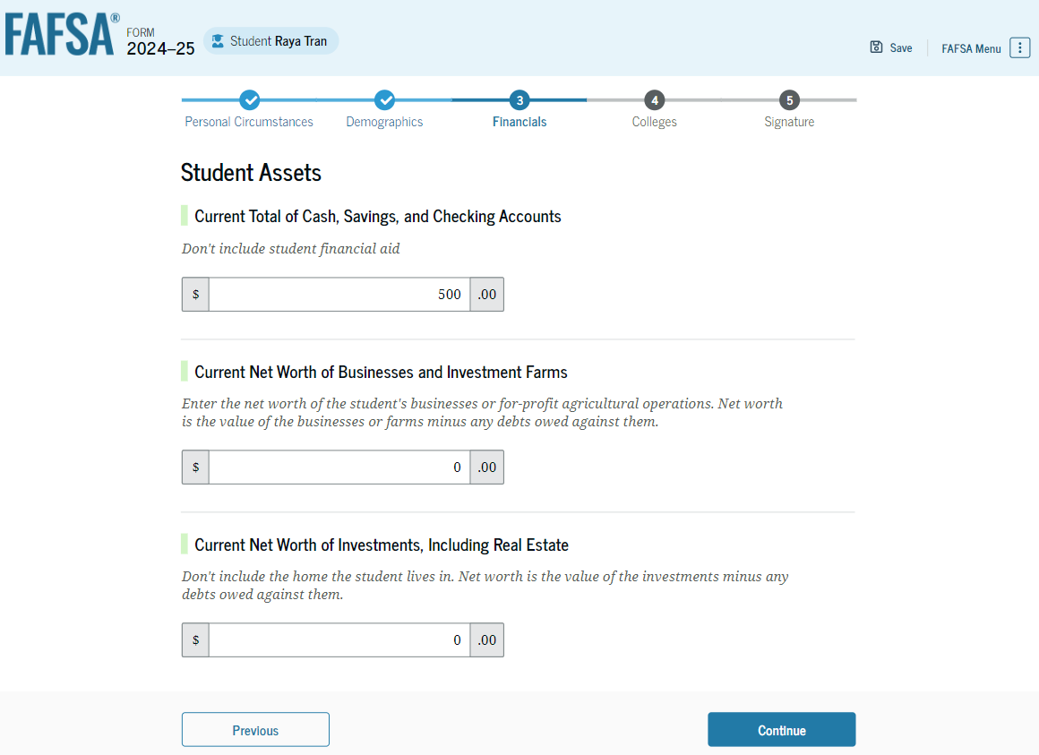
Student Assets
Assets are as of the date the form is signed.

Slide 25
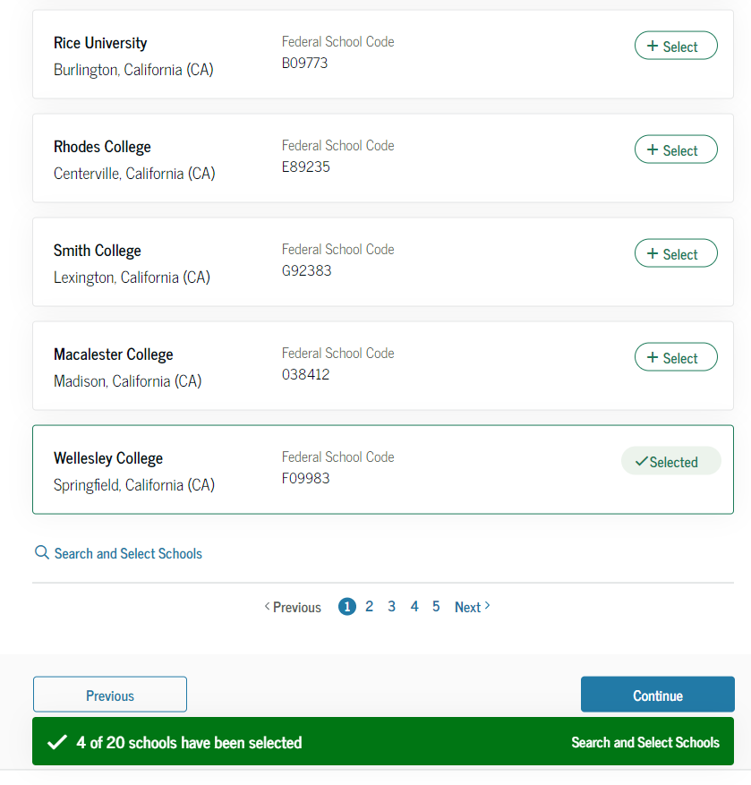
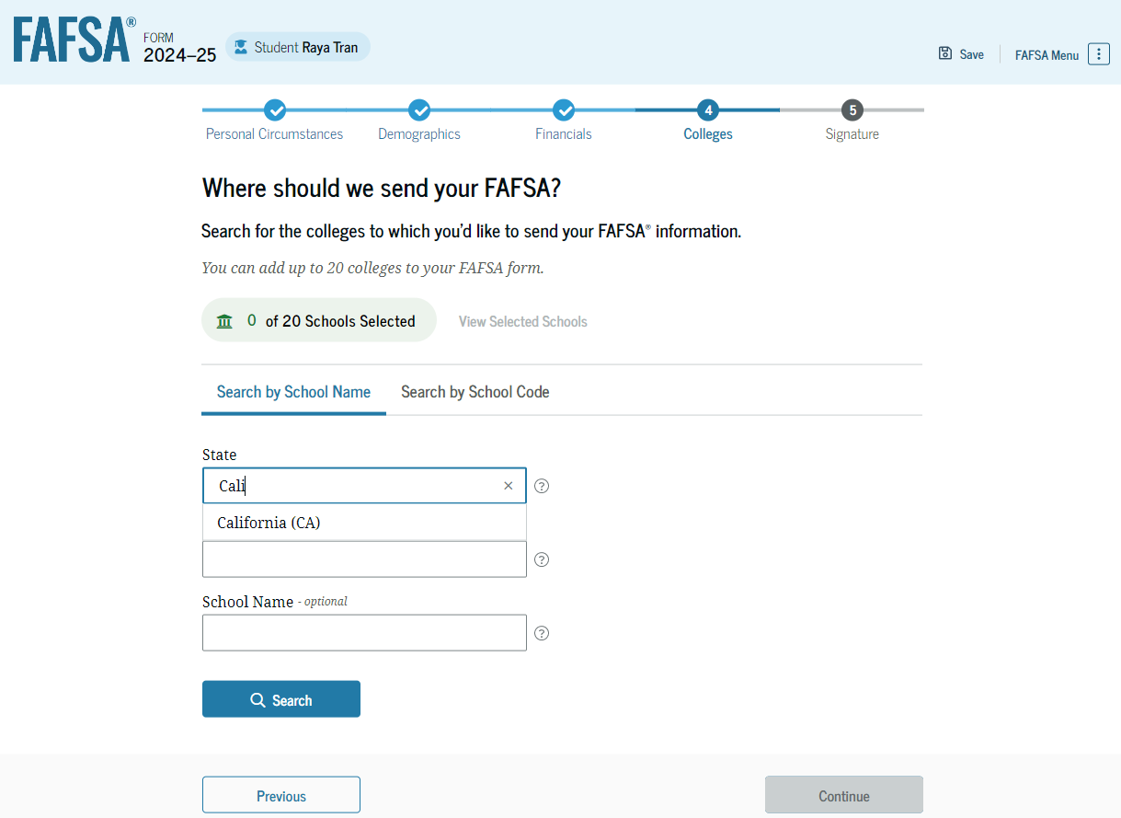
Student College Search
The student searches for a school by entering a state, city, and/or school name.
Students can select to send their FAFSA information to a maximum of 20 schools.

Slide 26
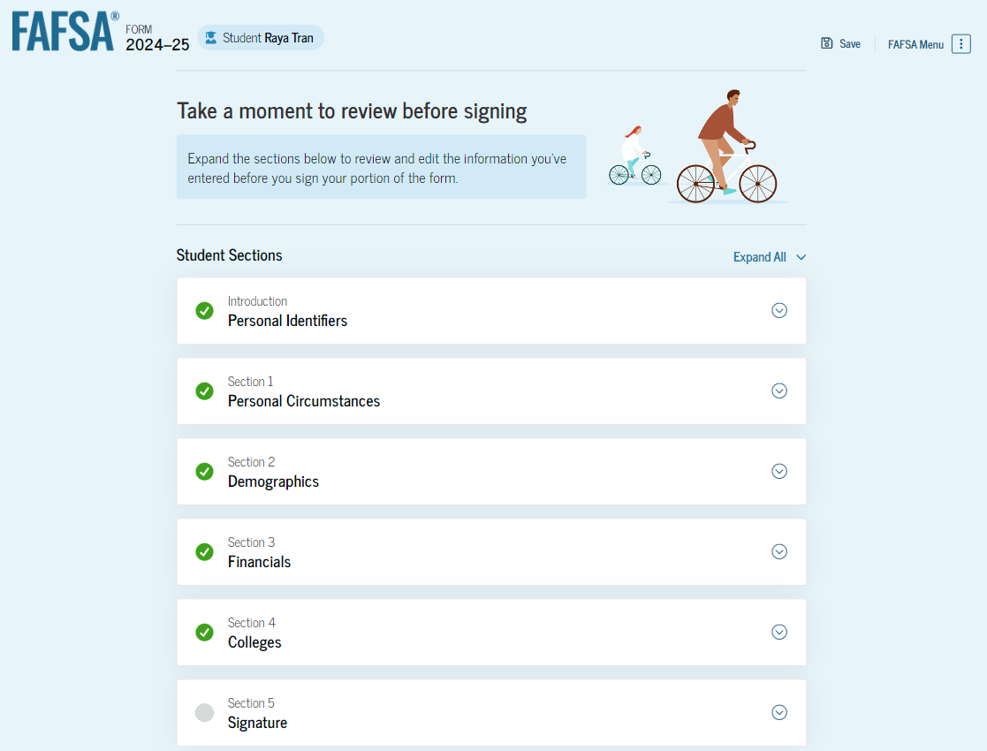
Student Review Page
To edit a response, the student can select the question’s hyperlink and will be taken to the corresponding page.

Slide 27
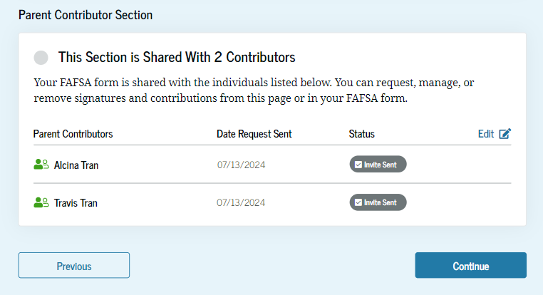
Student Review Page (Continued)
Since the student invited their parent into the form, they see the parent contributor section and the status of their parent’s invite.

Slide 28
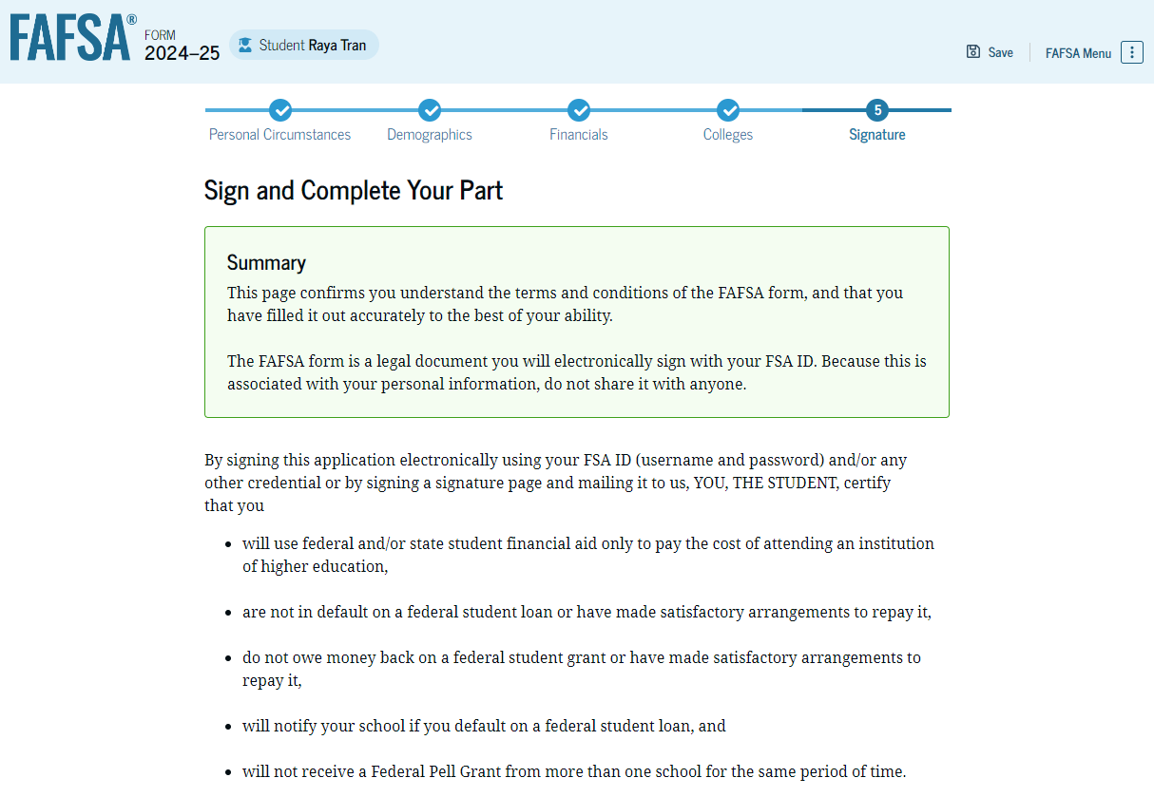
Student Signature
After agreeing and signing, the student is able to submit their section of the FAFSA form.
Since parent information has not been provided, the FAFSA form is not considered complete and can’t be processed yet.

Slide 29
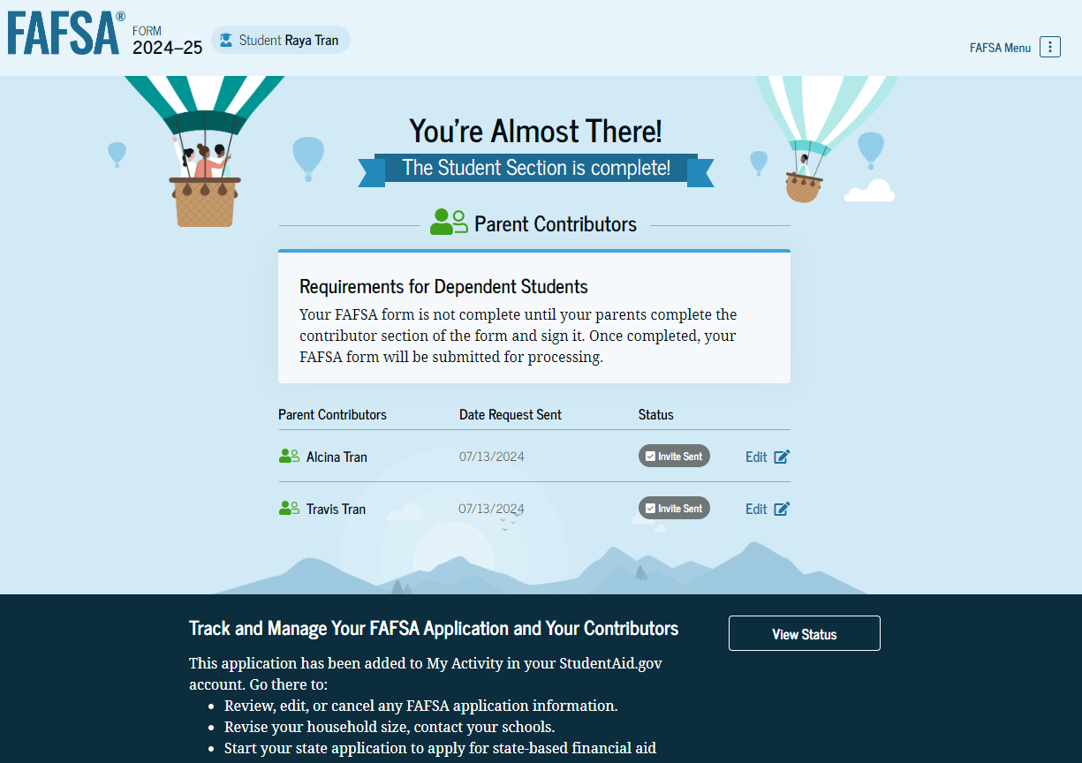
Student Section Complete
The student is reminded that their form is not completed and can’t be submitted until the parent completes the contributor section of the form and signs it.

Slide 30
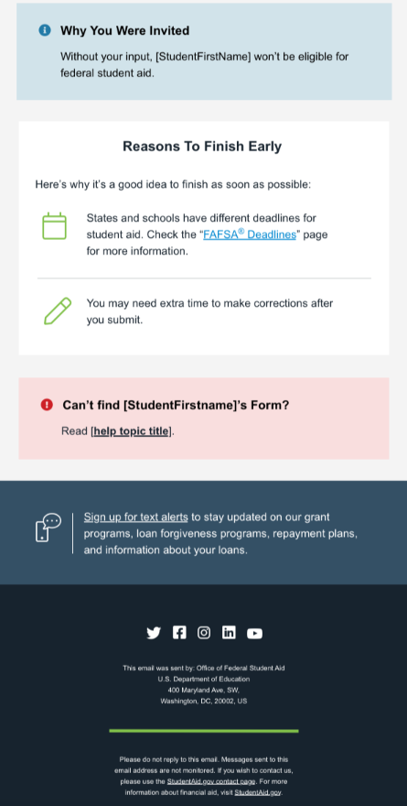
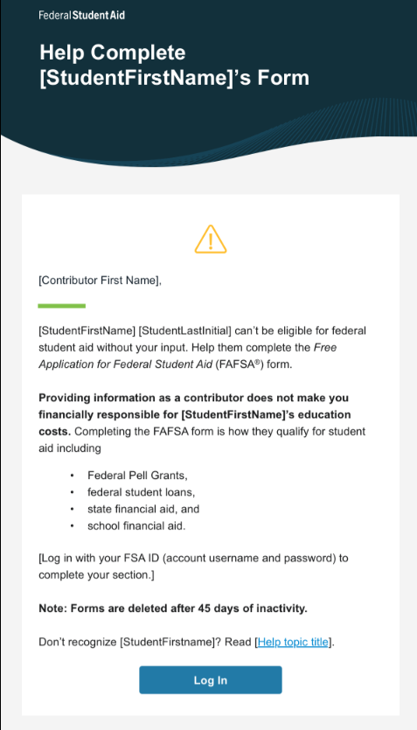
Student’s Parent Email
This view demonstrates a parent opening the FAFSA invitation from their email. The parent selects “Log In" and is taken to StudentAid.gov.

Slide 31
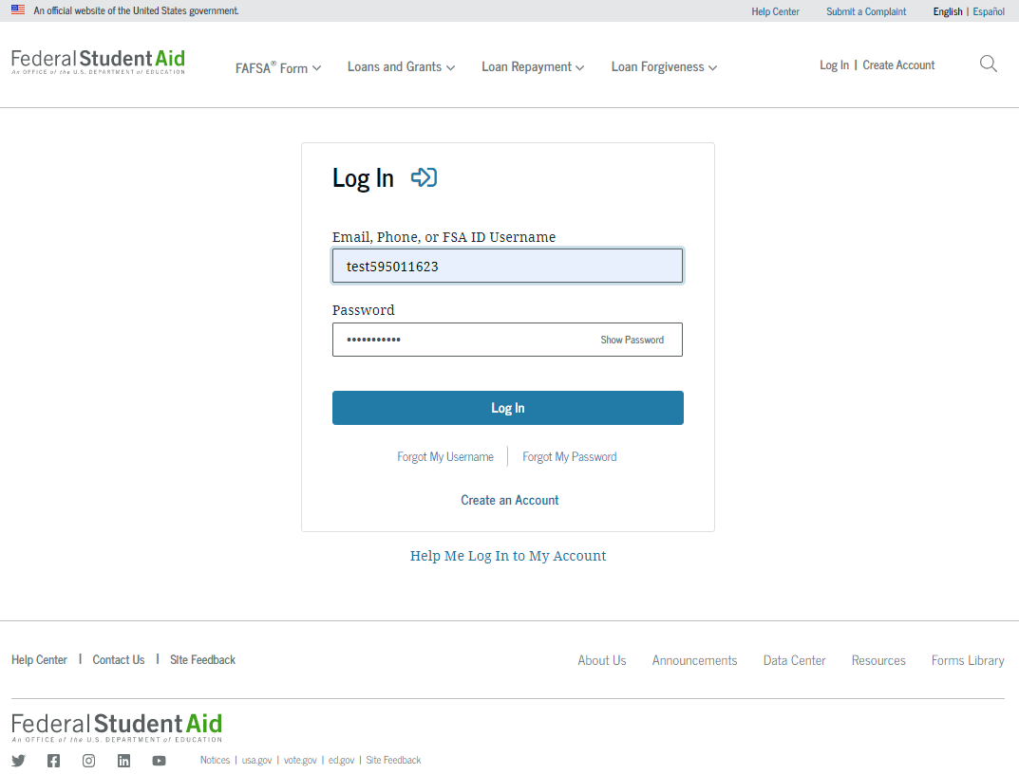
Parent Log In

Slide 32
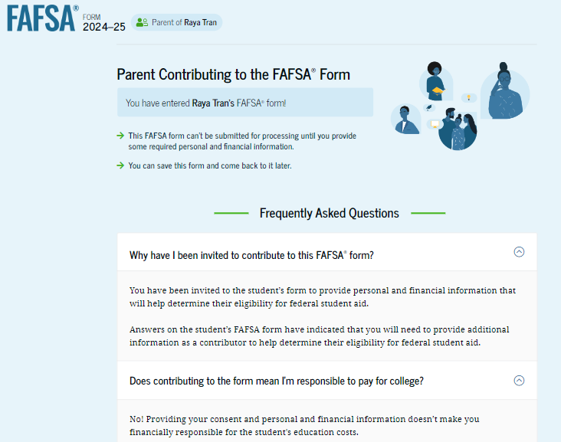
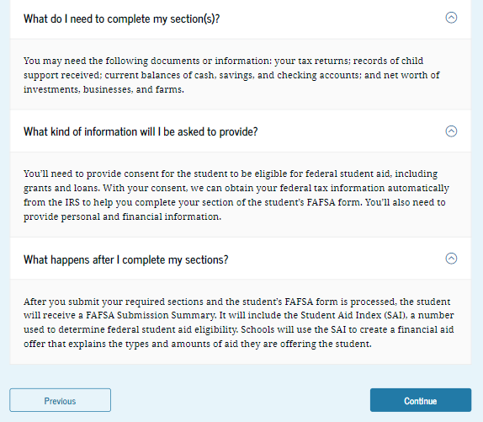
Parent Contributing to the FAFSA® Form
This page provides information about being a contributor on a FAFSA® form.

Slide 33
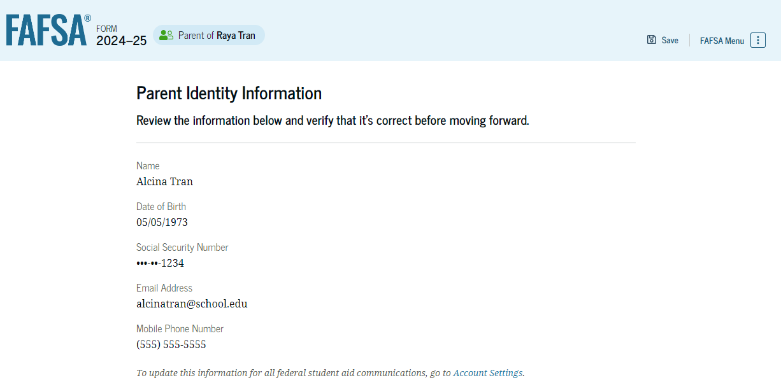
Parent Identity Information
To update any of the personal information, the parent must access their Account Settings on StudentAid.gov.

Slide 34
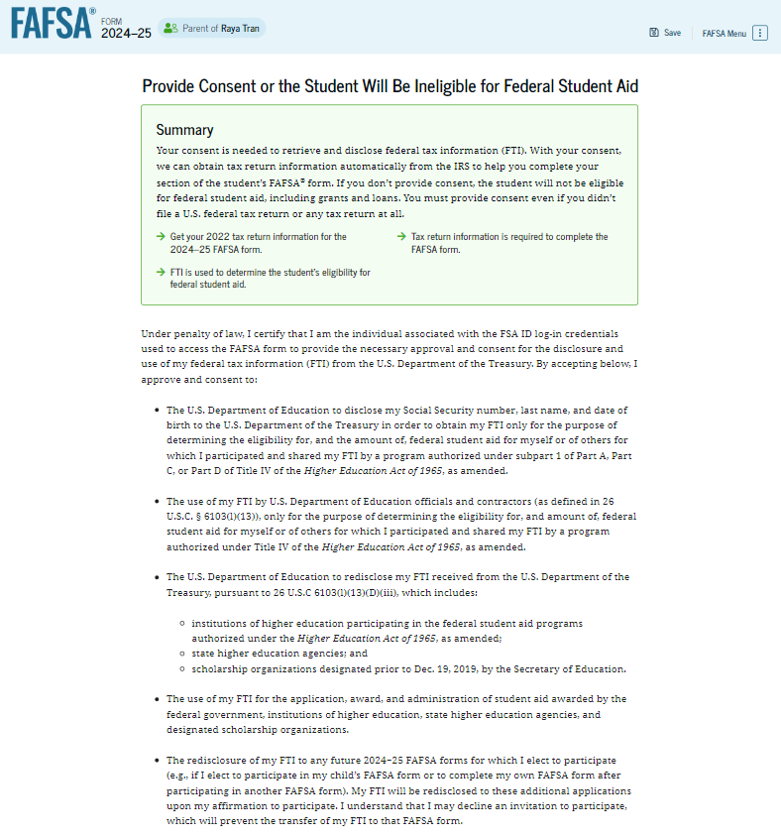
Parent Provides Consent
This page informs the parent about consent.
By providing consent, the parent’s federal tax information is transferred directly into the FAFSA® form from the IRS.

Slide 35
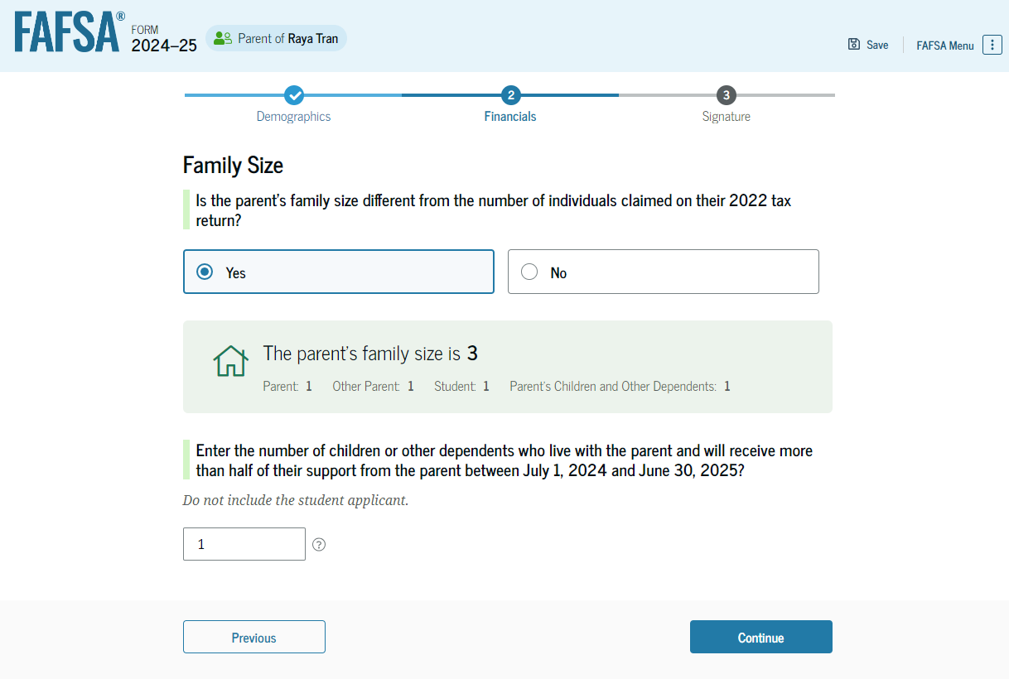
Parent Family Size
This page asks the parent if their family size has changed since filing their 2022 tax return.
If yes, parent may update.

Slide 36
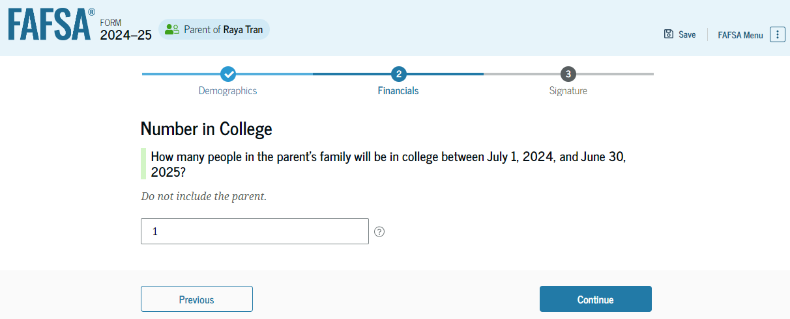
Parent Number in College
Response does not impact student aid eligibility.

Slide 37
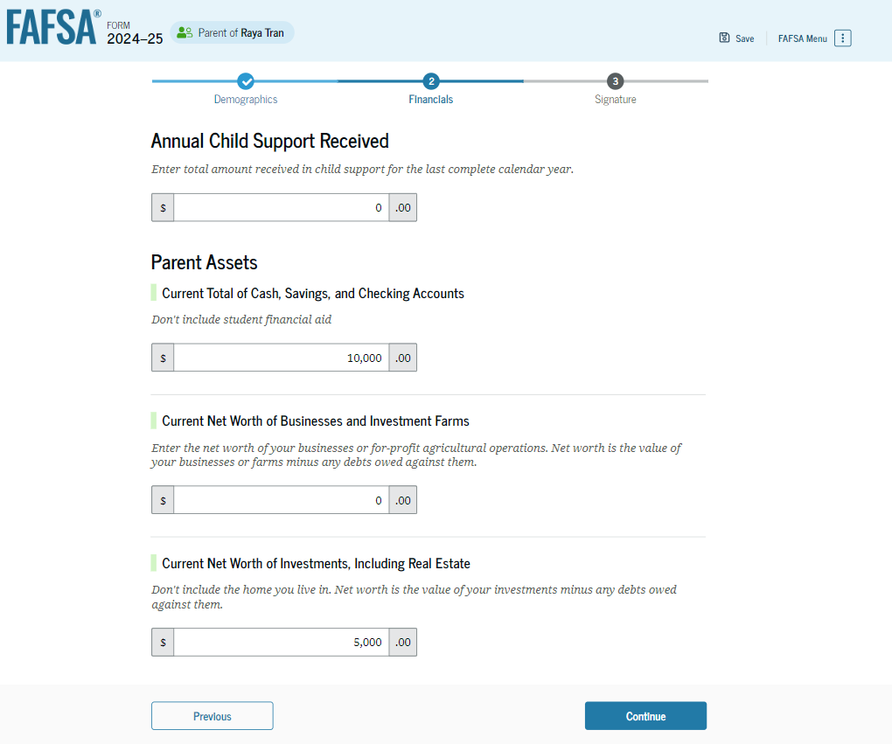
Parent Assets
Child Support Received is for the last complete calendar year.
All other assets are as of the date the form is signed.

Slide 38
Assets NOT reported
Primary residence
Life insurance plans
Retirement Plans
PERS/STERS
401K
Pension funds
Annuties
Non-education IRAs
KEOG plans

Slide 39
Assets Reported
Report the Net Worth of Assets:
Value today minus debt
Negative value is reported as Zero
Real estate (not the home you live in)
Rental property
Trust funds
Business and/or investment farm value
Market value of land, building, machinery, equipment, inventory, etc.
Uniform Gifts to Minor Act accounts (UGMA and UTMA)
Money market funds; mutual funds; stocks; stock options; bonds; certificates of deposits
Other securities and Commodities
Installment and land sale contracts
Qualified education benefits and education savings accounts/529 savings plans/Coverdell savings plans/refund value of prepaid tuition plans

Slide 40
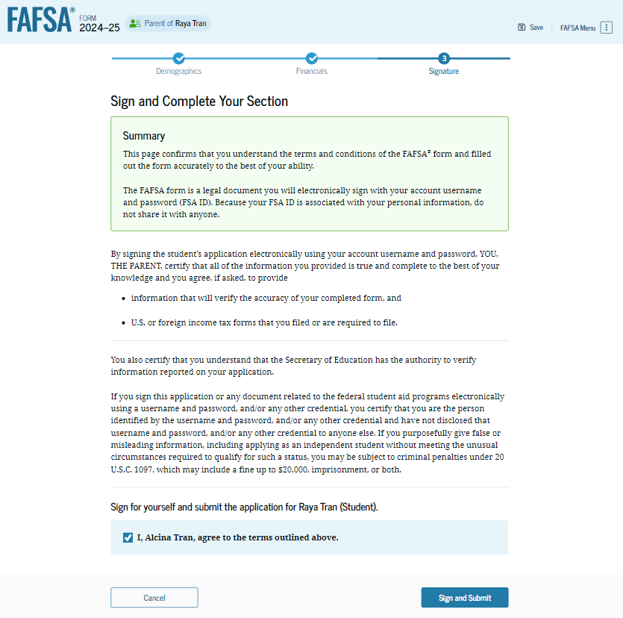
Parent Signature
On this page, the parent acknowledges the terms and conditions of the FAFSA® form and signs their section.
Since all required sections are complete, the parent can both sign and submit the student’s FAFSA form.

Slide 41
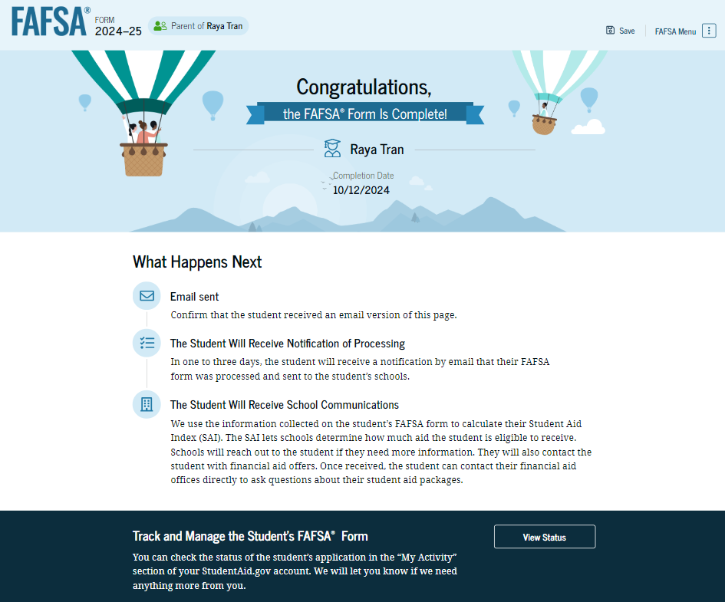
Student FAFSA® Confirmation
Upon submitting the student’s FAFSA® form, the parent is presented an abbreviated confirmation page.
The student will receive an email with the full, detailed confirmation.
With the student and parent sections completed and signed, the FAFSA form is now considered complete and submitted for processing.

Slide 42
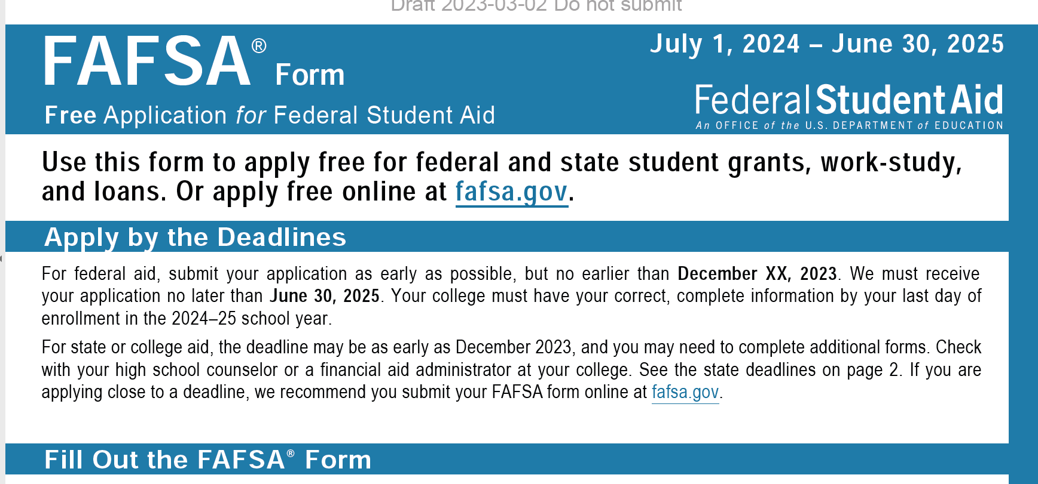
What if….
There will be a paper FAFSA form available.
It will take several weeks to process once mailed to the Federal Processing System.
Even with wet signature on the paper FAFSA, they will still need to confirm identity….
HOW is still to be determined.

Slide 43
Special Circumstances
Conditions exist that cannot be documented on the FAFSA
Send written explanation and documentation to the financial aid office(s)
School will review and request additional information if necessary
School decisions are final and cannot be appealed to the U.S. Department of Education

Slide 44
Special Circumstances
Loss of Child Support
Unusual uncovered medical/dental expenses
Extraordinary dependent care
Student cannot obtain parental information
Parent or spouse death
Loss of employment
Divorce

Slide 45
Financial Aid Office Review
May require additional information
Verification of Income
Family Size
Determines Financial Aid Offer
Sent by email or regular mail
Amount of Aid awarded from each program
How and when aid is disbursed
Terms and conditions of student’s offer
Identity and statement of educational purpose
Documentation of high school completion
2022 Tax returns/w2s

Slide 46
School Communications
Most schools use a student portal
An online starting point where students can register for classes, view financial aid and billing, etc.
Most schools assigned email account
Students are required to activate and check regularly.
Schools will begin to communicate with the student primarily through this email account.

Slide 47
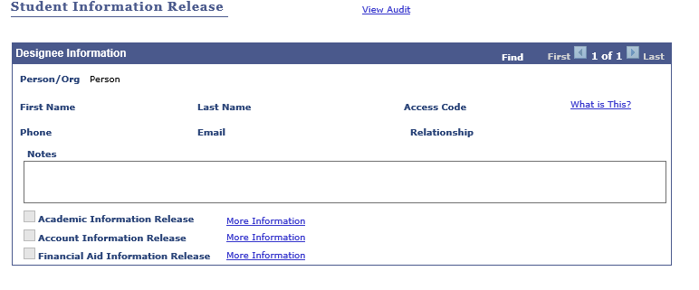
Student Privacy
Once a student enrolls, their college record (academics and finances) is protected under FERPA
Students can give parent/guardian permission to access this information if they choose.
EXAMPLE:

Slide 48
Contact Information:
Feel free to reach out to the OASFAA Outreach Committee with any questions:
Outreach@oasfaa.org

