Slide 1
OASFAA Counselor Workshop [enter presentation date]
Presented by: Faith Phillips & MorraLee Keller

Slide 2
ABOUT OASFAA AND THIS PRESENTATION
OASFAA is a non-profit organization comprised of financial aid professionals. The OASFAA Outreach Committee is an all-volunteer committee that serves as a primary resource of pertinent and current financial aid information. The committee disseminates this information through a variety of activities including training programs for various stakeholders external to OASFAA such as admissions staff, high school counselors, access advisors, TRIO, etc.
OASFAA has provided the information today as a free service to counselors.
You have permission to copy and distribute these materials to your students and families. Charges may not be assessed for the material or for the information presented. Permission must be granted for other use of this information or these materials. Contact the OASFAA Outreach Chairperson(s) listed on the OASFAA website or e-mail the OASFAA Outreach Committee at: outreach@oasfaa.org.

Slide 3
Workshop Agenda
High-level changes for 2024-2025
The Federal Student Aid ID
Dependency (Student Circumstances)
Parent of Record
The 2024-2025 FAFSA
Student Aid Index (SAI)
FAFSA Submission Summary
Federal Aid Programs
Ohio Aid Programs
Financial Aid Notifications
Resources

Slide 4
Workshop NOTE
The screenshots of the FAFSA are not final/could change by the time the FAFSA is released in December 2023!

Slide 5
changes for 2024-2025

Slide 6
Changes for 2024-2025
FAFSA will not be released until December 2023
The massive overhaul of the 2024-2025 form and process will delay the opening of the FAFSA until some date in December.
Encourage students to check on updated FAFSA priority deadlines at colleges.
FAFSA completion events should begin in early January.
Creates a condensed timeframe for FAFSA submission, FAFSA Submission Summary review, verification and aid offer review.

Slide 7
Changes for 2024-2025
FAFSA contains fewer questions
The FAFSA will have fewer questions.
Certain types of taxed income questions have been eliminated.
Several types of untaxed income questions have been eliminated.
Requesting Work-Study question has been eliminated.
Housing plans for each college has been eliminated.
Child support paid question has been eliminated.

Slide 8
Changes for 2024-2025
New terminology…
EFC is now…
STUDENT AID INDEX (SAI)
SAR is now…
FAFSA SUBMISSION SUMMARY
IRS DRT is now…
DIRECT DATA EXCHANGE (DDX)
PARENT/SPOUSE is now…
CONTRIBUTOR(S)

Slide 9
Changes for 2024-2025
Contributors
Anyone who provides information on the FAFSA
Student
Student spouse if married
Parent
Other parent if parent of record is married
Contributors MUST provide the required information and sign respective section of the FAFSA

Slide 10
Changes for 2024-2025
Race, Gender, and Ethnicity Questions
These demographic questions are now an official part of the student’s section of the FAFSA.
The answers will not be shared with state agencies or colleges. They have no bearing on aid eligibility and are to be used for research only.
The student will have a choice of “prefer not to answer” for each question.
The information will not appear on the FAFSA Submission Summary and cannot be seen by parents or student spouse.

Slide 11
Changes for 2024-2025
IRS consent required: (tax filers or non-tax filers)
All contributors are required to provide consent to the use of their Federal Tax Information (FTI) on the FAFSA.
This includes non-filers, people without a social security number, and foreign tax filers.
No consent = No federal Title IV aid.
The IRS will confirm if Federal Tax Information is available and the information will be automatically downloaded through the Direct Data Exchange (DDX) to the Department for use in determining financial aid eligibility.
The IRS will confirm non-filer status, which may reduce the verification burden.

Slide 12
Changes for 2024-2025
Number of colleges on the form
Students will be able to list up to 20 colleges on the web version of the FAFSA.
This should eliminate many students going back in to add colleges above 10.
The number is still limited to 10 on the paper FAFSA.
Notes:
Order does not matter.

Slide 13
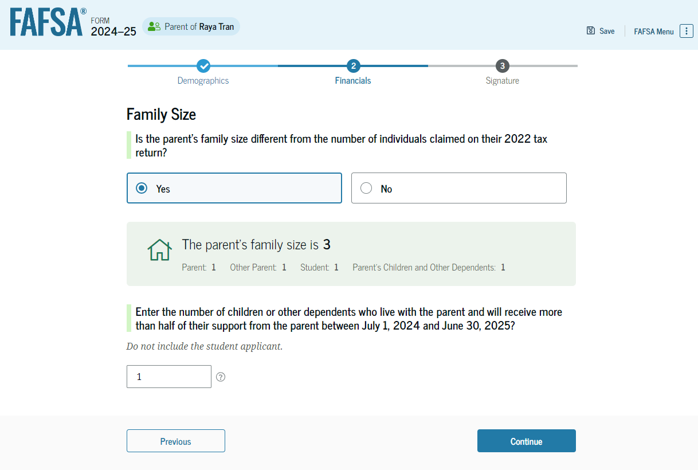
Changes for 2024-2025
Change to how family size is reported
Aligns with number of dependents reported on 2022 federal tax return.
Option to update if the family size is different than what was on the 2022 tax return for dependents.
Notes:
NOTE to presenter: This is a slide from FSA that does look accurate. We are not quite sure the Family Size = 3 when you add it up, it equals 4. We can only guess that the 3 is there before they add the 1 in the box below? In any event, we know it doesn’t look right but we have no other slide yet to use. USE this slide as an example of where the family can update the family size if it is different than the dependents and don’t get caught up in the over all addition. ☺
Presenter: NOTE to point out that they do not include parent and student in the number they enter in the box. The Form already knows to include the student and parent(s) in family size.

Slide 14
Changes for 2024-2025
Student
Parent(s)/Contributor(s)
Other Children/Dependents
Family Size
Notes:
NOTE to presenter: This is just a visualization of the family size. The student and contributor are already included, so other children/dependents would be added to total the family size.

Slide 15
Changes for 2024-2025
Dependent student family size
The student and the student’s parent(s), are already included here
The student’s siblings if the following are true:
They live with the student’s parents (or live apart because of college enrollment),
They receive more than half of their support from the student’s parents, and
They will continue to receive more than half their support from the student’s parents during the award year.
Other persons if the following are true:
They live with the student’s parents,
They receive more than half of their support from the student’s parents, and
They will continue to receive more than half their support from the student’s parents during the award year.

Slide 16
Changes for 2024-2025
Independent student family size
The student, and student spouse (if applicable), are already included here
The student’s dependent children, if the following are true:
They live with the student,
They receive more than half of their support from the student, and
They will continue to receive more than half their support from the student during the award year.
Other persons if the following are true:
The live with the student,
They receive more than half of their support from the student, and
They will continue to receive more than half their support from the student during the award year.

Slide 17
Federal Student Aid id (FSA ID)

Slide 18
FEDERAL STUDENT AID ID (FSA ID)
Username and password
Gives a student/parent access to Federal Student Aid’s online systems and serves as a legal signature.
Student and parent(s) whose information will be on the FAFSA need their own individual FSA IDs.
Parents without social security numbers (undocumented) are required to get an FSA ID.
Use the same website to create FSA ID but will have different set of questions.
Signature Page is no longer available.

Slide 19
FEDERAL STUDENT AID ID (FSA ID)
FSAID for undocumented parents (new for 2024-2025)
Non-SSN holders have similar process to request an FSA ID.
They will answer questions to verify their identity through information pulled from credit bureaus.
This knowledge-based identify process is not yet available.
A launch date is forthcoming.

Slide 20
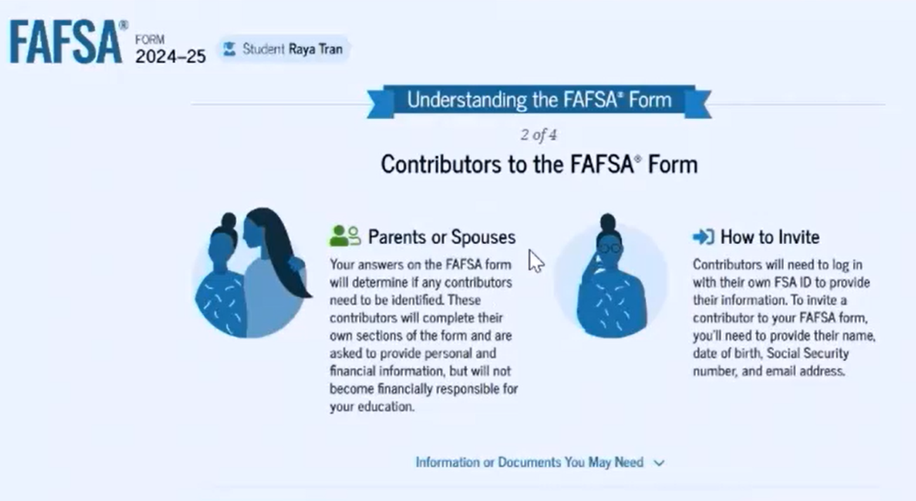
FEDERAL STUDENT AID ID (FSA ID)
Who needs to create an FSA ID?
Anyone who is a ‘Contributor’ needs an FSA ID.
Notes:
Anyone who is considered a “Contributor” to the FAFSA will need an FSA ID. This could include:
Student
Student’s Spouse
Parent
Parent’s Spouse

Slide 21
FEDERAL STUDENT AID ID (FSA ID)
Important information to know about the FSA ID:
All usernames and passwords must be different.
Each user must create and manage their own FSA ID.
Each user must use a separate email address and mobile phone number.
High school students should not use their high school email.
Each social security number, mobile phone and email can be associated with only one account.

Slide 22
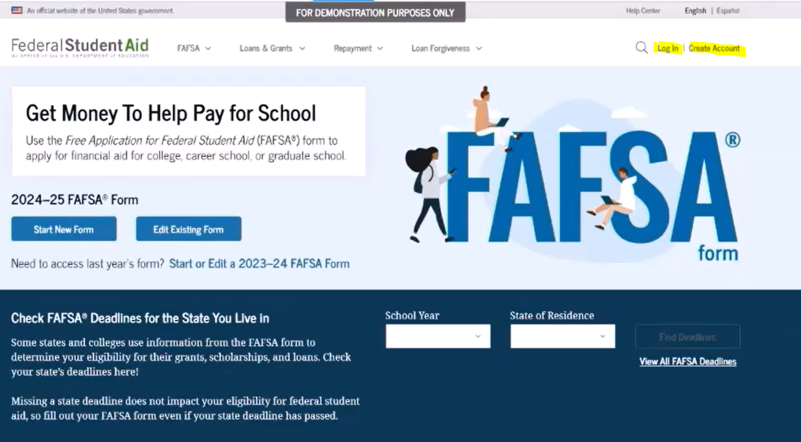
FEDERAL STUDENT AID ID (FSA ID)
With 2024-2025 comes a new look!
Notes:
There will be a new face to studentaid.gov
Website construction is still in progress
NOTE that applicants for 2024-2025 may still create their FSA ID now

Slide 23
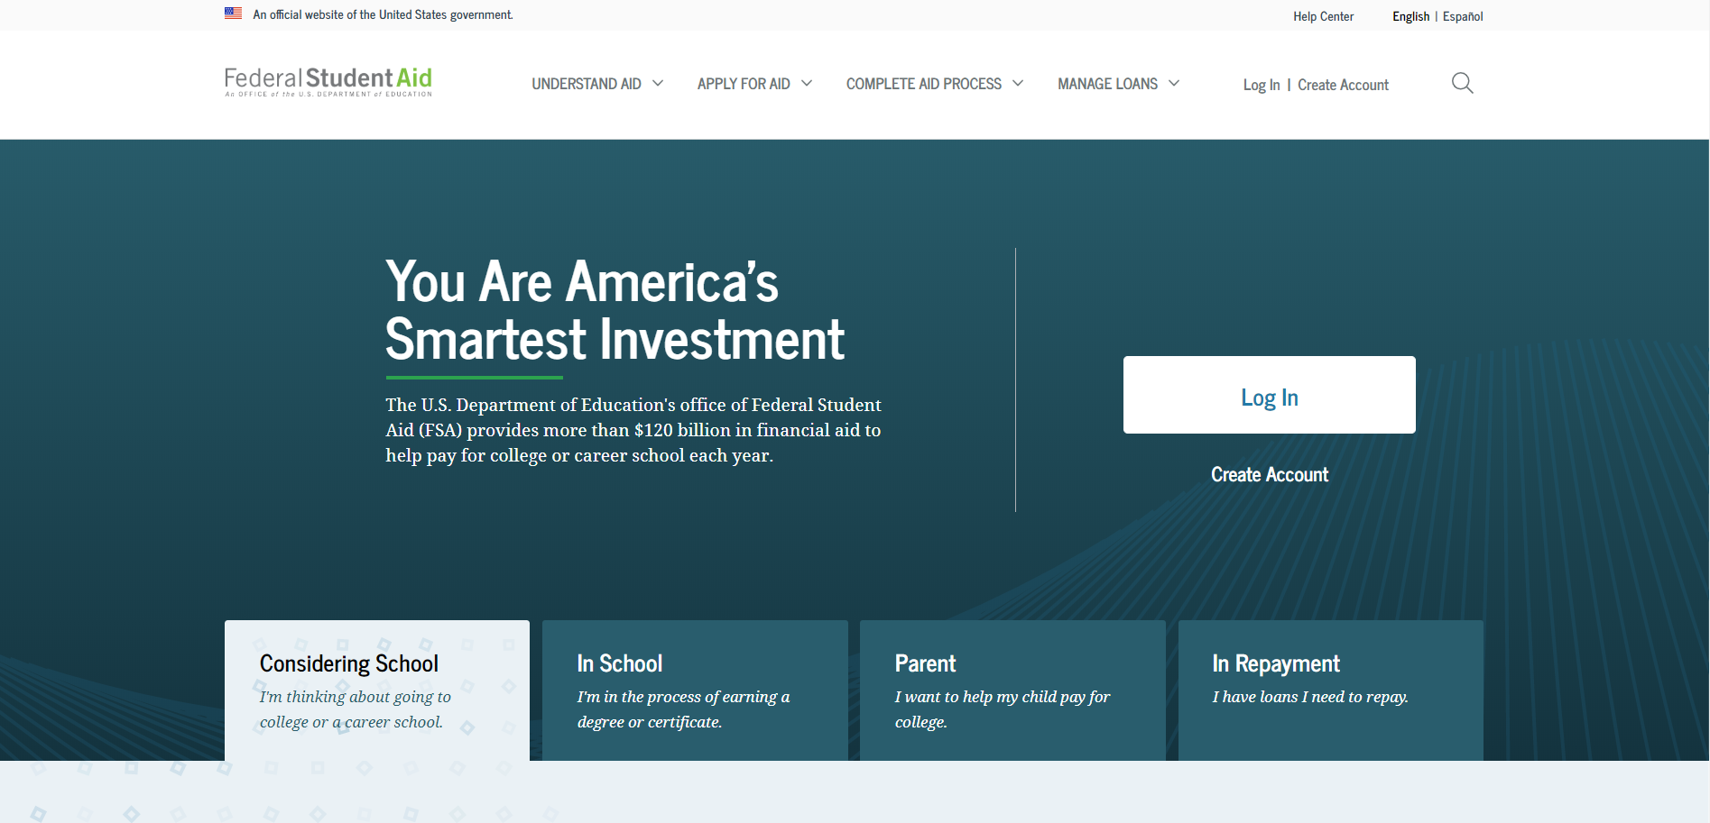
creating an FSA ID
Create an FSA ID at StudentAid.gov
Notes:
Select the “Create Account” button
On the “Create an Account (FSA ID)” page, select the “Get Started”

Slide 24
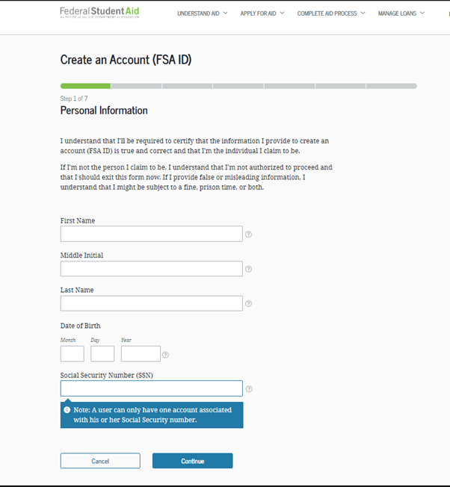
Creating an FSA ID
Social Security Number (SSN), date of birth and name must match the Social Security card.

Slide 25
Creating an FSA ID
Username:
Cannot include applicant name or date of birth.
Cannot already be used by another applicant.
“The username you entered is already in use” will pop up.
Password:
Must be 8–30 characters and contain 1 uppercase letter, 1 lowercase letter, 1 number.
Case-sensitive.

Slide 26
Creating an FSA ID
Mobile Phone Account Recovery
Applicant should provide a mobile phone number.
This will help to re-gain access to the account if locked out.
The mobile phone is also used for two-step verification.

Slide 27
Creating an FSA ID
Select Challenge Questions and Answers
Answering the established challenge questions is another way to unlock the account or retrieve a username or password.
Your answer is not case-sensitive.

Slide 28
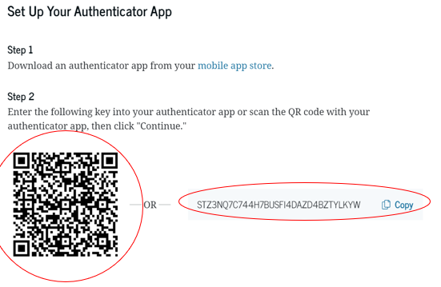
FSA ID Account Verification
Verify mobile phone number
Applicant will receive a text message with a six-digit secure code.
Verify email address
Applicant will receive an email with a six-digit secure code.
Set up an authentication app (optional)
Download an authenticator app from the mobile app store.
Notes:
NOTE That this not a real QR code at this time.

Slide 29
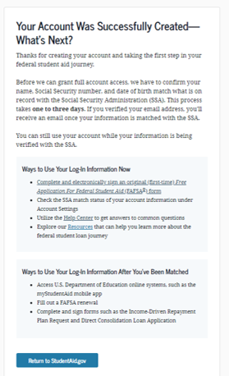
FSA ID Account confirmation
If an email address is provided, a confirmation email is sent.
All info is sent to the Social Security Administration (SSA) for confirmation.
SSA review will take 1–3 days.
Until contributor info is confirmed, they won’t be able to use the FSA ID.
It is ESSENTIAL to request FSA ID(s) before beginning the FAFSA at studentaid.gov.

Slide 30
Dependency

Slide 31
Dependency Status
New: Order of Questions
Birthdate, year in college, marital status asked earlier in FAFSA.
Remaining items listed, student asked to check all that apply (plus any appropriate follow-ups) or “none of these apply.”
If checking “none of these apply”, they complete the FAFSA as a dependent student with parent(s). (except for homelessness)
If student checks any of the questions, completes FAFSA as independent.

Slide 32
Determining Dependency Status
Dependent = Parent(s) also apply with student
Independent = Student (and spouse) apply without parent(s)
Student Personal Circumstances
Student Other Circumstances
Most high school students will be dependent.

Slide 33
Student Personal Circumstances
Notes:
NOTE the change: For pregnant applicants that having a dependent is the only thing that makes them independent, must file a dependent and notify the financial aid office after the child is born.

Slide 34
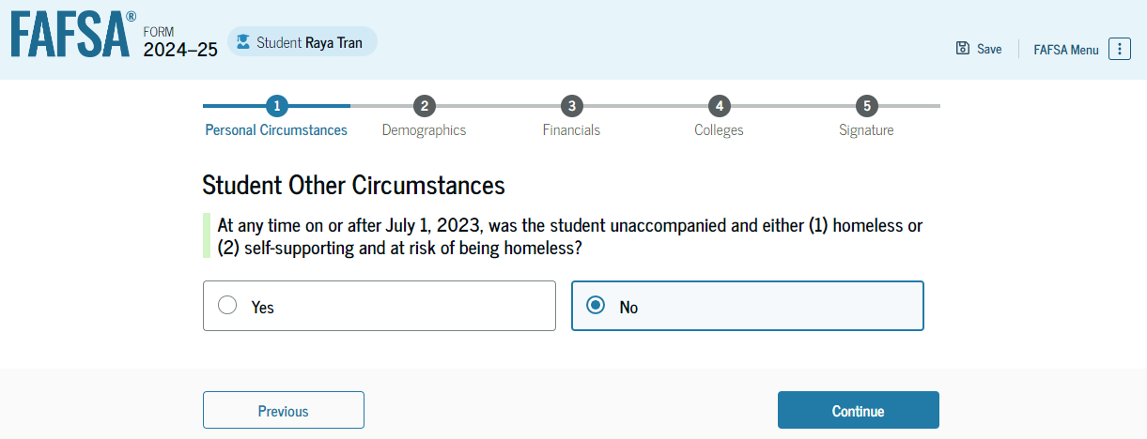
Student Other Circumstances
Homelessness
At any time on or after July 1, was the student unaccompanied and either (1) homeless or (2) self-supporting and at risk of being homeless as determined by:
Emergency or transitional shelter, street outreach program, homeless youth drop-in center, or other program serving those experiencing homelessness.
High school or school district homeless liaison or designee.
Director or designee of a project supported by a federal TRIO or GEAR UP program grant.
Financial aid administrator.

Slide 35
Student Unusual circumstances
New: If student selects “none of these apply” to the personal circumstance questions and “no” to the homeless youth question, the student is asked if an unusual circumstance prevents contact with parents or puts them at risk to do so.
Left abusive/threating environment,
Abandoned but not adopted,
Refugee or asylee separated from parent in foreign country,
Human trafficking victim,
Parents incarcerated, or otherwise unable to contact or locate parents and not adopted,
If no unusual circumstances exist, the student, completes FAFSA as dependent with parents.

Slide 36
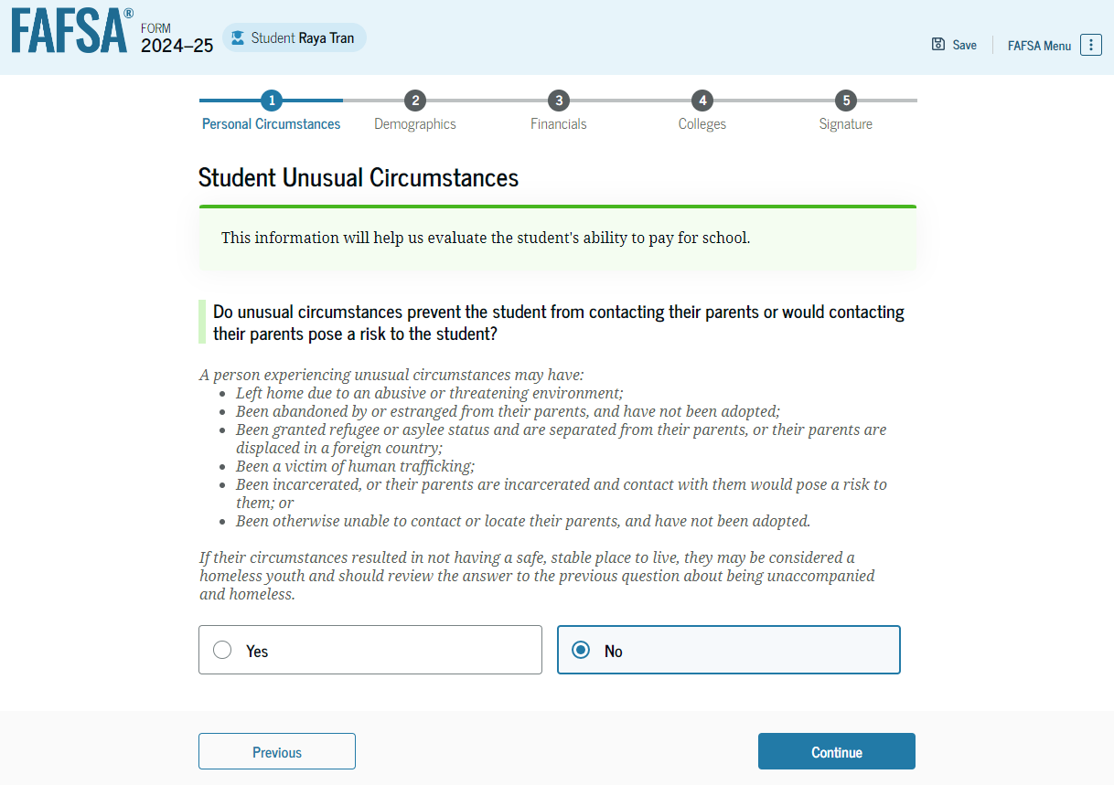
Student UNUSUAL CIRCUMSTANCEs
If applicant selects “YES,” they are provisionally independent.

Slide 37
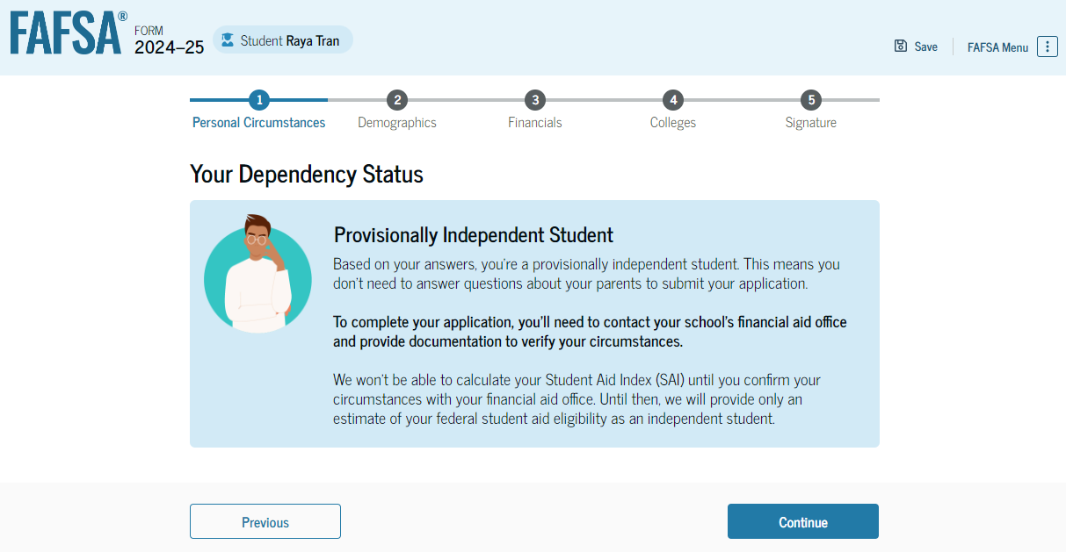
Impact of Provisionally Independent Status
The student can sign and submit their FAFSA form.
Student should contact their school to see what supporting documentation is needed.
A financial aid administrator will review and determine if an unusual circumstance appeal is warranted.

Slide 38
Dependency Documentation
College has right to request supporting docs for any dependency category response.
New: College required to reach out in cases of provisional independent status (homelessness and unusual circumstances) for information and supporting docs.
New: Provisional independent status will calculate an SAI but will not be eligible for aid until resolved by college.
New: Once independent, student anticipated to remain so.
Answers will transfer to future FAFSAs and limit need to redocument in future years.
Colleges therefore may seek defining documentation when reviewing independent cases (and required to do so with provisional) to solidify determination.

Slide 39
Dependent – Parent Refusal
New: A student who is otherwise dependent may report that parents are unwilling to provide information on the FAFSA, even though an unusual circumstance does not exist.
Student can be considered for limited federal aid in the form of a loan:
Federal Direct Unsubsidized Loan may be offered to the student.
Up to $5,500 freshmen/$6,500 sophomores/$7,500 junior or senior.
When parents do not consent, an SAI is NOT calculated.
When possible, stress to parent that consenting to provide FAFSA information does not obligate them to pay for college.

Slide 40
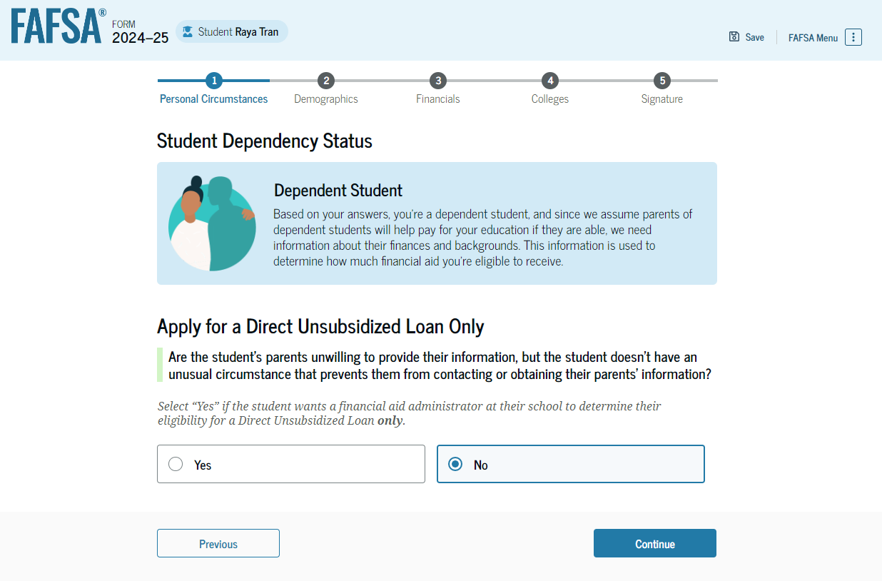
Student Dependency Status: Parent Refusal
Based on the answers provided by the student, they are considered a dependent student.
The student selects ‘yes’ if the student’s parents are unwilling to provide information.

Slide 41
Unusual vs. Special Circumstances
New: In past, terms interchangeable; now defined separately:
Unusual Circumstances
Used in FAFSA completion.
Conditions that justify making adjustment to student’s dependency status based on unusual situation (e.g., parental abandonment or human trafficking).
Commonly referred to as dependency override.
Special Circumstances
Used in COA or SAI data adjustment.
Special or extenuating situations (such as the loss of a job) that impact student’s or parent’s financial condition and support adjusting data elements in COA or in SAI calculation.
Both are professional judgements exercised on case-by-case basis.
Determined by financial aid administrator and may differ slightly college-to-college.

Slide 42
Parent Contributor(s)

Slide 43
Parent Contributor(s) for 2024-2025
Parents Who Live Together
Married and living together or
Unmarried but living together
Remarried Parents
Divorced, separated, or widowed parent who has remarried
Single Parent
Never married
Widowed or divorced (not remarried)
Separated
Death of a Parent
If either parent has died, the surviving parent is considered a single parent unless that parent has remarried

Slide 44
What parent to include on the 2024-2025
Effective with the 2024-2025 year, the contributor criteria has changed for students with divorced or separated parents not living together.
The student must include the parent on the FAFSA who provided the greater portion of the student’s financial support in the 12 months prior to filing the FAFSA even if student does not live with that parent.
If neither parent provided support in that 12-month period, include information for the parent who provided the greater portion of support during the most recent year the student received financial support.
If both parents claim equal amount of support, the parent with the greater amount of income or assets is the contributor.

Slide 45
The 2024-2025 FAFSA

Slide 46
2024-2025 FAFSA
Dependent Student Invites Parent

Slide 47
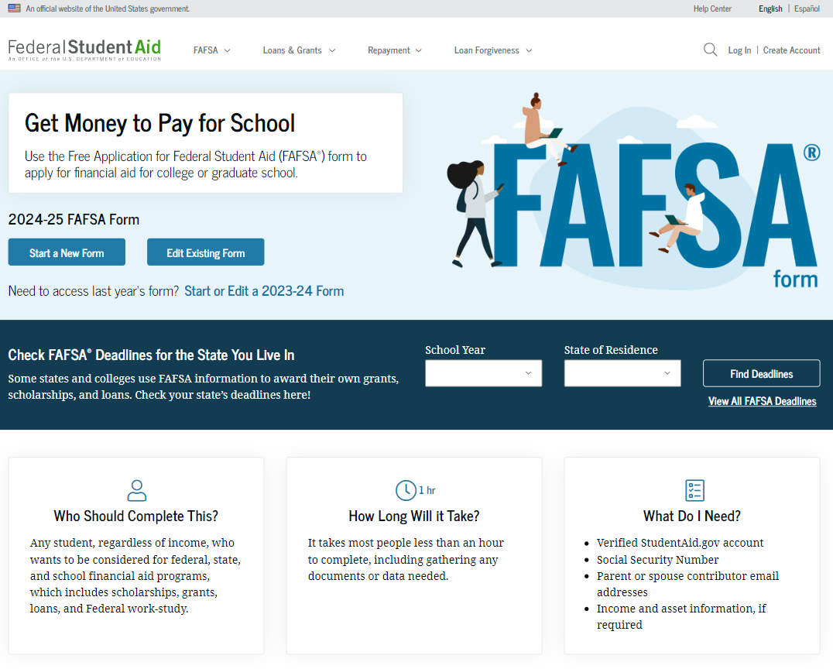
Dependent Student FAFSA Form Landing Page
This is the main FAFSA form landing page.
On this page, students are directed to "Start a New Form" or "Edit Existing Form."
Notes:
Tell attendees we will not cover every question that is presented on the FAFSA but will focus on those that have changed or could use some clarification.

Slide 48
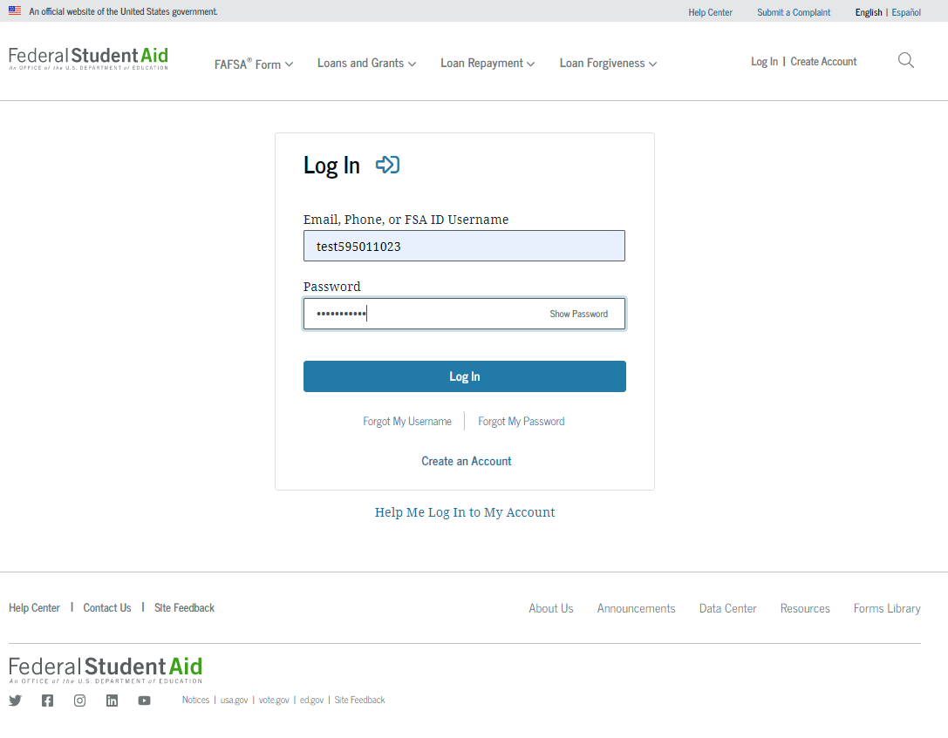
Dependent Student Log In
To access the FAFSA form, all students are required to have an FSA ID (account username and password).

Slide 49
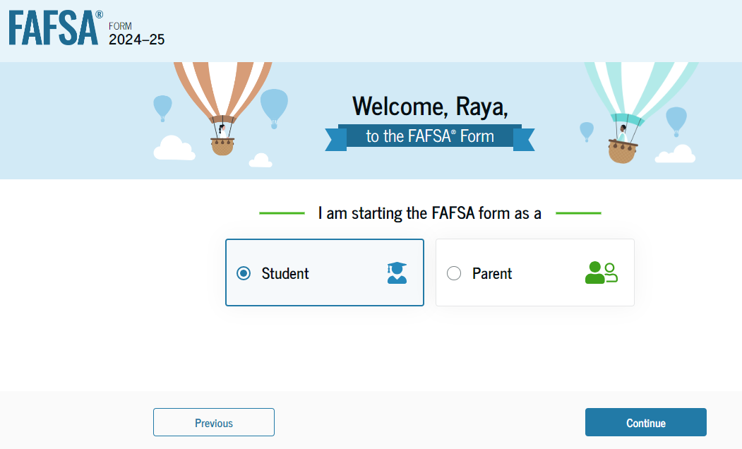
Dependent Student Roles
After logging in, the student can select the applicable role to fill out the FAFSA form: “Student,“ or "Parent.“ The student selects “Student."

Slide 50
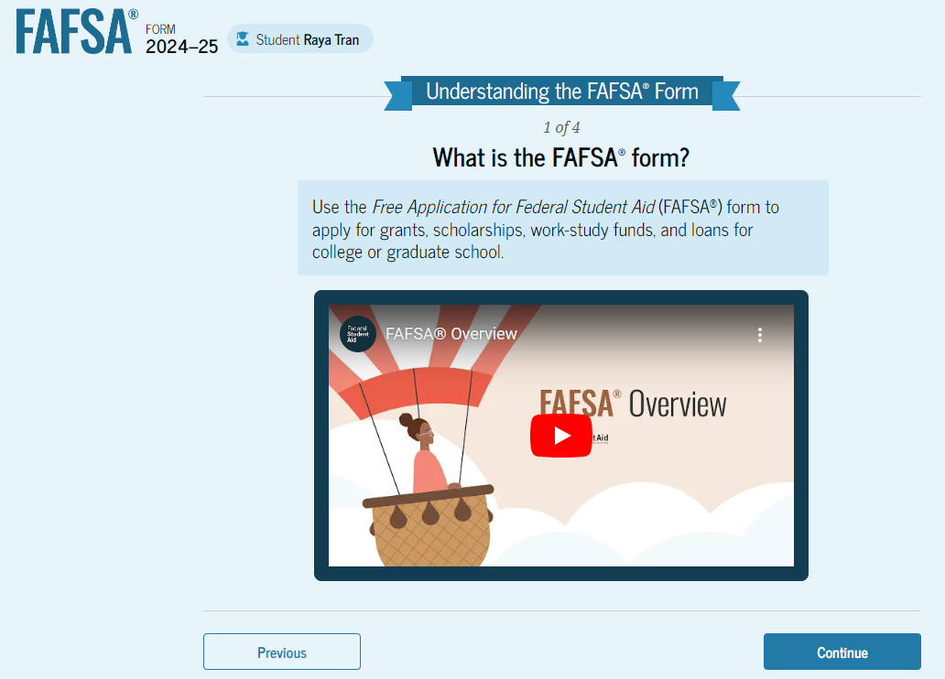
Dependent Student Onboarding (1 of 4)
When the student starts the 2024–25 FAFSA form for the first time, they are taken through the FAFSA onboarding process. The first onboarding page provides an overview of the FAFSA form and an accompanying video.

Slide 51
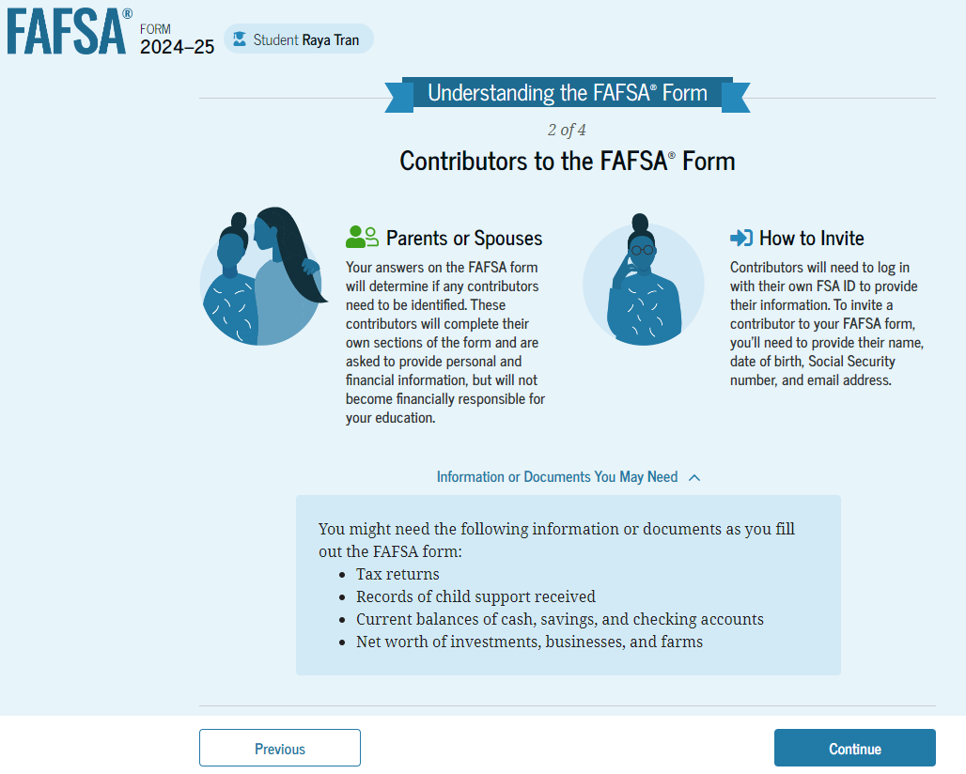
Dependent Student Onboarding (2 of 4)
The second FAFSA onboarding page provides information about the different roles that may be required to participate in the student’s FAFSA form and documents that may be needed to fill out the form.

Slide 52
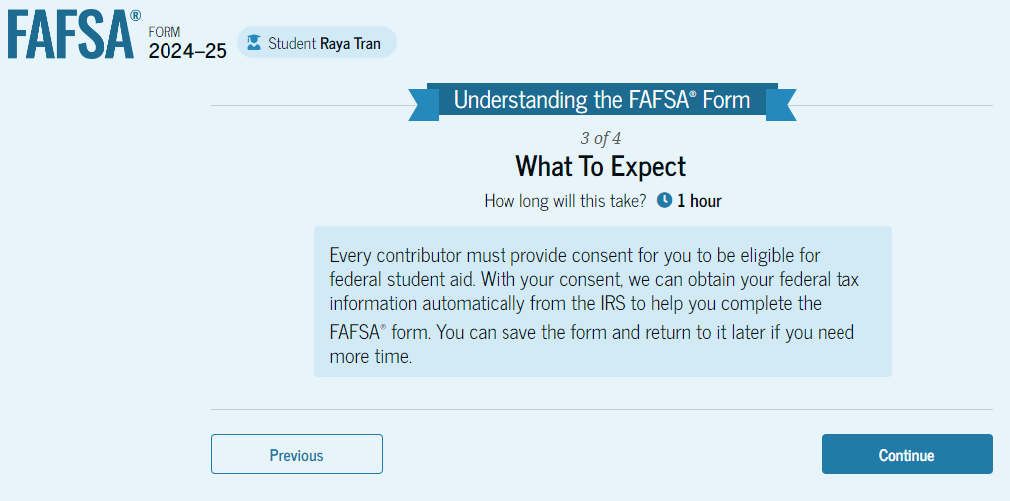
Dependent Student Onboarding (3 of 4)
The third FAFSA onboarding page provides information about the types of questions the student can expect to see and how they can get additional help with filling out the FAFSA form.

Slide 53
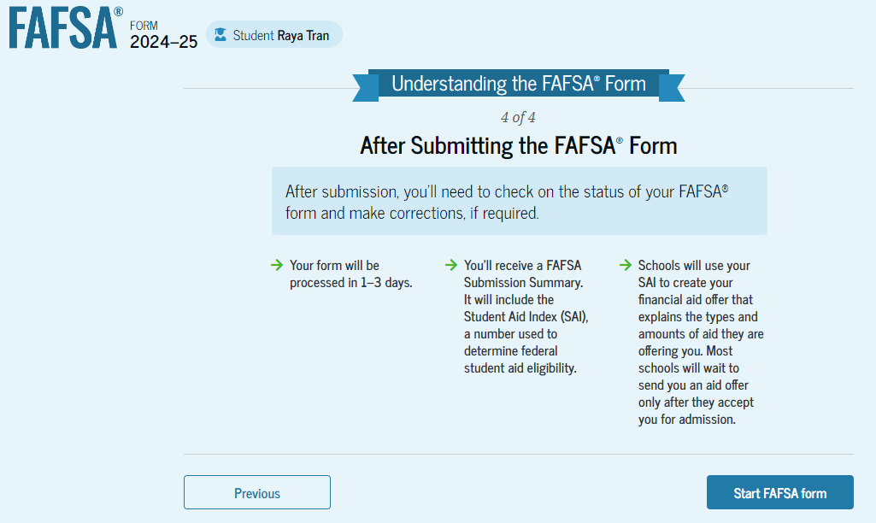
Dependent Student Onboarding (4 of 4)
The last FAFSA onboarding page provides information about what to expect once the FAFSA form is completed and submitted. On this page, the student can select "Start the FAFSA form" to begin.
Notes:
PRESENTER: These onboarding slides only appear the first time the student logs in.

Slide 54
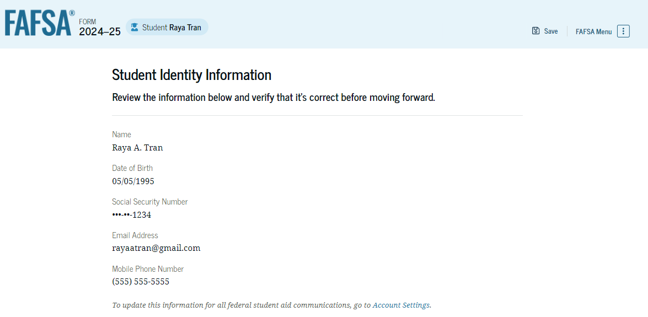
Dependent Student Identity Information
The student can verify that their personal information is correct.
To update any of the personal information, the student must access their Account Settings on StudentAid.gov.
For fields related to the student’s mailing address, the student can edit them directly on this page.

Slide 55
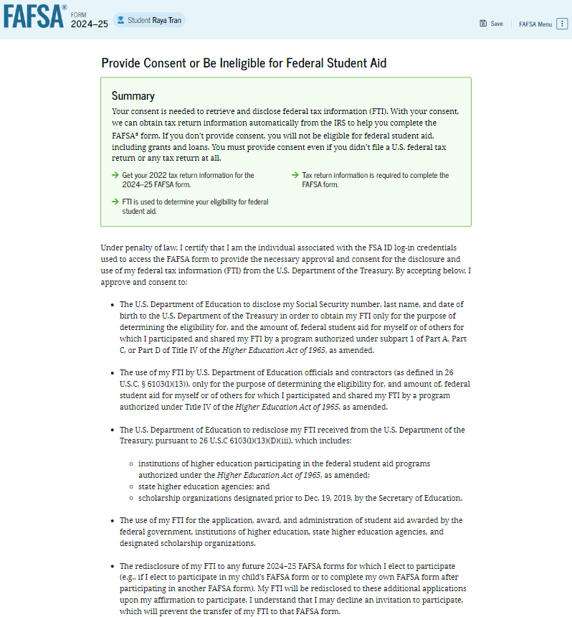
Dependent Student Consent and Approval
This page informs the student about consent and their federal tax information.
By providing consent, the student’s federal tax information is transferred directly into the FAFSA form from the IRS to help complete the Student Financials section.
The student selects "Approve" to provide consent and is taken to the next page.

Slide 56
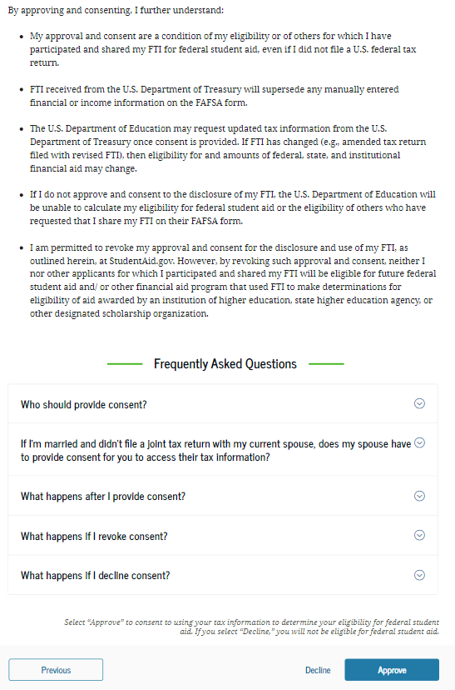
Dependent Student Consent and Approval
No student consent/approval = NO SAI is generated which means no Federal AID
Notes:
NO consent also means no state aid and at many schools, may also mean no institutional aid.

Slide 57
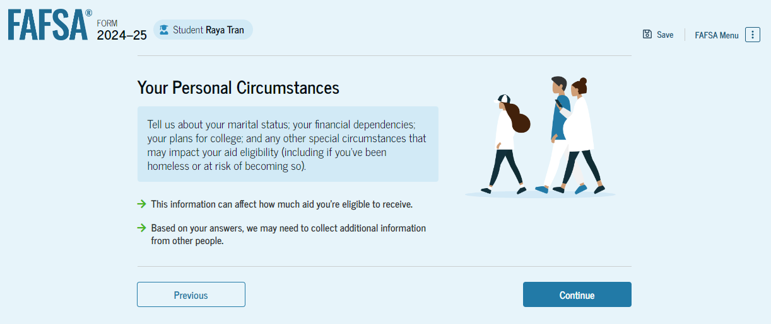
Dependent Personal Circumstances
This is the first page within the Student Personal Circumstances section.
Notes:
The focus on the person circumstances section is to confirm a student’s dependency status and who the contributors will be.

Slide 58
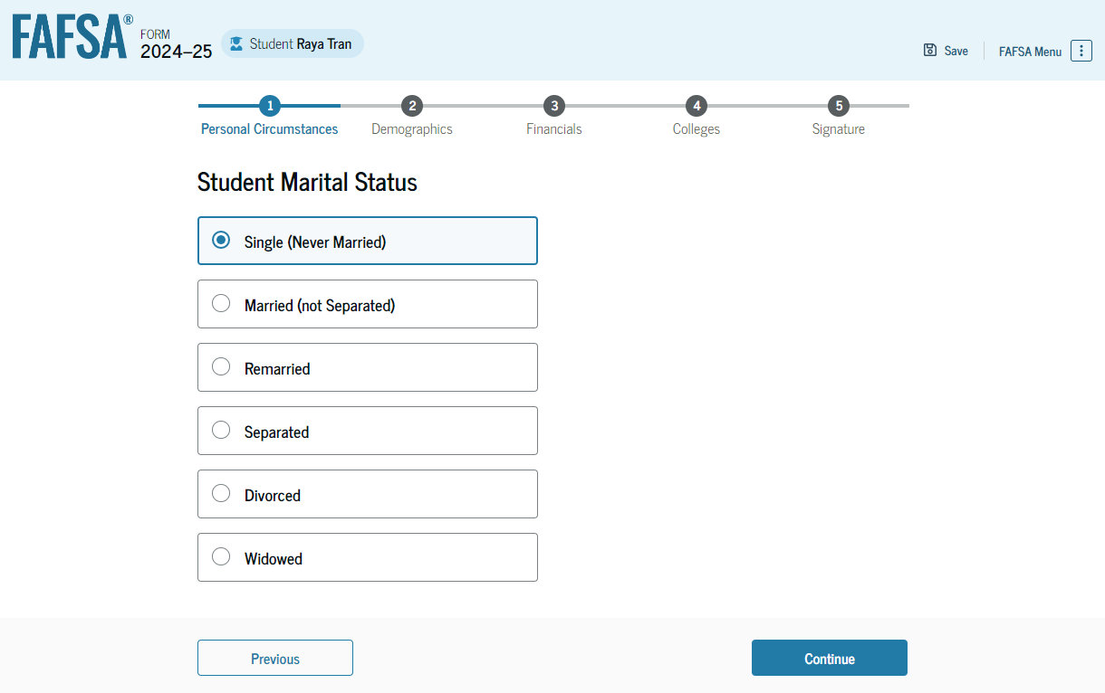
Dependent Student Marital Status
The student is asked about their marital status.

Slide 59
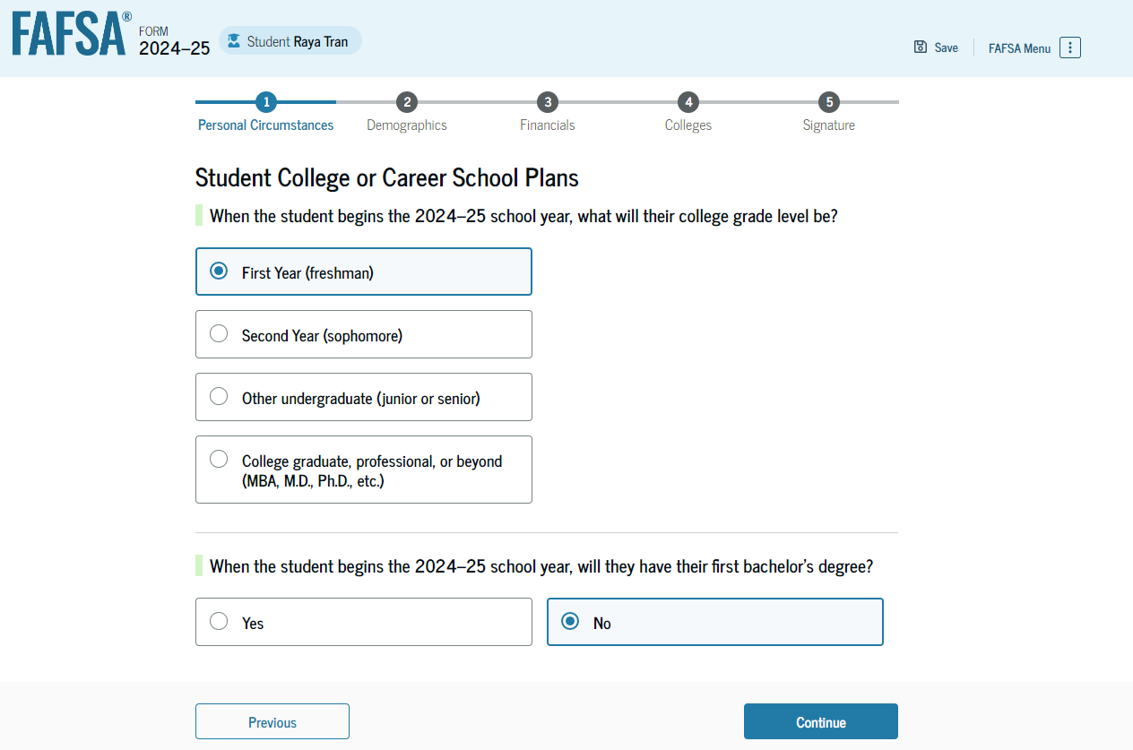
Dependent Student College or Career School Plans
The student is asked about their college grade level for the 2024–25 school year and if they will have their first bachelor’s degree.
The student selects that they will be a "First Year (freshman)" and that they will not have their first bachelor’s degree.

Slide 60
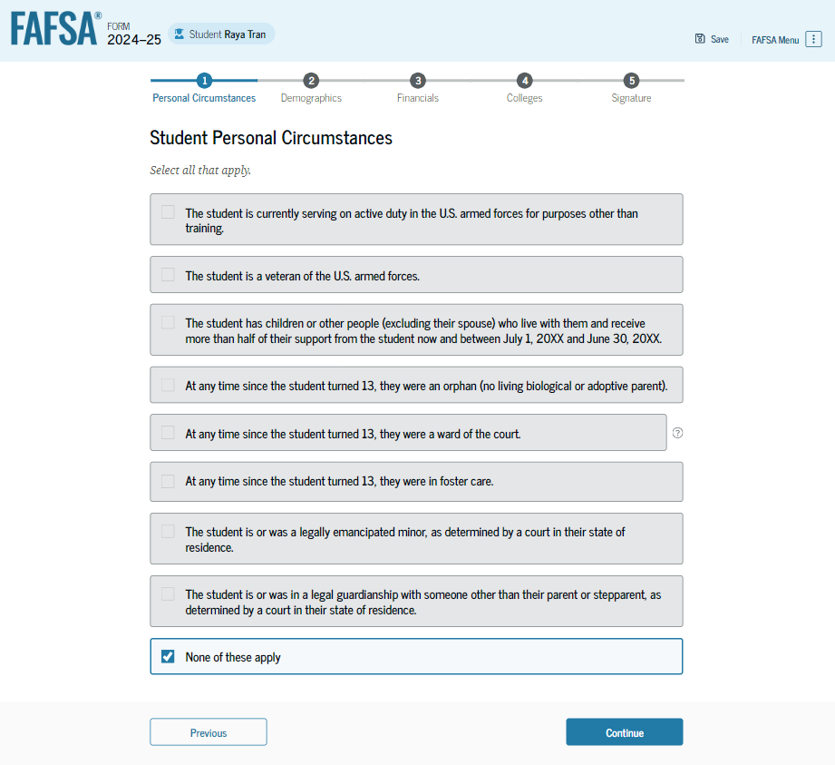
Dependent Student Personal Circumstances
The student is asked if any of the listed personal circumstances apply to them.

Slide 61
Dependent Student Other Circumstances
The student is asked if they were homeless or at risk of being homeless. The student selects "No."

Slide 62
Dependent Student Unusual Circumstances
The student is asked if unusual circumstances prevent them from contacting their parent(s). The student selects "No."

Slide 63
Dependent Student: Parent Refusal Questions
Based on the answers provided by the student, they are considered a dependent student.
The student is asked if they want a financial aid administrator to determine their eligibility for a Direct Unsubsidized Loan only.
This is an option if the student’s parents are unwilling to provide information. The student selects "No."

Slide 64
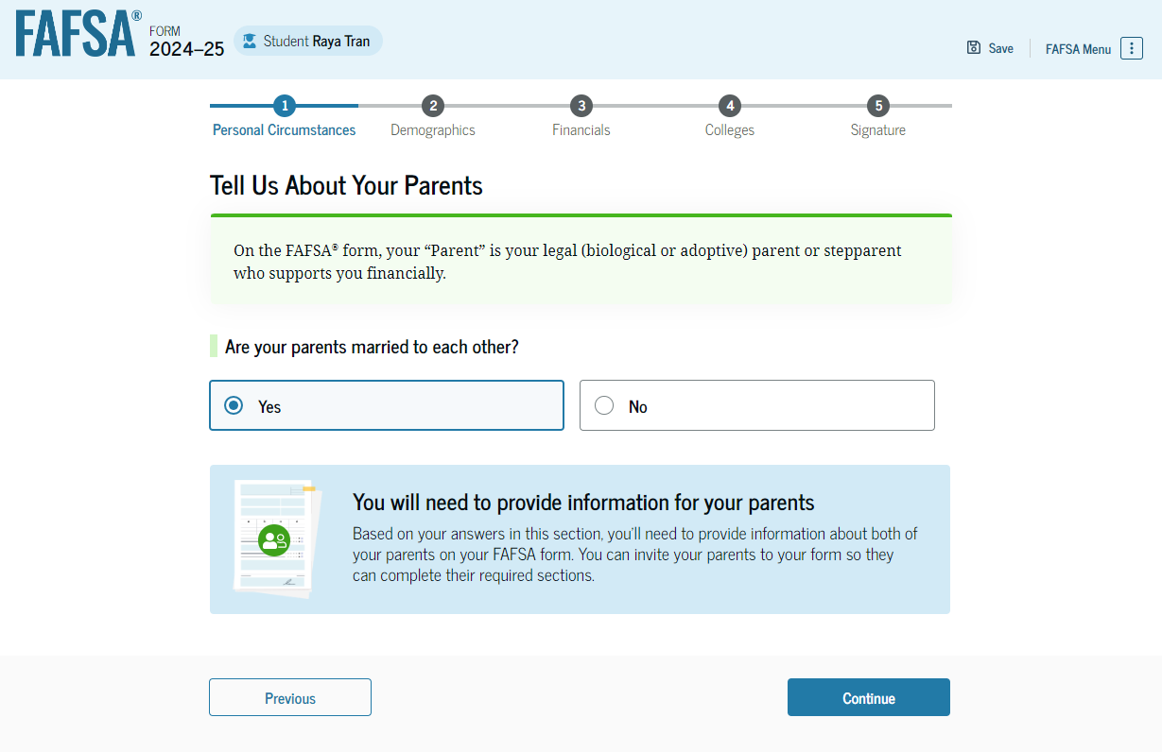
Dependent Student: Tell Us About Your Parents
As the student is considered dependent, they are asked to provide information about their parents.
The FAFSA form considers their “Parent” to be their legal (biological or adoptive) parent. The student is asked if their parents are married.
The student selects "Yes" and is required to invite their parents to their FAFSA form to complete the required parent sections.

Slide 65
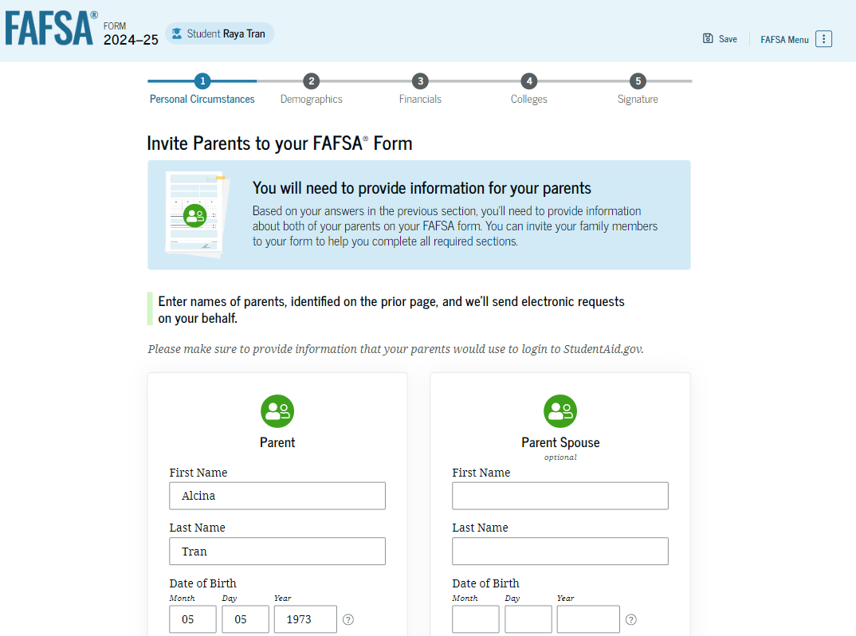
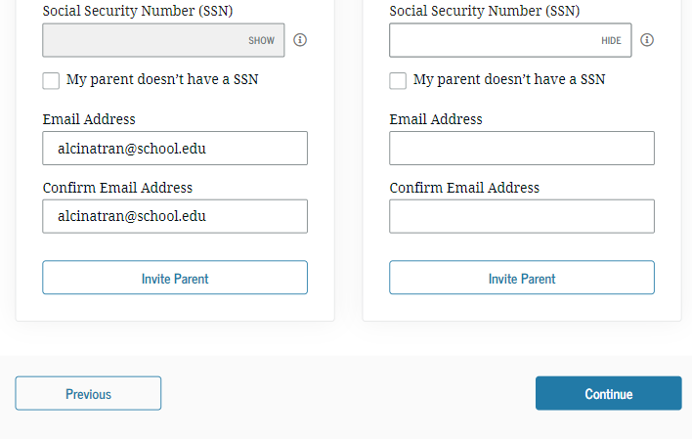
Dependent Student Invites Parents to FAFSA Form
The student is asked to enter information about their parent(s) to send them an invite to their FAFSA form.
Notes:
If the parent does not have an SSN, that box will force the student to provide the parent(s) mailing address.

Slide 66
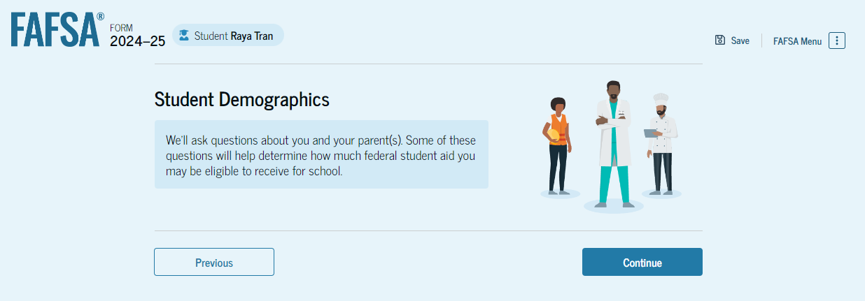
Dependent Student Demographics
This is the first view within the Student Demographics section. It provides an overview of the section.

Slide 67
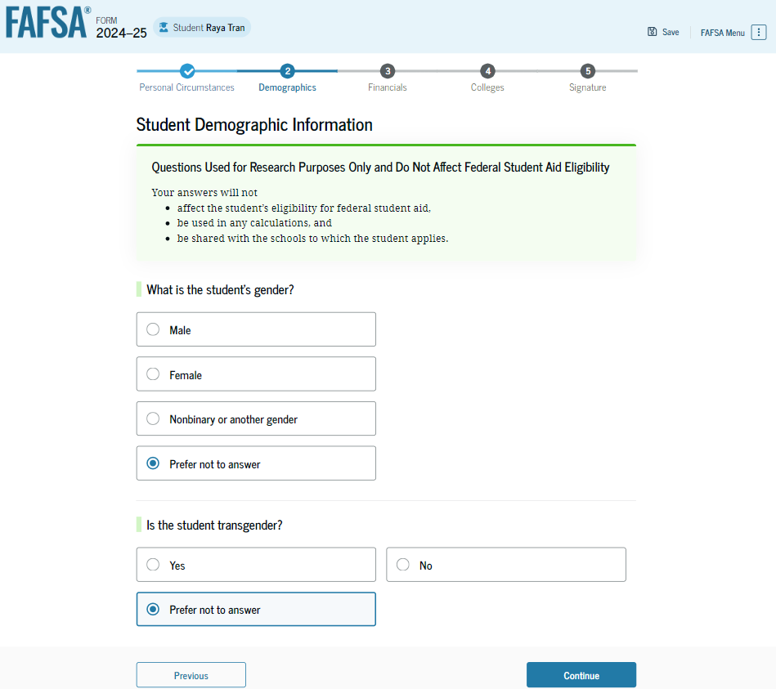
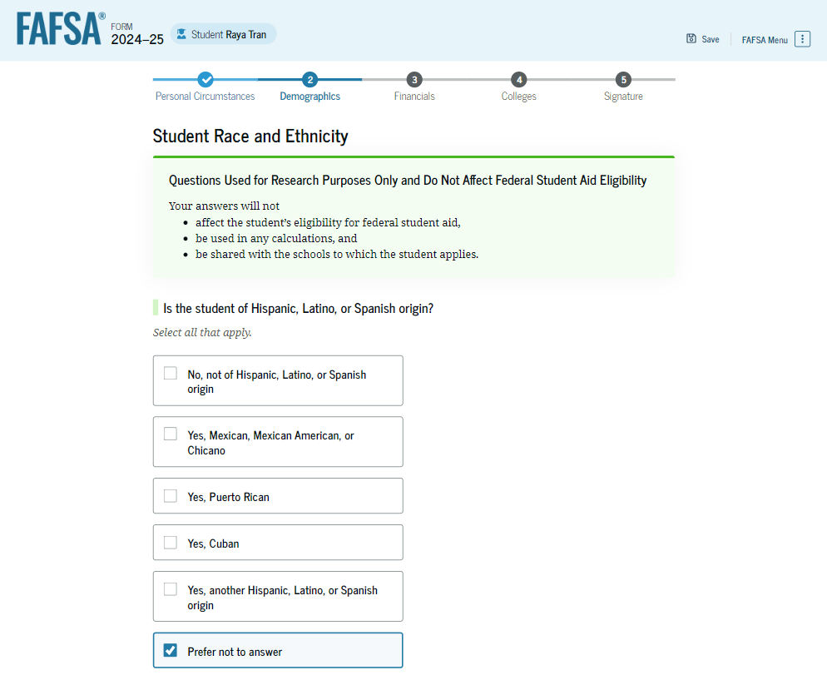
Dependent Student Demographic Information
Notes:
PRESENTER: the student MUST answer these questions to progress passed this, but ‘prefer not to answer’ is an option.
Transgender question has been removed.

Slide 68
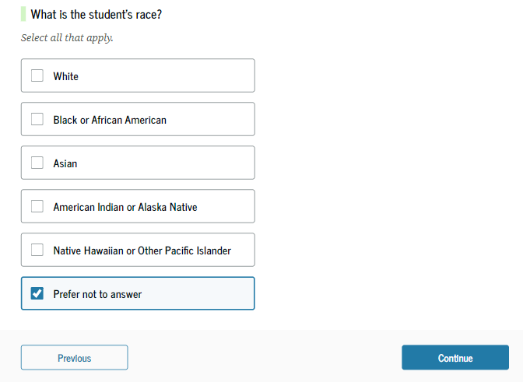
Dependent Student Demographic Information
Applicants must answer these questions but there is an option: “Prefer not to answer.”

Slide 69
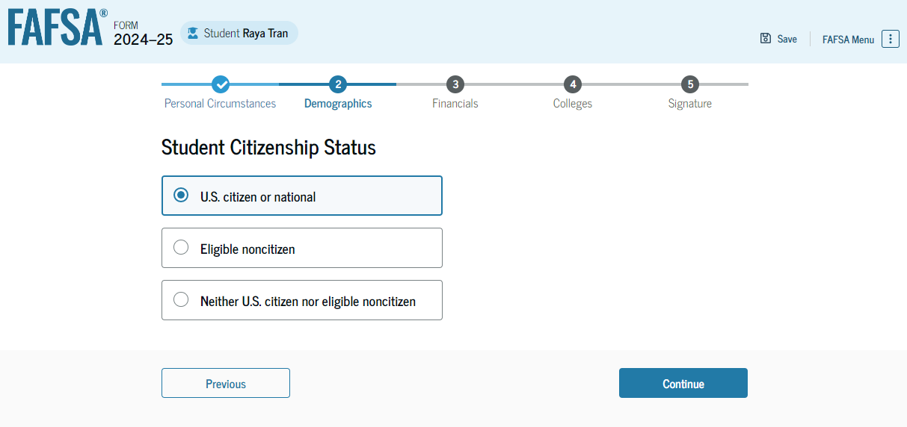
Dependent Student Citizenship Status
The student is asked about their citizenship status. The student selects the "U.S. citizen or national" option.

Slide 70
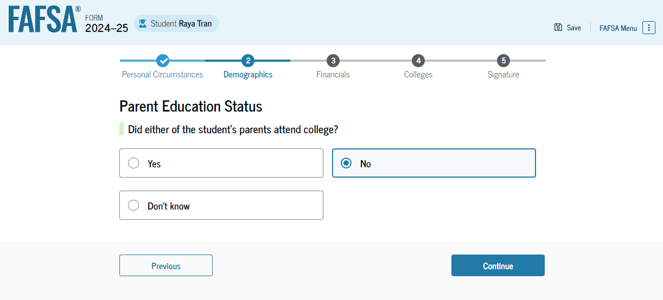
Dependent Student’s Parent Education Status
The student is asked about their parents’ education status. The student selects the “No” option.
Notes:
PRESENTER NOTE: this question is being update with more options related to attendance and completion of college.

Slide 71
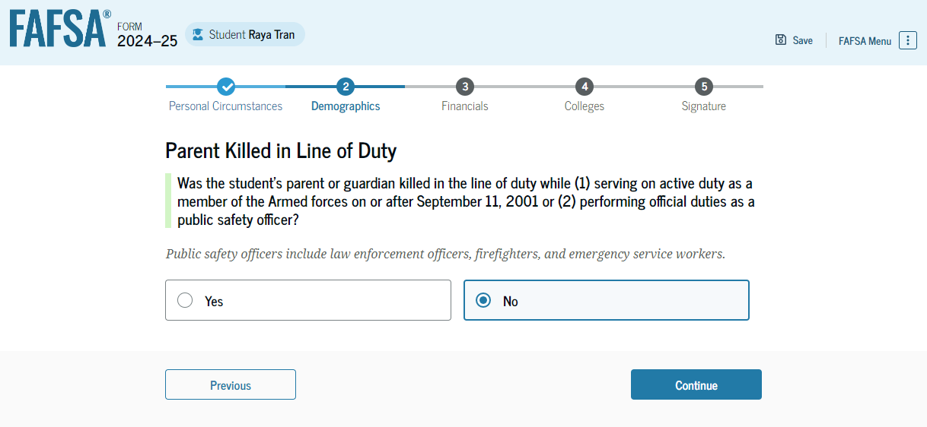
Dependent Student’s Parent Killed in Line of Duty
The student is asked if their parent was killed in the line of duty. The student selects the “No” option.

Slide 72
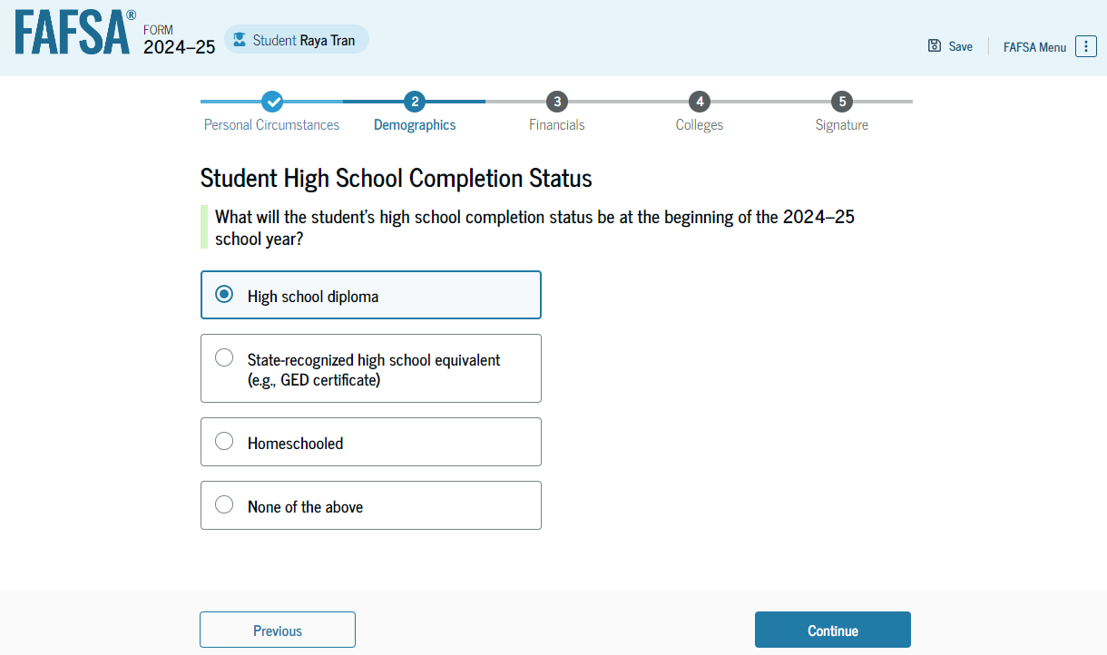
Dependent Student High School Completion Status
The student is asked what their high school completion status will be when they start the 2024–25 year.

Slide 73
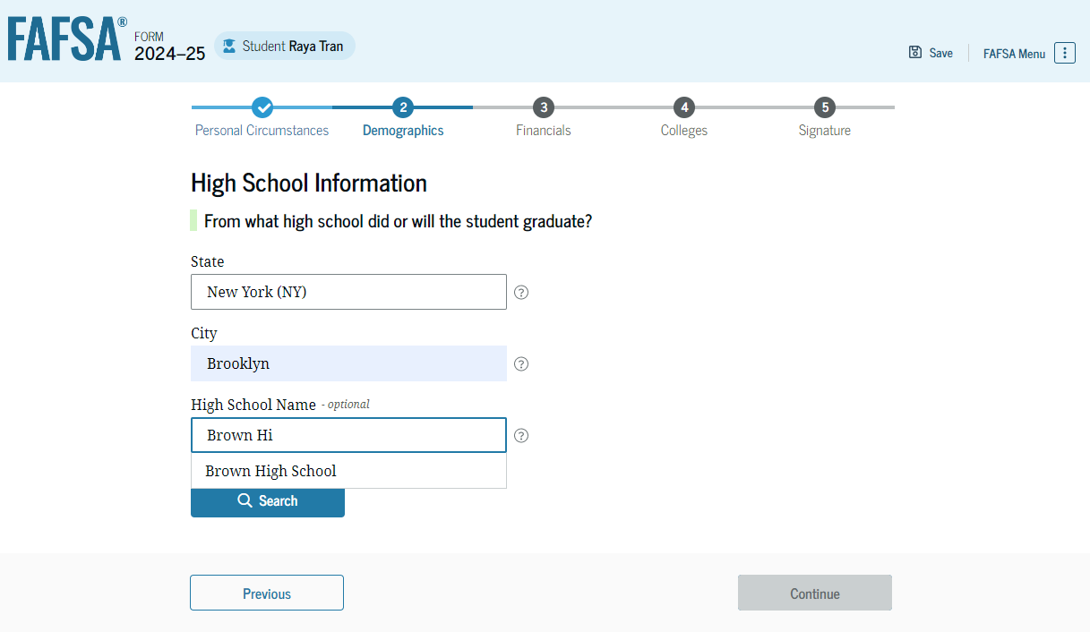
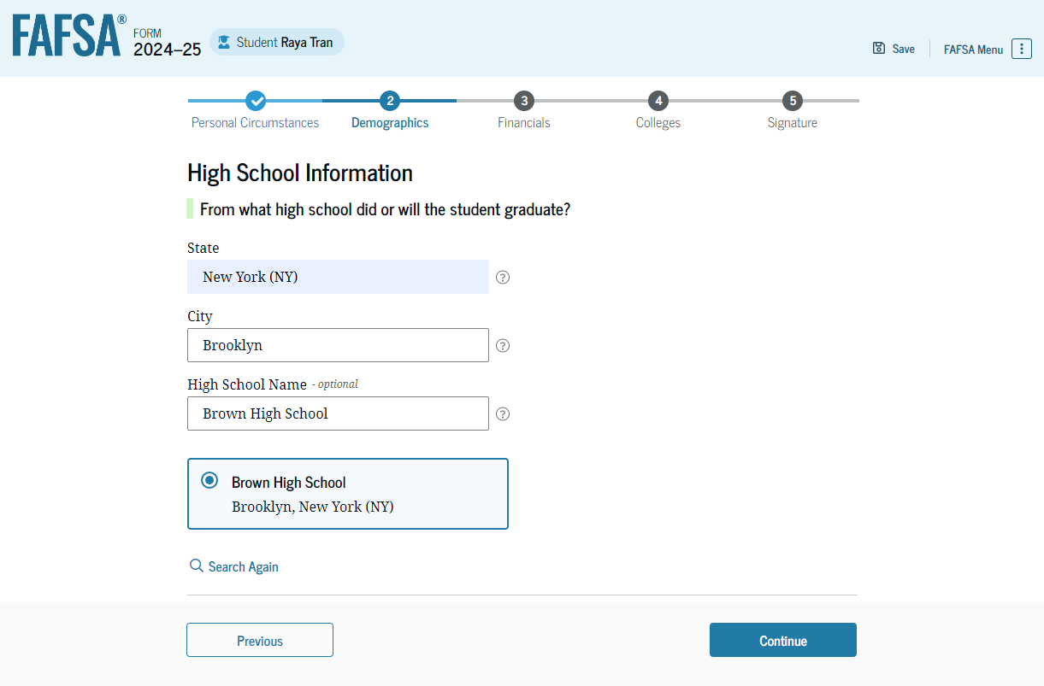
Dependent Student High School Information
The student is asked which high school they did or will graduate from. The student enters their high school’s state and city. After selecting "Search," they select the correct high school from the search results.

Slide 74
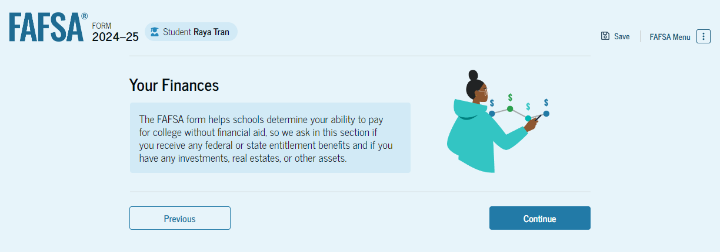
Dependent Student Financials
This is the first page within the Student Financials section. It provides an overview of the section.

Slide 75
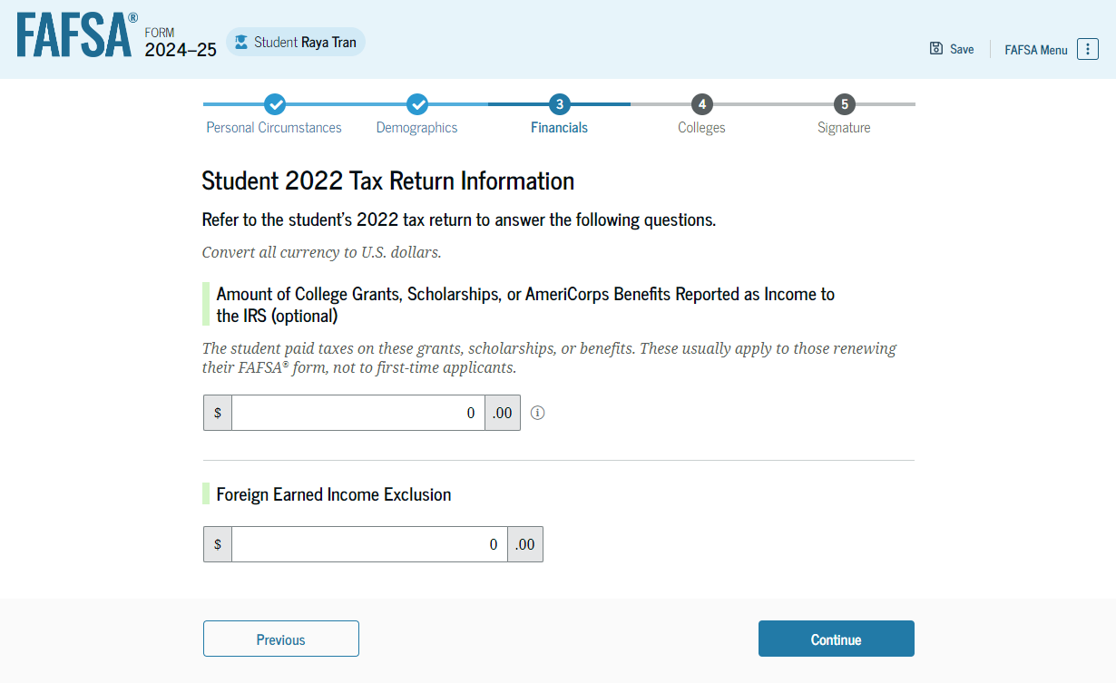
Dependent Student Tax Return Information
The student is asked questions about their 2022 tax return. The student enters a response in each entry field.

Slide 76
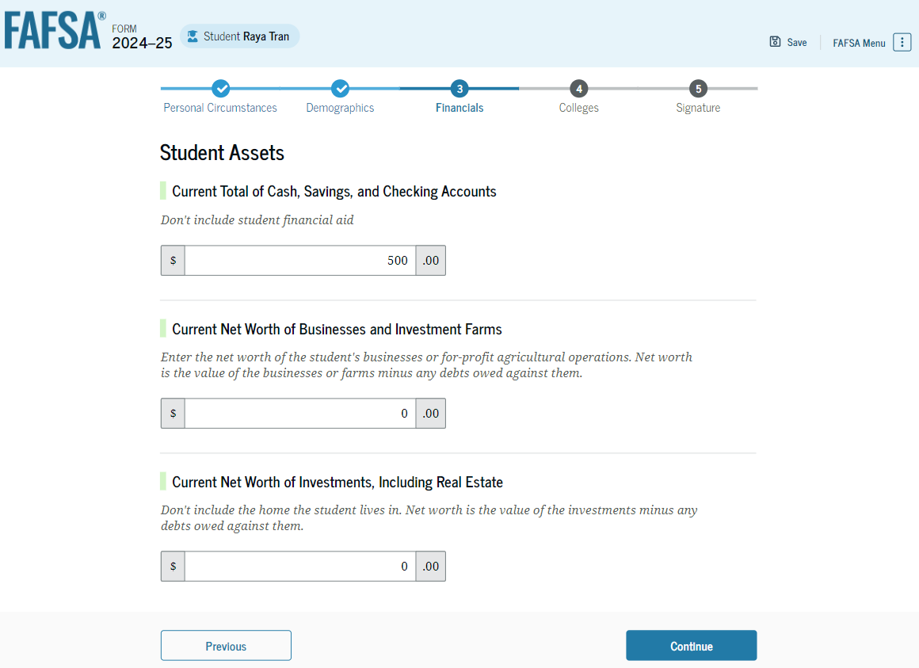
Dependent Student Assets
The student is asked about their assets. The student enters a response in each entry field.

Slide 77
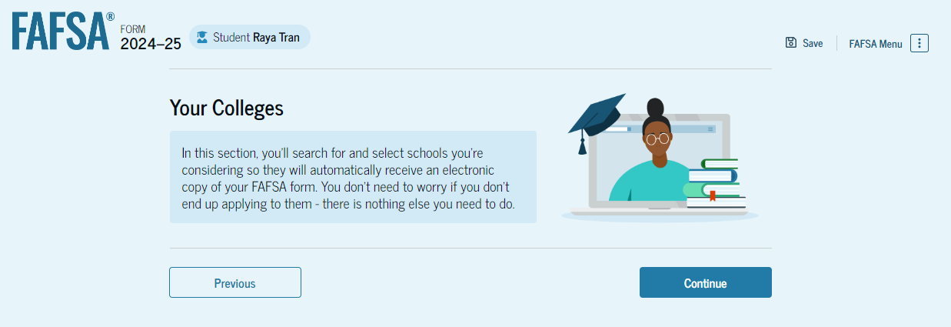
Dependent Student Select Colleges
This is the Select Colleges section, and the final part of the FAFSA form’s student section.

Slide 78
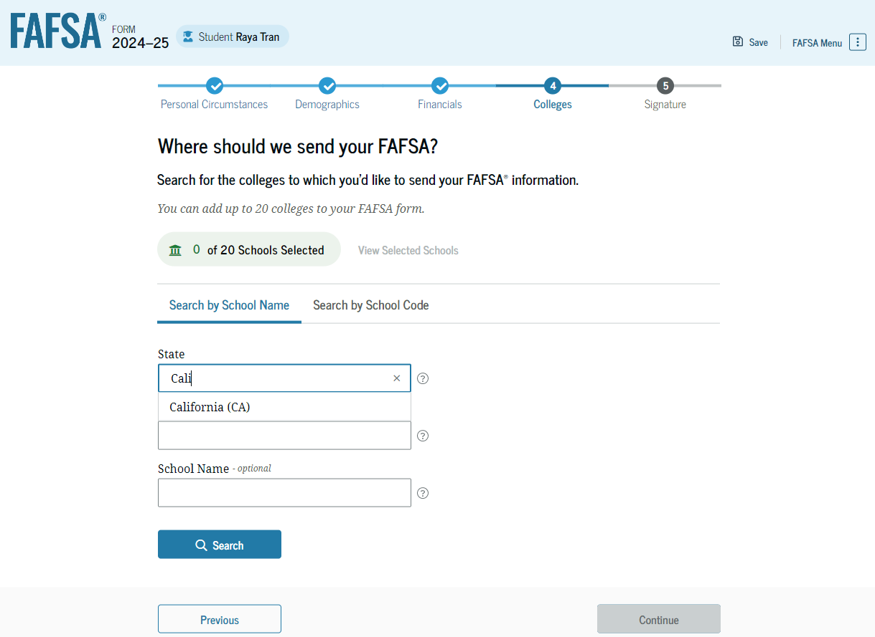
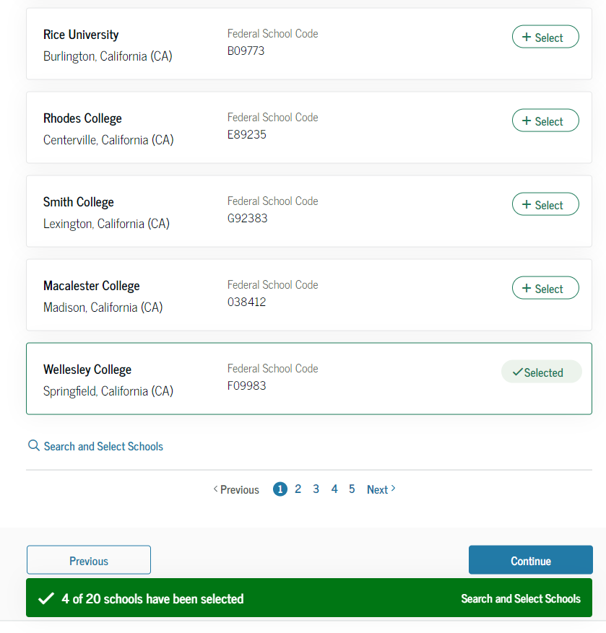
Dependent Student College Search
The student is asked to search for the colleges and/or career schools they would like to receive their FAFSA information.
Students can select to send their FAFSA information to a maximum of 20 schools.
Notes:
Presenter: Point out that colleges do not see what other colleges were listed on this form.

Slide 79
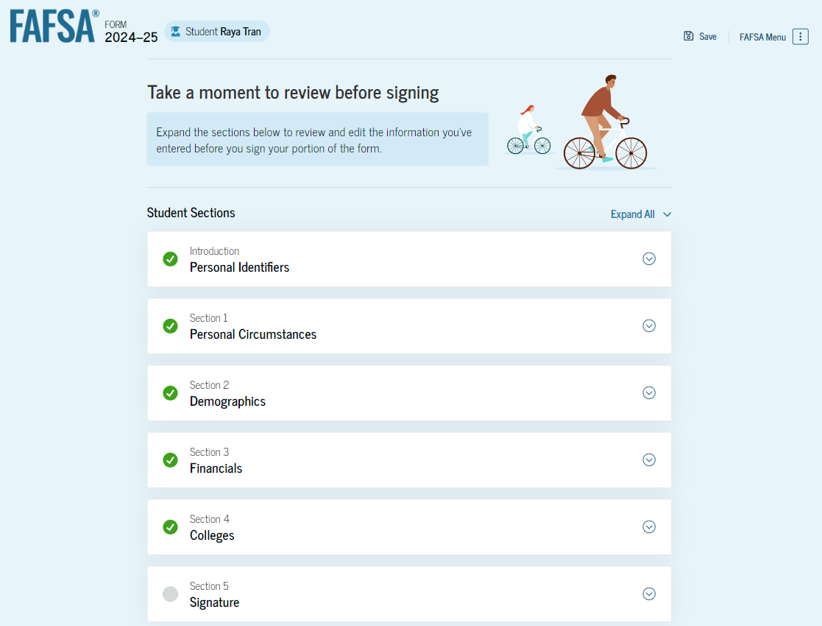
Dependent Student Review Page
The review page displays the responses that the student has provided in the FAFSA form.
The student can view all their responses by selecting "Expand All" or expand each section individually.
To edit a response, the student can select the question’s hyperlink and will be taken to the corresponding page.
Additionally, since the student invited their parent into the form, they see the parent contributor section and the status of their parent’s invite.
Notes:
The review page displays the responses that the student has provided in the FAFSA form.
The student can view all their responses by selecting "Expand All" or expand each section individually.
To edit a response, the student can select the question’s hyperlink and will be taken to the corresponding page.
Additionally, since the student invited their parent into the form, they see the parent contributor section and the status of their parent’s invite.

Slide 80
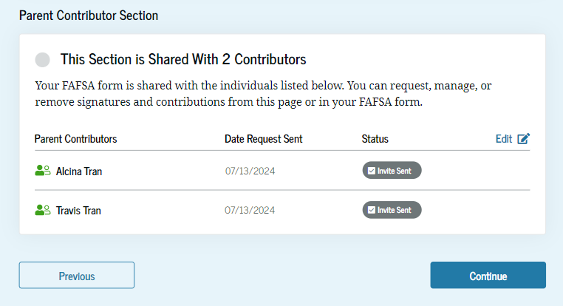
Dependent Student Review Page

Slide 81
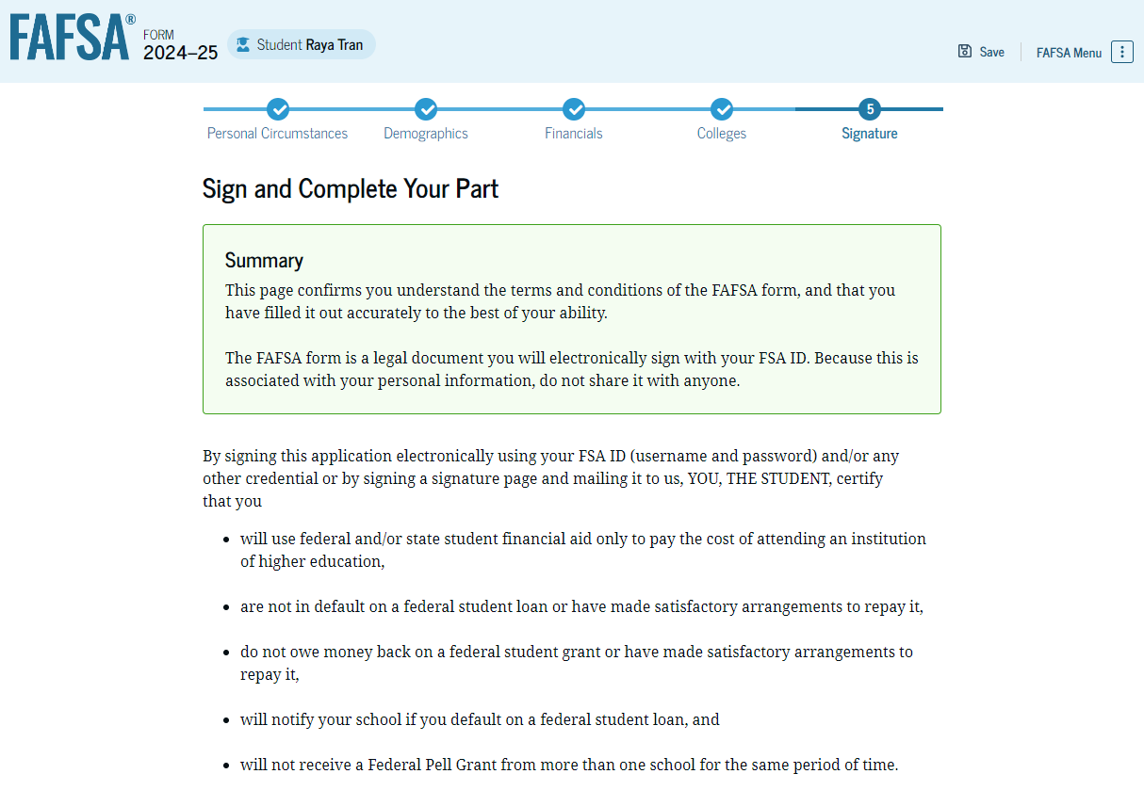
Dependent Student Signature
Notes:
On this page, the student acknowledges the terms and conditions of the FAFSA form and signs their section.
After agreeing and signing, the student is able to submit their section of the FAFSA form. Since parent information has not been provided, the FAFSA form is not considered complete and can’t be processed yet.

Slide 82
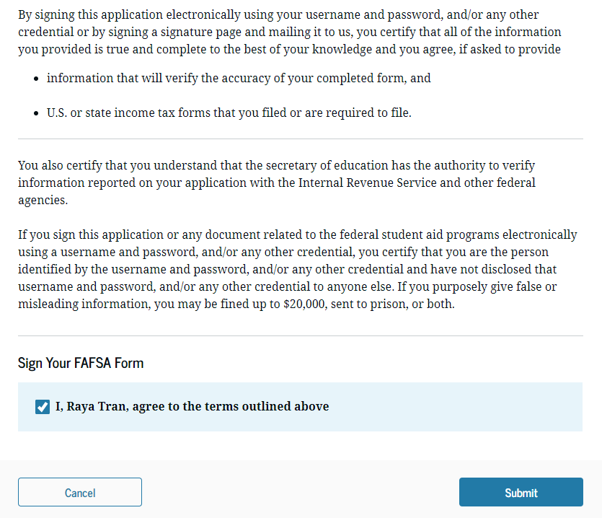
Dependent Student Signature

Slide 83
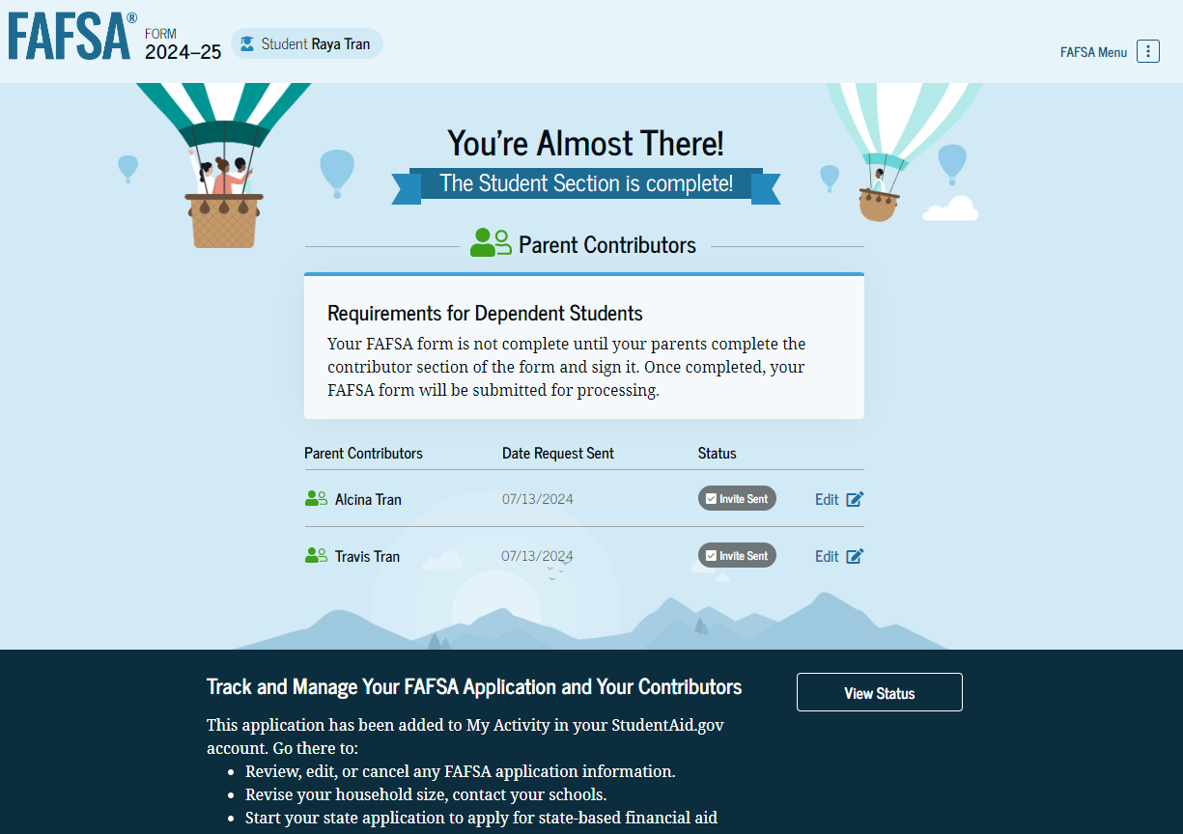
Dependent Student Section Complete
Notes:
Upon signing the student section, the student is presented the student section complete page.
This page displays information for the student about next steps, including tracking their FAFSA form.
The student is reminded that their form is not completed and can’t be submitted until the parent completes the contributor section of the form and signs it.
Next, in this scenario, the student’s invited parent will enter the FAFSA form and complete the parent section.

Slide 84
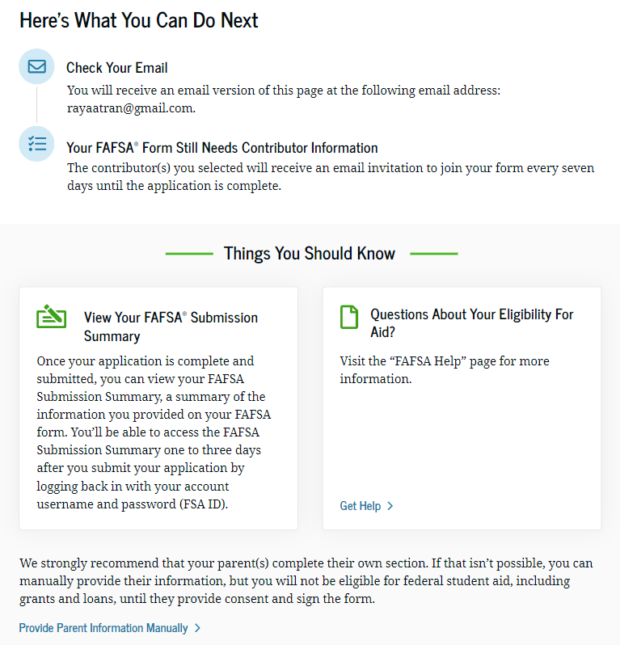
Dependent Student Section Complete

Slide 85
Dependent Student’s Parent Email
This view demonstrates a parent opening the FAFSA invitation from their email. The parent selects “Log In" and is taken to StudentAid.gov.
Notes:
This is NOT a view within StudentAid.gov nor the FAFSA form. It is a screenshot of the email the parent receives.

Slide 86
Dependent Student’s Parent Log In
The parent is taken from their email to the “Log In” page to enter their log-in credentials.
To access the FAFSA form, all users are required to have an FSA ID (account username and password).
If the parent doesn't have an FSA ID, they can select "Create an Account."

Slide 87
Parent Status Center – My Activity
After successfully logging in, the parent is taken to their “My Activity” page. The parent sees an invitation to be a contributor on the student’s FAFSA form.

Slide 88
Dependent Student’s Parent Contributor
This page provides information about being a contributor on a FAFSA form.

Slide 89
Dependent Student’s Parent Onboarding (1 of 4)
When the parent enters a 2024–25 FAFSA form for the first time, they are taken through the FAFSA onboarding process. The first onboarding page provides an overview of the FAFSA form and an accompanying video.

Slide 90
Dependent Student’s Parent Onboarding (2 of 4)
The second FAFSA onboarding page provides information about the different roles that may be required to complete the student’s FAFSA form and the documents that may be needed to fill out the form.

Slide 91
Dependent Student’s Parent Onboarding (3 of 4)
The third onboarding page provides information about the types of questions the parent can expect to see and how they can get help in filling out the FAFSA form.

Slide 92
Dependent Student’s Parent Onboarding (4 of 4)
The last onboarding page provides information about what to expect once the FAFSA form is completed and submitted. On this page, the parent selects "Start the FAFSA form" to begin the parent section.
Notes:
NOTE TO Presenters:
Parents will only see these videos once.

Slide 93
Dependent Student’s Parent Identity Information
This is the first page within the parent section.
The parent can verify that their personal information is correct. To update any of the personal information, the parent must access their Account Settings on StudentAid.gov.
For fields related to the parent’s mailing address, the parent can edit them directly on this page.

Slide 94
Dependent Student’s Parent Identity Information

Slide 95
Dependent Student’s Parent Provides Consent
This page informs the parent about consent and their federal tax information.
By providing consent, the parent’s federal tax information is transferred directly into the FAFSA form from the IRS to help complete the Parent Financials section.
The parent selects "Approve" to provide consent and is taken to the next page.
Notes:
It is important to note and stress that contributors will NOT see any of the tax information transferred. Once the parent and student provide consent and submit, the transferring of tax information occurs between the IRS and FSA and is provide only to the schools. They will not have an opportunity to ‘change’ what is transferred from the IRS as they have been with the DRT.

Slide 96
Dependent Student’s Parent Provides Consent and Approval

Slide 97
Dependent Student’s Parent Demographics
This is the first page in the Parent Demographics section. It provides an overview of the section.

Slide 98
Dependent Student’s Parent Current Marital Status
The parent is asked about their current marital status. They select the "Married (not Separated)" option.

Slide 99
Dependent Student’s Parent Financials
This is the first page within the Parent Financials section. It provides an overview of the section.

Slide 100
Dependent Student’s Parent Federal Benefits Received
This page asks the parent if they or anyone in their family has received federal benefits. The parent selects "None of these apply."
Notes:
PRESENTER: Remind parents to select the free and reduced lunch is student receives as it will mean they will not report any assets regardless of income.

Slide 101
Dependent Student’s Parent Tax Filing Status
This page asks the parent about their tax filing status. The parent selects "Yes" to "Did or will the parent file a 2022 joint tax return with their current spouse?"

Slide 102
Dependent Student’s Parent Family Size
This page asks the parent if their family size has changed. The parent selects the “Yes“ option.

Slide 103
Dependent Student’s Parent Number in College
This page asks the parent how many people in the family will be in college between July 1, 2024, and June 30, 2025.
The parent enters a response into the entry field.
Notes:
REMINDER that this question does not have any impact on the calculation of the SAI.

Slide 104
Dependent Student’s Parent Tax Return Information
The parent is asked questions about their 2022 tax return. The parent enters a response in each entry field.

Slide 105
Dependent Student’s Parent Assets
The parent is asked about their assets. The parent enters a response in each entry field.
Notes:
PRESENTER: point out that child support is reported for the previous full calendar year.
PRESENTER: remind that ALL small businesses and farm values are now reported. No longer an exemption on the number of employees.

Slide 106
Dependent Student’s Other Parent Information
The parent is asked to provide information about their spouse or partner.

Slide 107
Dependent Student’s Parent Review Page
The review page displays the responses that the parent has provided in the FAFSA form.
Notes:
In this scenario, the parent can only view responses within the parent section of the student’s FAFSA form.
The parent can view all their responses by selecting "Expand All" or expand each section individually.
To edit a response, the parent can select the question’s hyperlink to be taken to the corresponding page.

Slide 108
Dependent Student’s Parent Signature
On this page, the parent acknowledges the terms and conditions of the FAFSA form and signs their section. Since all required sections are complete, the parent can both sign and submit the student’s FAFSA form.
Notes:
PRESENTER: The contributor that signs last will be the person that submits the FASFA.

Slide 109
Dependent Student FAFSA Confirmation
Upon submitting the student’s FAFSA form, the parent is presented an abbreviated confirmation page.
Notes:
This page displays information about tracking the student’s FAFSA form and next steps.
The student will receive an email with the full, detailed confirmation. If the student is the one that submits, they will receive the full confirmation page.
With the student and parent sections completed and signed, the FAFSA form is now considered complete and submitted for processing.

Slide 110
Student Aid index (SAI)

Slide 111
Student Aid Index and Need Analysis Changes
Student Aid Index (SAI) replaces Expected Family Contribution (EFC).
Broadly speaking, the SAI will create higher levels of financial need.
Like other federal programs, the federal poverty level thresholds will be used for eligibility.

Slide 112
Student Aid index formula
Reduces the number of income items and allowance against income.
Changes items included as assets.
Changes family size and removes number in college.
Allows for negative SAI up to -$1500.
No allowance to prorate SAI other than nine months.

Slide 113
More students eligible for federal aid
The new SAI formula projects that more students will be eligible for Pell Grants than under the current formula.
The new formula also projects that students who currently receive a partial Pell Grant will likely be eligible for a larger one.
The new formula may make more students eligible for the Ohio College Opportunity Grant.

Slide 114
Student aid index
Income on the FAFSA will now mostly be provided by Direct Data Exchange (DDX)
AGI
Taxes Paid
Number of dependents on IRS tax return
Income earned from work (not W2 but from 1040)

Slide 115
Fafsa submission summary

Slide 116
FAFSA Submission Summary Landing Page
The FAFSA Submission Summary replaces the Student Aid Report (SAR).
The student receives a FAFSA Submission Summary for their processed FAFSA form and subsequent corrections they submit.

Slide 117
FAFSA Submission Summary Landing Page
The FAFSA Submission Summary is broken into four tabs:
Eligibility Overview
FAFSA Form Answers
NOTE: Information transferred from the IRS will not be shown on the Summary
School Information
Next Steps
At the top, the student will see information about when their form was received and processed.
They also have the option to print their FAFSA Submission Summary to keep for their records.

Slide 118
Eligibility Overview
On the Eligibility Overview tab, the student sees information about what federal student aid they may be eligible for, such as a Federal Pell Grant and Federal Direct Loans.
They are also able to view the Student Aid Index. Any amounts of financial aid that display on this tab are estimates and are not guaranteed.
Final determination of the student’s financial aid eligibility is provided by their school’s financial aid office.

Slide 119
Eligibility Overview

Slide 120
FAFSA Form Answers
On the FAFSA Form Answers tab, the student sees the answers that they and, if applicable, their contributor(s) provided on their FAFSA form. If any of the provided answers are incorrect, the student can choose to start a correction.
Notes:
PRESENTER: the student may make corrections while logged into the FAFSA Submission Summary. If a correction needs to be made to the parent section, the parent will need to log in.

Slide 121
School Information
On the School Information tab, the student sees information about the college(s) and/or career school(s) that they selected to send their FAFSA information.
The student can compare the graduation rate, retention rate, transfer rate, default rate, median debt upon completion, and average annual cost of their selected schools.

Slide 122
Next Steps
On the Next Steps tab, the student sees comments that pertain to their FAFSA form. Some comments may require the student to start a correction or send additional documentation to their school. Other comments may be informational and do not require any further action from the student.

Slide 123
More Resources
Lastly, along the right side of their FAFSA Submission Summary, the student can choose from additional resources, including visiting Aid Summary or College Scorecard.

Slide 124
Federal Aid Programs

Slide 125
FEDERAL AID PROGRAMS
Pell Grant
TEACH
Campus-Based Programs
Direct Loans

Slide 126
FEDERAL PELL GRANT
Maximum award amount increased by $500 for 2023-2024.
$7,395 maximum award for full-time enrollment and an Expected Family Contribution (EFC) of zero.
Beginning 2024-2025 award year, Pell eligibility will be determined using the Student Aid Index (SAI) applicant’s family size, poverty tables and AGI.

Slide 127
FEDERAL PELL GRANT
Students have a maximum number of terms they can receive Pell Grant for 2023-2024.
600% of an annual award amount, or the equivalent of 12 full-time semesters.
Year-round Pell Grants remain.
Students can attend on a year-round basis and receive up to 150% of their annual award.
Starting 2024-25, will no longer have half-time enrollment requirement.
Serves as an incentive to complete the credential/degree.

Slide 128
Federal Pell Grant
Say good-bye to the Pell chart in 2024-2025
Pell Grant eligibility in 2024-25 determined in one of three ways.
Maximum Pell Grant
Minimum Pell Grant
Calculated Scheduled Pell Grant
ED will publish the Max and Min Pell amounts for the award year
Not yet known (will be in $5 increments)
Disbursement amounts calculated using Enrollment Intensity
Year-Round Pell now for students enrolled less than half-time

Slide 129
Federal Pell Grant
Calculated Scheduled Pell Grant
Students not eligible for an automatic Maximum Pell Grant may be eligible for a Calculated Scheduled Pell Grant
How to calculate:
Published Maximum Pell Grant (unknown at this time) minus Student Aid Index (SAI) = Calculated Scheduled Pell Grant, rounded to the nearest $5
EXAMPLE
Max Pell = $7850 (actual amount not yet known)
SAI = 1,002
Calculated Scheduled Pell = $7,850 – 1,002 = $6,848 ---- Rounded to $6,850

Slide 130
Federal Pell Grant
2024-2025 Pell based on Enrollment Intensity
Pell Grant disbursement amounts will be based on number of enrolled credits
No longer based on an enrollment category (ex. Full-time, Half-time)
Number of enrolled credits ÷ credits required for full-time enrollment (i.e.: 12 credit hours)
Round to the nearest whole percent using standard rounding rules
EXAMPLE
Student eligible for Max Pell (ex. $7850)
Enrolled for Fall and Spring Semester

Slide 131
TEACH Grant 2023-2024
For any 2023–2024 TEACH Grant first disbursed on or after Oct. 1, 2023, and before Oct. 1, 2024, the maximum award of $4000 is reduced by 5.7% ($228).
Grant of up to $3,772 per year to students who intend to teach in a public or private elementary or secondary school that serves students from low-income families.
Service requirement upon graduation must be met, or grant becomes an Unsubsidized Direct Loan that must be re-paid!
Notes:
Teacher Education Assistance for College and Higher Education Grant….

Slide 132
CAMPUS-BASED PROGRAMS 2023-2024
Can vary significantly in amount between colleges and universities.
Priority Deadlines can impact eligibility between schools.
For most schools, FWS earnings are given in paycheck form and not applied directly to the student’s bill.
Federal Supplemental Education Opportunity Grant (SEOG)
Federal Work-Study
Remember to double check Priority Deadlines. Colleges many have made changes due to the delayed opening of the FAFSA to December 2023.
Notes:
Speaker Note:
Reference the “FAFSA Priority Deadline OASFAA 2024-25” --survey document Outreach Committee has reached out to colleges and Universities to collect – for first time in long time there were MANY changes. Especially to the following
“FAFSA Priority Date (Fall Starts; Regular Decision)* “
“Estimated Aid Offer Start Date”

Slide 133
FEDERAL WORK-STUDY (FWS)
Undergraduate and graduate students are eligible.
Employment can be on or off campus.
FWS wages are subtracted from income in the SAI calculation.
FWS wages are no longer reported on the FAFSA by the student.
Ohio Minimum Wage in 2023 is $10.10/hour.
There is a difference between work-study and “work” or “employment” on an aid offer.
Interest in Work-Study question removed from FAFSA. Alternative collection of interest may be used by schools.
Notes:
While this is rare, some schools will list an arbitrary “work” award. the difference between work study and “work” or “summer job”-, i.e. some schools are putting “summer income, $2,000,” on the award letter basically suggesting that students get a job.
Students must work their maximum number of allowed hours to earn their full work study award.
In most cases, FWS earning are not applied directly to the students bill but earned through a paycheck like any other employment.
Starting in 2024-2025, FWS is still ‘excluded’ from the future FAFSA based on the appropriate tax year, however, student no longer has to report it on the FAFSA, it will be automatically pulled from FSA as a result of schools being required to report FWS earnings for all students.

Slide 134
Federal SEOG
Offered to undergraduates with exceptional financial need.
Award ranges from $100 to $4,000, depending on when student applies, financial need, and the funding and policies of school attending.

Slide 135
DIRECT LOANS: UNDERGRADUATE 2023-2024
Direct Subsidized and Unsubsidized Loans are two separate, unique types of loans that are awarded separately.
Subsidized Undergraduate | Unsubsidized Undergraduate
Need-Based | Not Need-Based
Interest is fixed at 5.50% for new undergraduate loans disbursed during 2023-2024*; interest is subsidized while the student is in school and during deferment. Loan fees are 1.057% (On or after 10/1/20 and before 10/1/24) | Interest is fixed at 5.50% for all new loans disbursed during 2023-2024*; interest accrues from time of disbursement of the funds. Loan fees are 1.057% (On or after 10/1/20 and before 10/1/24)
*Interest rates recalculated annually and are effective July 1st based on the 10-year treasury note index plus 2.05%, capped at 8.25%.
Notes:
Fees for Federal Student Loans
Most federal student loans have loan fees. These fees are a percentage of the total loan amount.
A loan fee comes out of the amount of money that is disbursed (paid out) to you while you’re in school. This means the money you receive will be less than the amount you actually borrow.
You’re responsible for repaying the entire amount you borrowed and not just the amount you received.
The chart below shows the loan fees for Direct Subsidized Loans, Direct Unsubsidized Loans, and Direct PLUS Loans first disbursed on or after Oct. 1, 2019.
Loan Fees for Direct Subsidized Loans and Direct Unsubsidized Loans
First Disbursement Date
Loan Fee
On or after 10/1/20 and before 10/1/24
1.057%
On or after 10/1/19 and before 10/1/20
1.059%
Loan Fees for Direct PLUS Loans
First Disbursement Date
Loan Fee
On or after 10/1/20 and before 10/1/24
4.228%
On or after 10/1/19 and before 10/1/20
4.236%

Slide 136
DIRECT LOANS 2023-2024 – No Changes
Class Year | Maximum Subsidized Amount | Additional Unsubsidized Amount | Total Available to Borrow
Freshman | $3,500 | $2,000 | $5,500
Sophomore | $4,500 | $2,000 | $6,500
Junior | $5,500 | $2,000 | $7,500
Senior | $5,500 | $2,000 | $7,500
Undergraduate Independent Students and Dependent Students whose parents have been denied the PLUS Loan are eligible for additional Direct Unsubsidized Loans ($4,000 as freshmen and sophomores and $5,000 as juniors and seniors).

Slide 137
Federal Parent PLUS loan
Loan to parents of dependent students.
Loan limits up to cost of attendance less any financial aid received.
Interest rate is 8.05%% fixed.*
Loan fees are 4.228% (On or after 10/1/20 and before 10/1/24).
Repayment begins within 60 days of full disbursement; payments may be deferred while student is in school.
FAFSA completion is required.
*Interest rates recalculated annually and are effective July 1st based on the 10-year Treasury note index plus 4.6%, capped at 10.5%
Notes:
Fees for Federal Student Loans
Most federal student loans have loan fees. These fees are a percentage of the total loan amount.
A loan fee comes out of the amount of money that is disbursed (paid out) to you while you’re in school. This means the money you receive will be less than the amount you actually borrow.
You’re responsible for repaying the entire amount you borrowed and not just the amount you received.
The chart below shows the loan fees for Direct Subsidized Loans, Direct Unsubsidized Loans, and Direct PLUS Loans first disbursed on or after Oct. 1, 2019.
Loan Fees for Direct Subsidized Loans and Direct Unsubsidized Loans
First Disbursement Date
Loan Fee
On or after 10/1/20 and before 10/1/24
1.057%
On or after 10/1/19 and before 10/1/20
1.059%
Loan Fees for Direct PLUS Loans
First Disbursement Date
Loan Fee
On or after 10/1/20 and before 10/1/24
4.228%
On or after 10/1/19 and before 10/1/20
4.236%

Slide 138
Ohio aid programs

Slide 139
OHIO COLLEGE OPPORTUNITY GRANT (ocog)
2023-2024 ELIGIBILITY
Ohio’s only need-based grant program.
Must file Free Application for Federal Student Aid (FAFSA).
Student’s must be:
Ohio residents.
Enrolled in an eligible degree-granting program at an eligible institution.
EFC (SAI for 2024-25) must not exceed 3750. Household income must not exceed $96,000.
Notes:
Presenter: Note that we discussed the 23-24 program criteria since we do not yet know it for 2024-25. That is why you see the reference to EFC in this slide.

Slide 140
OHIO COLLEGE OPPORTUNITY GRANT (ocog)
Grant amounts are determined by institution type
Community College or Regional campus - $0.00
Public, 4-year, Main campus – up to $3200.00
Private, Non-Profit – up to $4700.00
Proprietary – $1850.00
More information available at:
highered.ohio.gov

Slide 141
OTHER Aid Programs
Ohio Safety Officers College Memorial Fund
Ohio War Orphans & Severely Disabled Veterans’ Children Scholarship
Ohio National Guard (ONG)
Nurse Education Assistance Loan Program (NEALP)

Slide 142
OTHER AID PROGRAMS
Ohio Safety Officers College Memorial Fund – provides undergraduate tuition assistance to a child, spouse, and qualified former spouse of peace officers, fire fighters and certain other safety officers who are killed in the line-of-duty, anywhere in the United States.
Ohio National Guard (ONG) – provides scholarships to current members of the Ohio Army & Air National Guard, as well as former members with qualifying deployment time
Ohio War Orphans – awards tuition assistance to the children of deceased or severely disabled Ohio veterans who served in the armed forces during a period of declared war or conflict.
Nursing Education Assistance Loan Program (NEALP) – provides forgivable loans to Ohio students enrolled in an approved Ohio nurse education program. Forgiveness is contingent upon meeting post-graduation work requirements.

Slide 143
OTHER AID PROGRAMS
Ohio Safety Officers College Memorial Fund – covers 100% of tuition and fees at public colleges and $10,692 at private colleges.
Ohio National Guard (ONG) – covers 100% of instructional and general fee charges at public institutions and an equivalent amount at private colleges after considering federal aid and Department of Defense funding.
Ohio War Orphans – covers 83% of tuition and general fees at public colleges and $6,490 at private colleges.
Nursing Education Assistance Loan Program (NEALP)
Loan forgiveness program
RN = $1,650
Nurse Educators = $6,000

Slide 144
OTHER AID PROGRAMS
Require additional action beyond filing the FAFSA
Safety Officers – Student must submit eligibility documents to the college/university
War Orphans, NEALP & ONG – Must complete supplemental application
Some programs have a service/work component
ONG – Must serve in Ohio National Guard
NEALP – Must complete 4 years of post-graduation employment in Ohio
Full eligibility information:
highered.ohio.gov

Slide 145
Financial Aid Notifications
Notes:
In this next section, we are going to look at Financial Aid Offers up close .
But before we even start with the basics like what is an aid offer…..We need to be sure to understand the SIGNIFICANT impact the delay in the opening of the 2024-25 FAFSA until sometime in Dec 2023 is going to have on the timing of when students will be receiving these aid offers.
For many schools it means a delay in sending out aid offers to accepted students who list them on the FAFSA. SO WHAT DOES THAT really mean for students … it means a delay in understanding what a school is REALLY GOING TO COST THEM. The timing of when they will be receiving the info needed to figure out that bottom line at some schools it is literally MONTHS later than the timing for last year’s senior class.
For any of us who have been around for awhile –we will remember what it was like BEFORE October 1st 2016 when the FAFSA did not open until Jan 1st. It was back in 2016, that the FAFSA opening date changed to October 1st for that upcoming 2017-2018 AY. SIMILAR to what happened way back then … this delay in the opening of the 24-25 FAFSA until Dec 2023 will present challenges for students – especially those who need the most assistance.
This three page handout –FAFSA PRIORITY DEADLINES FOR OHIO SCHOOLS for 2024-2025 AY (HOLDING UP HANDOUT) includes the results of the latest annual survey OASFAA conducted with Ohio Colleges & Universities. It includes their FAFSA priority deadlines & their estimated aid offer start date. This gives students an idea how different things are going to be, but Please remember to tell your students to confirm the dates and deadlines listed in this handout on the school’s website or with the financial aid office. Each year we do everything we can to be sure the info is accurate but this year especially things are changing more than ever. They need to be sure.
Any questions … Now we can look at some things that are staying pretty much the same … such as what is an aid offer?? --- NEXT SLIDE

Slide 146
Financial Aid Offers
May be mailed, emailed or posted on a self-service portal
Students should consider:
Annual costs, such as tuition, fees, books, room/board, travel
Financial aid that does not need to be paid back
Financial aid that DOES need to be paid back
What’s left after accounting for costs and aid… What is the out-of-pocket expense?
Overview provided by each college listed on the FAFSA at which the student has been accepted and covers one academic year.
Notes:
An aid offer covers one academic year at a time.
And basically, are overviews sent to the student by the colleges the student lists on the FAFSA , again when they file 2024-25 FAFSA online-the number is increasing to up to 20 different colleges.
Since the FAFSA started opening Oct 1st , we have been counseling students they did not have to be accepted for admissions to list a school on the FAFSA. BUT if they had not yet been accepted for ADM they likely would not hear from the school would not receive their aid offer until they were officially accepted.
Well this year is definitely different– some 40 schools’ responses to the OASFAA’s survey included changes to their estimated aid offer start date IN many cases it is a delay most likely due to the FAFSA not opening until Dec 2023. Some schools for the 2024-25 AY rather than a specific estimated start date now say Aid Offers are on a “ROLLING “ basis.
This year your students should be applying and being accepted in many cases before the FAFSA even opens. Keep in mind MANY schools have already told us THE CHANGES are ONLY for the 2024-25 AY. AND When the FAFSA opening date goes back to October 1st 2024 for the 2025-2026 AY many schools will be going back to the way things were last year .. 2024-2025 is an EXCEPTION
The goal or purpose is to enable the students – “the family” -- to be able to determine how much a student will pay for college. Which of course we all know is a critical step in their taking the leap to attend. But too many financial aid offers are hard to decipher and to compare to other offers.
One of the reasons is simply in how they are delivered –
Delivery methods vary among colleges and universities – paper version, email version, online portal version, etc.
On this slide see the info students need to consider and SHOULD be included in any/all aid offers a student receives.
But info included can be different and won’t necessarily look the same on aid offers received from diff schools.
We will be taking a closer look at these on the next several slides.

Slide 147
OFFER NOTIFICATION Example #1
Provides details of COA (Cost of Attendance)
Work-study awards are not guarantee of a job and do not apply to a student’s account.
$26,400
Notes:
At the 10,000 foot level ---an aid offer includes:
Cost of attendance
Financial aid student can expect to receive
Over the next several slides you will see examples of two factors which contribute to the confusion of students/families.
Formatting variations -- Schools rarely use the same template/layout – will see a lot of this.
Language variations-- Sub Loan, Direct Sub Loan; Federal Direct Subsidized Loan: what’s the difference?
Now let’s look at the Pros and the Cons – of what is presented here
This example does a good job of providing detailed costs that make up the estimated cost of attendance or COA
Would be better job if distinguished between “direct costs” –billed by the institution and then the ‘indirect costs” --which they have some control over or are able to “manage” to some extent
When it comes to the aid :
The sample does separate the loans from the Scholarships and Grants
Although the “gift aid “ should be listed first—always want to maximize ‘gift aid” first --- and the “self help” which includes loans that have to be repaid should be presented to student only after the free money.
It Separates the Federal loans student is eligible to borrow from the “gift aid” as far as the appearance or format… HOWEVER the total aid is the sum of all aid - both the gift aid and the loans– should not be one lump sum.
And one of the most common items that can cause confusion is when -- the aid offer fails to explain what “work-study” requires.
In this example it is also listed with all the types of gift aid student is eligible for. This is misleading and work study needs to be with other self help They have to earn by working to receive these funds – not subtracted from direct costs..

Slide 148
OFFER NOTIFICATION Example #2
Expense are broken into Direct and Indirect costs.
Direct: tuition, fees, housing
Indirect: books, transportation, misc. expenses
Separates ‘gift aid’ and ‘self-help’ options.
Notes:
Looking closer at the ANNUAL Costs --- (Boxes demonstrate the two aspects that this example does include --- Green for Direct & indirect totals and Red for Aid .)
Should include both direct costs & indirect costs
This separates direct and indirect costs and provides an estimate for each (shown in the text –green box):
Direct costs – one lump sum $45,000
Indirect all combined together for an estimate of $2500
But does NOT break down each category to show what is included in each. Remember the indirect expenses are those students have at least some control over. Seeing them broken out to enables students to identify and focus on the costs they feel are able to decrease– say renting books instead of buy ing– share rides home etc.
Financial Aid - -should make it clear what kind of Financial Aid is included – FA that does NOT need to be paid back and FA that DOES need to be paid back.
Does a pretty good job of explaining them in the paragraph of text at the top
Would be better if separated them in the listing at the bottom with totals or subtotals so know for sure which are gift aid and which are loans.
After all – what do folks tend to “go to’ FIRST??
the list or all the text at the top ??

Slide 149
Step 1: Isolate cost of attendance (as best you can)
Notes:
As we mentioned even when similar information is presented in aid offers from two different schools, when info is presented in two different layouts can cause confusion for the students.
So, we are going to break down the sections or the info which should be presented into small bites or “Steps” to help students/families know what they should be looking for.
In the first example – highlighted in yellow
the primary individual DIRECT expenses are shown separately,
Identified direct costs are referred to as “billable charges” – another example of different terminology when comparing to other aid offers
For Indirect costs … While it would be better to SPELL THEM OUT specifically.
This example at least has an asterisk -- highlighted in yellow -- noting for students that there are an additional $2,000-$3,000 in indirect expenses not accounted for on the offer sheet.
This first example –unfortunately doesn’t show all the gift aid broken out individually –(Shown in the red box) You can see it does provide the balance AFTER the free money – and BEFORE any federal loans are subtracted.
Unfortunately, this example as well as all the others we are looking at, does not show the fees associated with the federal loans –shows only the “gross amount” – not the net amount the student will actually receive. So student is unaware they are NOT going to receive the full $5500 shown
The second example does a better job of breaking out all the costs individually – however --
While it includes both direct expenses and indirect expenses it FAILS to distinguish between the two types. Both types are lumped together under “Cost of Attendance”.
It does have the note that lets you know there is additional information but really needs to be included/defined in one place on the aid offer.

Slide 150
Step 2: Identify scholarships and grants
Notes:
Scholarships and grants are gift aid, and gift aid is exactly that: money that is a gift. It is “free money” that has little to no strings attached and, as long as students fulfil the requirements, they don’t have to pay it back.
Both examples on this slide do a good job of breaking out each individual scholarships and grants. – see yellow highlights
With these screen shots we aren’t looking at the entire aid offer so can’t really tell, but aid offers should also include information about the requirements student need to meet to maintain each scholarship or grant. If there is no additional info included at least each is identified separately so students are able to ask for info about each.
While the second example shows us a section of an aid offer that includes ONLY gift aid that does not have to be repaid
The first example on the other hand includes both “gift aid” and “self help” both WORK and loans -- money that does need to be repaid.
You can see it has them all listed under the title “Financial Aid Award”
Could easily lead to confusion and to students thinking of loans as an “AWARD” similar to their scholarships & grants listed in this section. So they don’t understand their responsibility and liability to repay them.
Speaker : Depending on the audience and level of experience ..could add the following
Scholarships tend to be given due to academics or some sort of special talent (think athletics, band, etc.), and can be given by the school themselves, or by a outside 3rd party (rarely from the federal government).
Grants, on the other hand, are largely based on need, and are usually determined by some type of application used to determine need (FAFSA; CSS Profile)

Slide 151
Step 3: Factor in Federal Loans and Federal Work Study
Notes:
The next step is to look at another “piece of the puzzle.. “self help” which include federal student loans. Borrowed by the student. These loans are provided by the government and must be paid back with interest, and the student must complete the FAFSA in order to be eligible.
A big challenge is often that schools will use different phrases to identify the same type of student loan. We see just a couple of those in these two examples.
First one we see Federal Subsidized Loan and Federal Unsubsidized Loan
Second one we see Federal Direct Subsidized Student Loan and Federal Direct Unsubsidized Student Loan
AND there are more terms that vary widely:
Federal Subsidized Stafford Loan and Federal Unsubsidized Stafford Loan
Or maybe just Direct Sub. And Direct Unsub
Another key difference students must recognize and watch for when compare aid offers is demonstrated when we look at these two samples. And this is;
if – and how --- federal loans appear and
ALSO if and how “other options” appear or are addressed:
The second school here has optional loans on their award offer,
So student needs to be careful to only factor in or consider the Federal Direct Subsidized and/or Federal Direct Unsubsidized Loans which appear in both aid offers.
To compare apples to apples they would need for the first schools to provide info on “other options to meet the bottom line”
Now the last step – …. On the Next slide .. ….

Slide 152
Step 4: Work-Study and Credit-Based Loan Options
Notes:
is step 4 where we are taking a closer look at Work and Credit based loans
To qualify for Federal Work Study assistance students must file the FAFSA.
Work study is also presented in both, yet very differently in these two samples.
The first as it did with the loans includes it in one grand total for all aid.
While the second sample more appropriately separates it and recognizes it one of several “other options” which are available.
Students need to keep in mind that Work Study funds are dollars that must be earned through an on-campus job, and are paid via a paycheck, so in the case the $3000 highlighted is not applied to the bill.
That’s why makes more sense for it to be separate from the “Free money” –grants & scholarships which are applied to balance due.
The second sample even clearly states that additional action is needed.
Credit-based Loan Options – presented only in the second sample as we talked about on the last slide. (highlighted
Any comparison needs to either exclude these options or more info/ details are needed from the first school in order to make a fair comparison.
The Parent PLUS Loan is a federal loan program where the loan is in the parent’s name, parent is solely responsible for the loan. It has a fixed interest rate with various repayment terms.
Private education loans are education loans through a private lender. Generally speaking, the student is the primary borrower; co-signer may be required. They have a fixed or variable interest rate and repayment terms; both will vary based on lender.

Slide 153
OASFAA Cost Comparison Worksheet
Notes:
To effectively read and compare award offers, it’s important to have a tool to help you.
OASFAA has a great, free comparison tool at the URL on the slide: this will help you effectively compare the net price of multiple schools.
****Note: Counselors sometime ask about students’ and families’ ability to “negotiate” financial aid awards or offers with colleges and universities. While most institutions typically award their best financial aid offer upfront with little to no room for negotiation, there could be options for some families at some institutions in terms of receiving an updated award offer, including special circumstances appeals, applications for additional institutional scholarships or grants, or agreeing to participate in certain programs (i.e. honors, etc.)***

Slide 154
Resources

Slide 155
OASFAA COUNSELOR RESOURCES
https://www.oasfaa.org/counselors
Request a financial aid night presenter.
Put yourself in the OASFAA Counselor database to receive all important training/resource notices.
Find resource documents.

Slide 156
OASFAA RESOURCES – FAFSA Help Oh
Resources for students and parents
Instructional videos
Handouts
You can link to your school site
Notes:
ADD THE FAFSA ESTIMATOR

Slide 157
More Counselor Resources
https://www.oasfaa.org/counselors
Notes:
https://studentaid.gov/aid-estimator/ ADD THE ESTIMATOR TO THIS SLIDE….

Slide 158
Final Thoughts

Slide 159
The paper fafsa is back
Available to print and mail for certain students
Paper FAFSA filers may include:
Users having issues creating an FSA ID
Users with contributors having issues creating an FSA ID
Incarcerated individuals with limited access to the internet
Processing time is slower than applying on studentaid.gov
Even with a ‘wet’ signature, applicant(s) will still need to confirm identity
How it will be confirmed is still unknown

Slide 160
We are still waiting to learn:
Best practices for the FSA ID process for parents without social security number.
What manual income & tax information process looks like.
If any questions on the FAFSA will change based on feedback from open comment period.
How to advise assessing net worth of family farm and small business.
How the Better FAFSA will impact verification selection.
The screenshots of the FAFSA are not final/could change by the time the FAFSA is released in December 2023!

Slide 161
prepare for the Release of the FAFSA
Support students/ families with FSA ID creation.
Run FSA ID creation events.
Remember, if you host FAFSA Workshops, the FSA ID should be created in advance of a workshop, not AT the workshop.
Start to identify any special or unusual circumstances.
Identify students you know that may need added help navigating certain processes.
Encourage scholarship applications!
Leverage the FAFSA release delay to encourage students to start applying for scholarships.

Slide 162
QUESTIONS?

